Slide 1
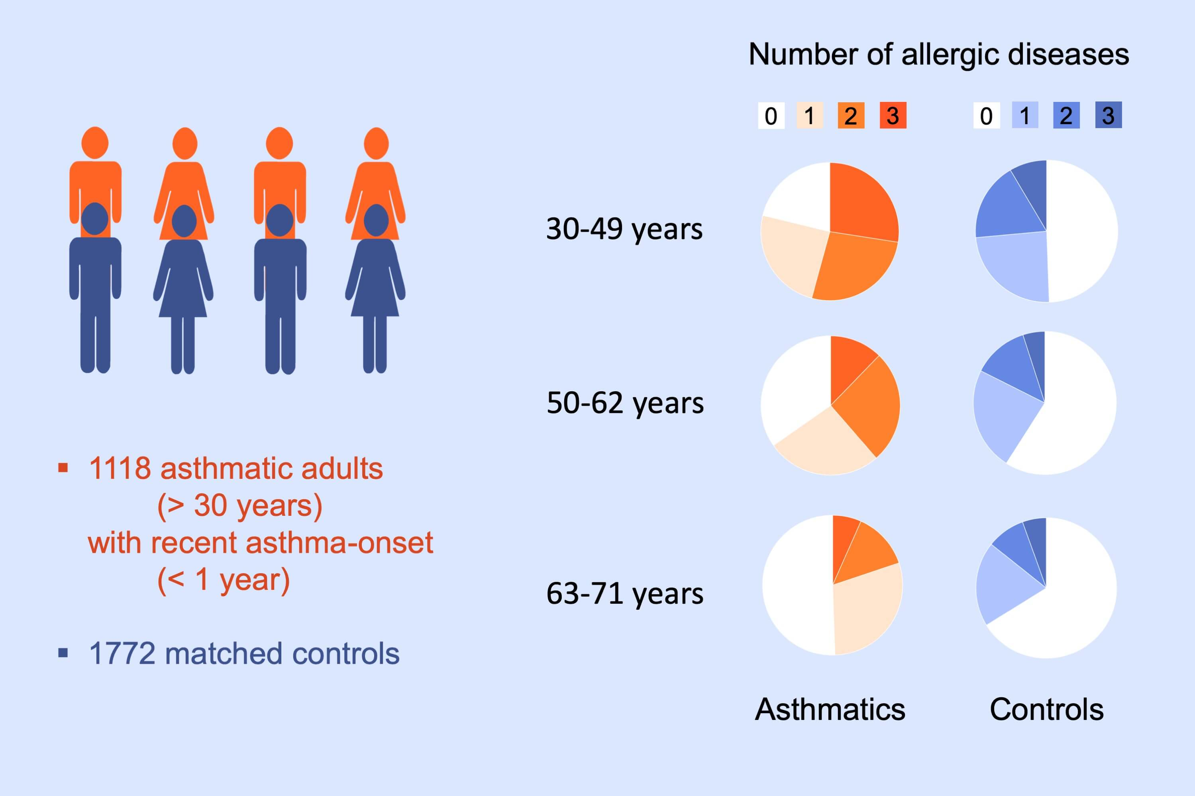
Risk of adult‐onset asthma increases with the number of allergic multimorbidities and decreases with age
Sanna Toppila‐Salmi, Sebastien Chanoine, Jussi Karjalainen, Juha Pekkanen, Jean Bousquet et al.
Allergy. 2019; 2406-2416 https://doi.org/10.1111/all.13971
© 2019 EAACI and John Wiley and Sons A/S. Published by John Wiley and Sons Ltd.
Notes:
HIGHLIGHTS
• A population‐based matched case‐control study of adult‐onset asthma was performed in Finland.
• The odds ratio for asthma increased with the number of allergic diseases, and the association between ≥1 allergic disease and asthma decreased with age.
• Three allergic diseases were reported by 27.5%, 12.3%, and 6.6% asthmatic patients in the age‐groups ≤49, 50‐62, and ≥63 years old, respectively, while in control groups, only 8.5%, 5.0%, and 5.5% subjects reported three allergic diseases.

