Slide 1
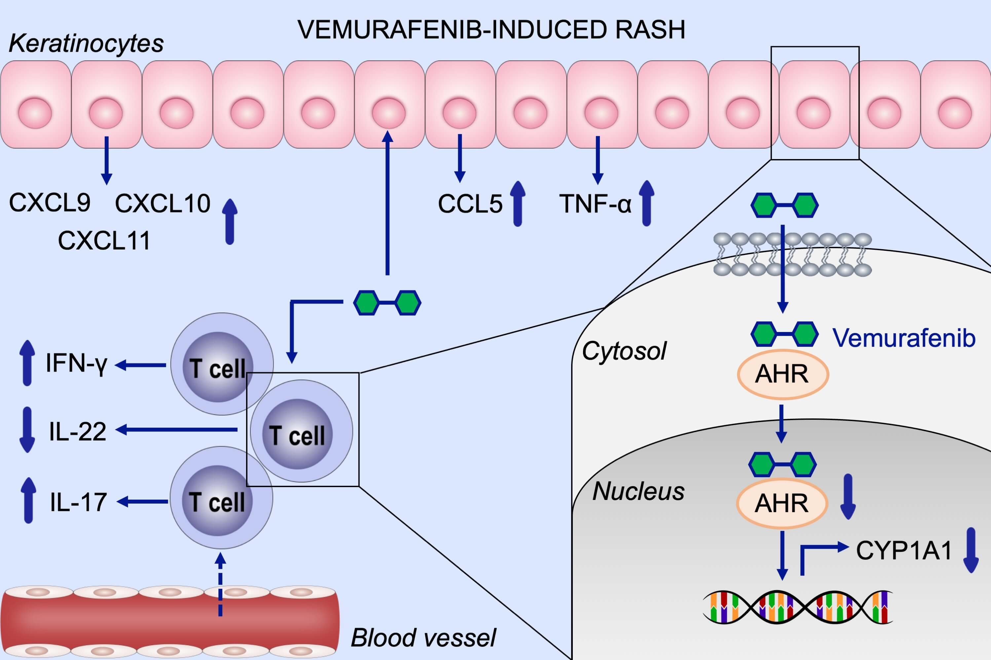
Vemurafenib acts as an aryl hydrocarbon receptor antagonist: Implications for inflammatory cutaneous adverse events
Heike C. Hawerkamp, Andreas Kislat, Peter A. Gerber, Marius Pollet, Katharina M. Rolfes et al.
Allergy. 2019; 2437-2448 https://doi.org/10.1111/all.13972
© 2019 EAACI and John Wiley and Sons A/S. Published by John Wiley and Sons Ltd.
Notes:
HIGHLIGHTS
• Vemurafenib‐induced rashes are characterized by an increased expression of IFNG, TNFA, and chemokines including CCL5, CXCL9, CXCL10, and CXCL11.
• Vemurafenib acts as aryl hydrocarbon receptor (AHR) antagonist by inhibiting AhR translocation to the nucleus and leading to downregulation of cytochrome P450 family 1 subfamily A member 1 (CYP1A1).
• Vemurafenib induces IL‐17 and IFN‐γ expression in T cells, while inhibiting IL‐22 expression.

