Slide 1
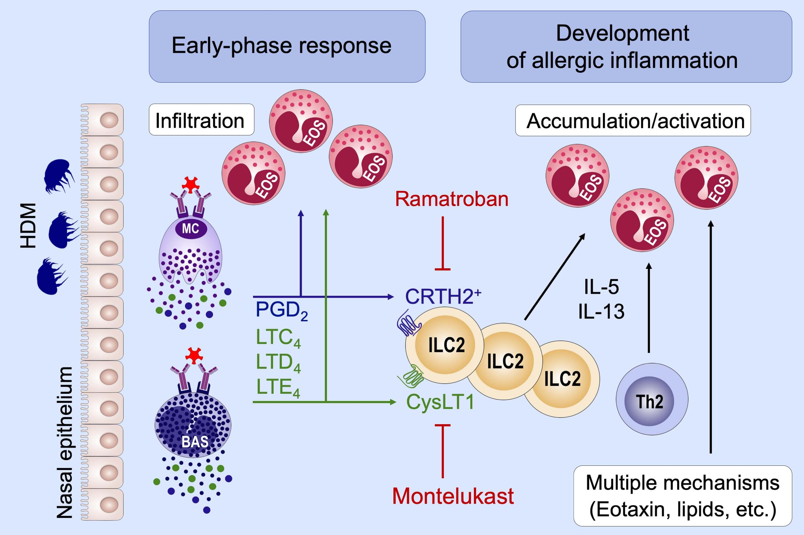
Evidence for the induction of Th2 inflammation by group 2 innate lymphoid cells in response to prostaglandin D2 and cysteinyl leukotrienes in allergic rhinitis
Ichiro Tojima, Koji Matsumoto, Hirotaka Kikuoka, Shiori Hara, Sayuri Yamamoto et al.
Allergy. 2019; 2417-2426 https://doi.org/10.1111/all.13974
© 2019 EAACI and John Wiley and Sons A/S. Published by John Wiley and Sons Ltd.
Notes:
HIGHLIGHTS
• The prevalence of ILC2s was increased in nasal mucosa of allergic rhinitis (AR) patients.
• During early‐phase responses, PGD2 and cysLTs (LTC4, LTD4, LTE4) may stimulate tissue‐resident ILC2s through chemoattractant receptor‐homologous molecule expressed on TH2 cells and
cysteinyl leukotriene receptor 1, leading to the development of allergic inflammation.
• The clinical effectiveness of ramatroban and montelukast in AR may be mediated partly through the inhibition of IL‐5/IL‐13 release from ILC2s.

