Slide 1
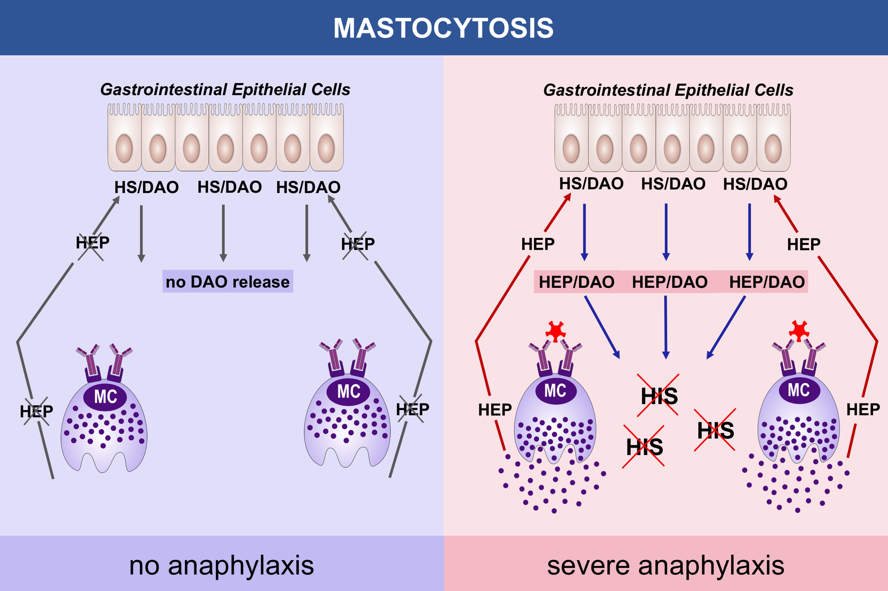
Massive release of the histamine‐degrading enzyme diamine oxidase during severe anaphylaxis in mastocytosis patients
Thomas Boehm, Birgit Reiter, Robin Ristl, Karin Petroczi, Wolfgang Sperr, et al.
Allergy. 2019; 583-593 https://doi.org/10.1111/all.13663
© 2019 EAACI and John Wiley and Sons A/S. Published by John Wiley and Sons Ltd.
Notes:
HIGHLIGHTS
•
•
•
ABBREVIATIONS

