Slide 1
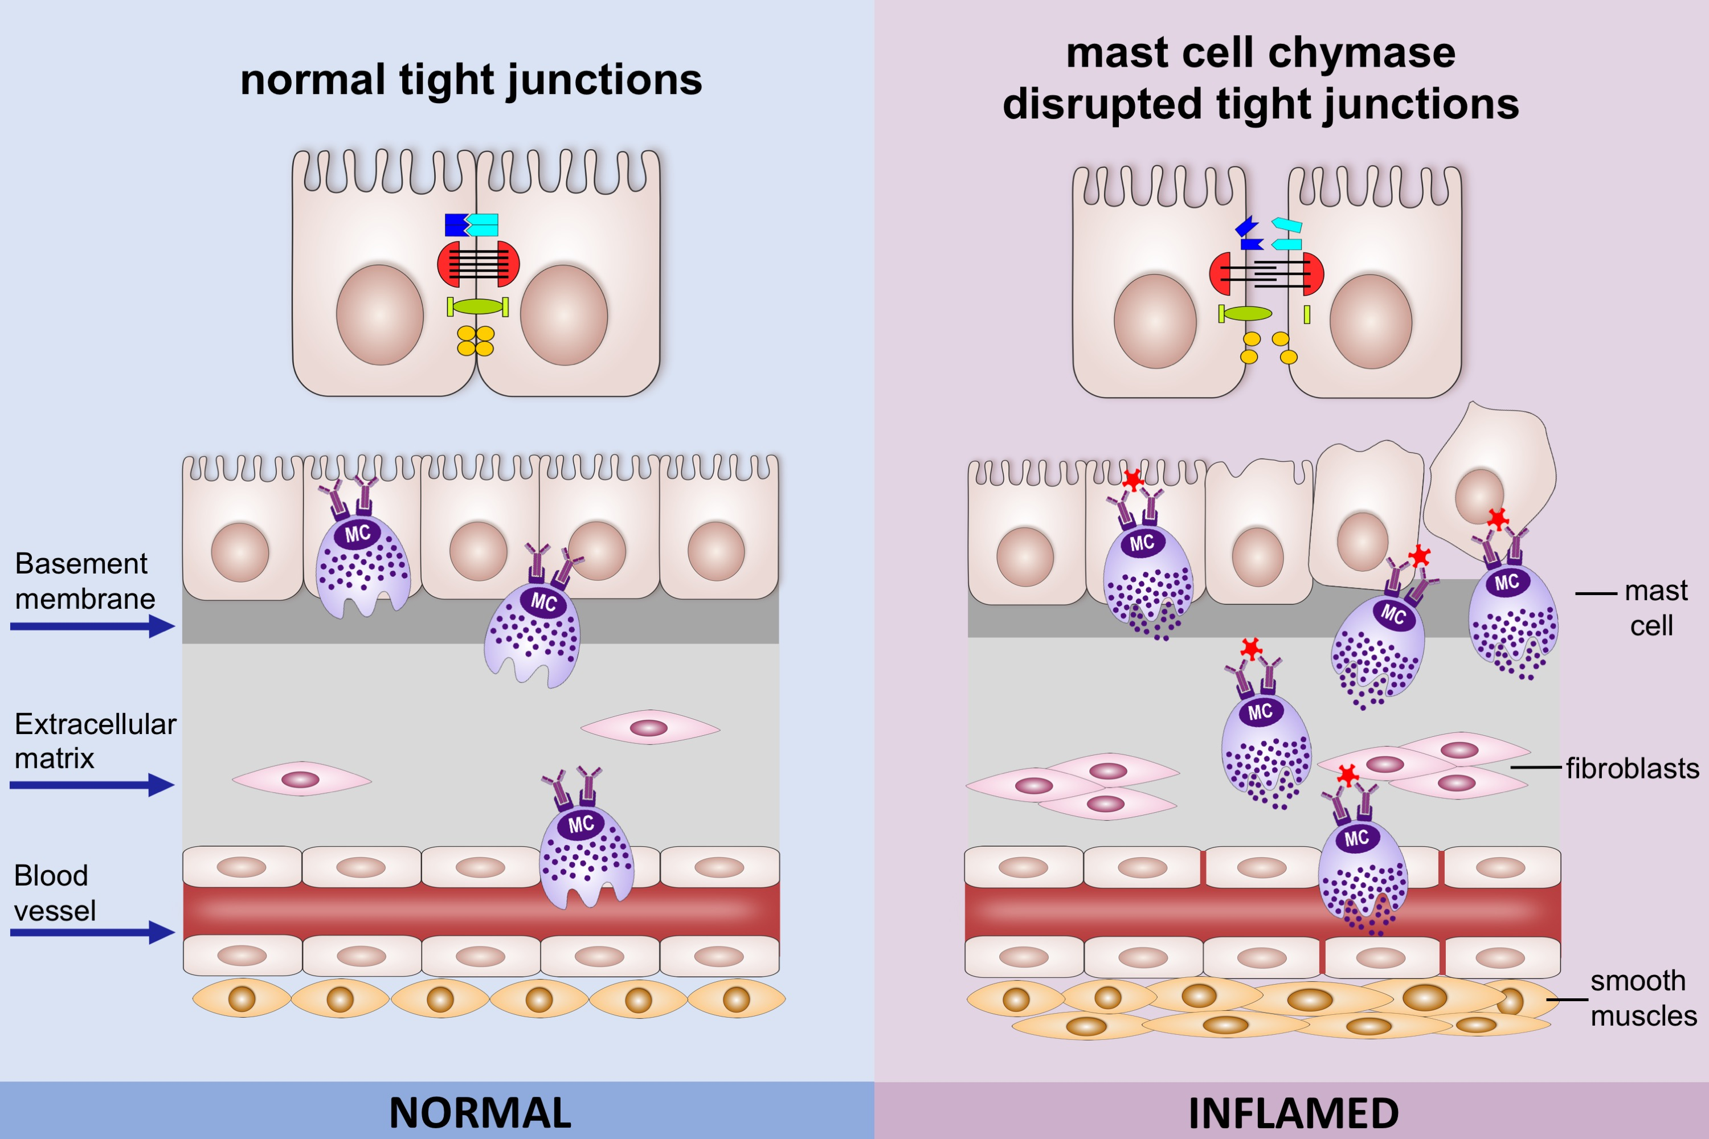
Mast cell chymase impairs bronchial epithelium integrity by degrading cell junction molecules of epithelial cells
Xiaoying Zhou, Tao Wei, Christopher W. Cox, Yuan Jiang, William R. Roche, et al.
Allergy. 2019; 1266-1276 https://doi.org/10.1111/all.13666
© 2019 EAACI and John Wiley and Sons A/S. Published by John Wiley and Sons Ltd.
Notes:
HIGHLIGHTS
•
•
•
ABBREVIATIONS

