Slide 1
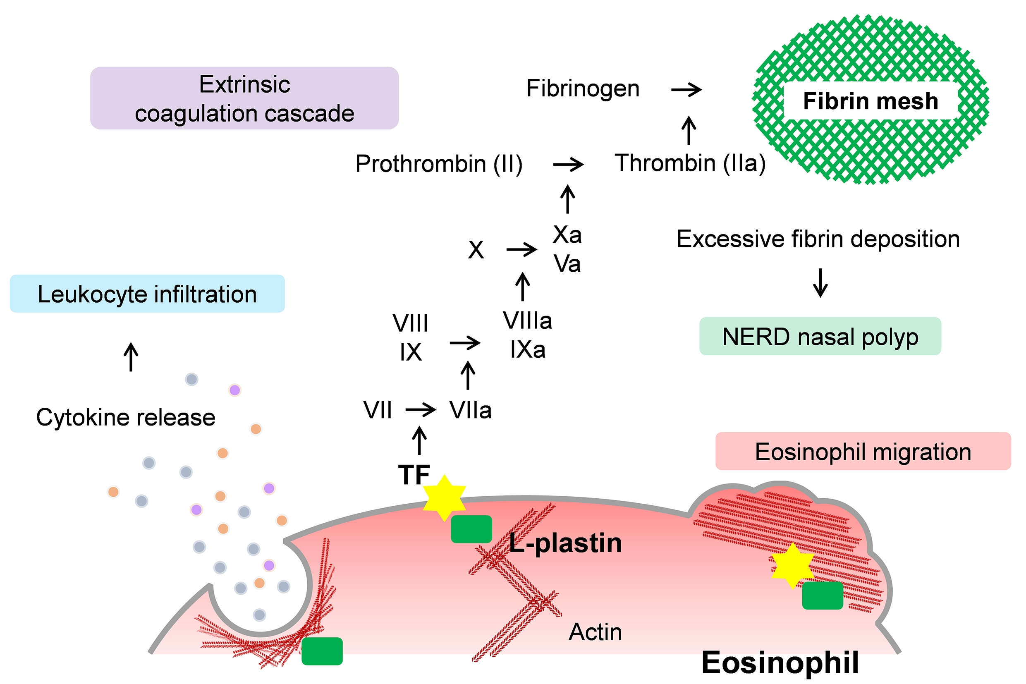
Increased expression of L‐plastin in nasal polyp of patients with nonsteroidal anti‐inflammatory drug‐exacerbated respiratory disease
Tetsuji Takabayashi, Yukie Tanaka, Dai Susuki, Kanako Yoshida, Kaori Tomita, et al.
Allergy. 2019; 1307-1316 https://doi.org/10.1111/all.13677
© 2019 EAACI and John Wiley and Sons A/S. Published by John Wiley and Sons Ltd.
Notes:
HIGHLIGHTS
•
•
•
ABBREVIATIONS

