Slide 1
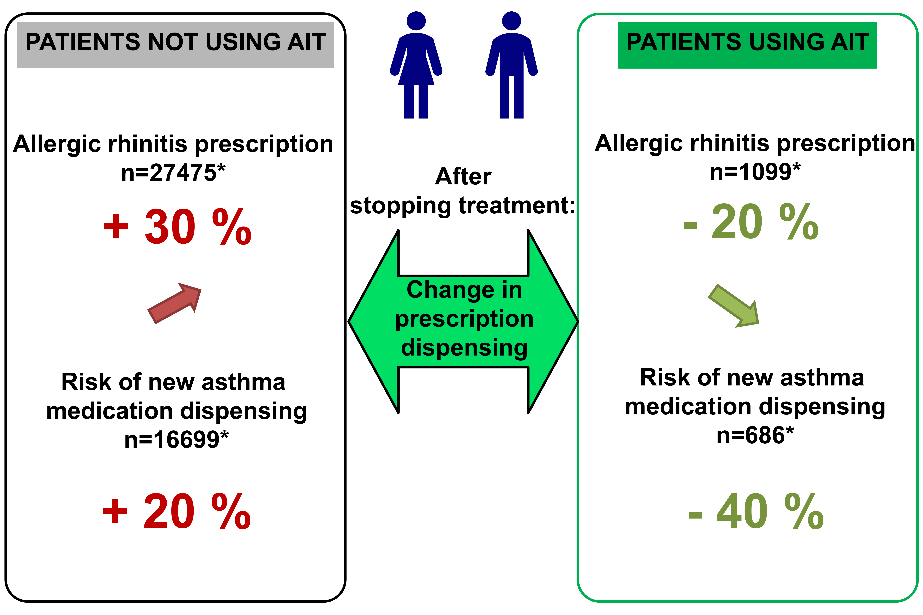
Immunotherapy with grass pollen tablets reduces medication dispensing for allergic rhinitis and asthma: A retrospective database study in France
Philippe Devillier, Mathieu Molimard, Xavier Ansolabehere, Isabelle Bardoulat, Nicolas Coulombel, et al.
Allergy. 2019; 1317-1326 https://doi.org/10.1111/all.13705
© 2019 EAACI and John Wiley and Sons A/S. Published by John Wiley and Sons Ltd.
Notes:
HIGHLIGHTS
•
•
•
ABBREVIATIONS

