Slide 1
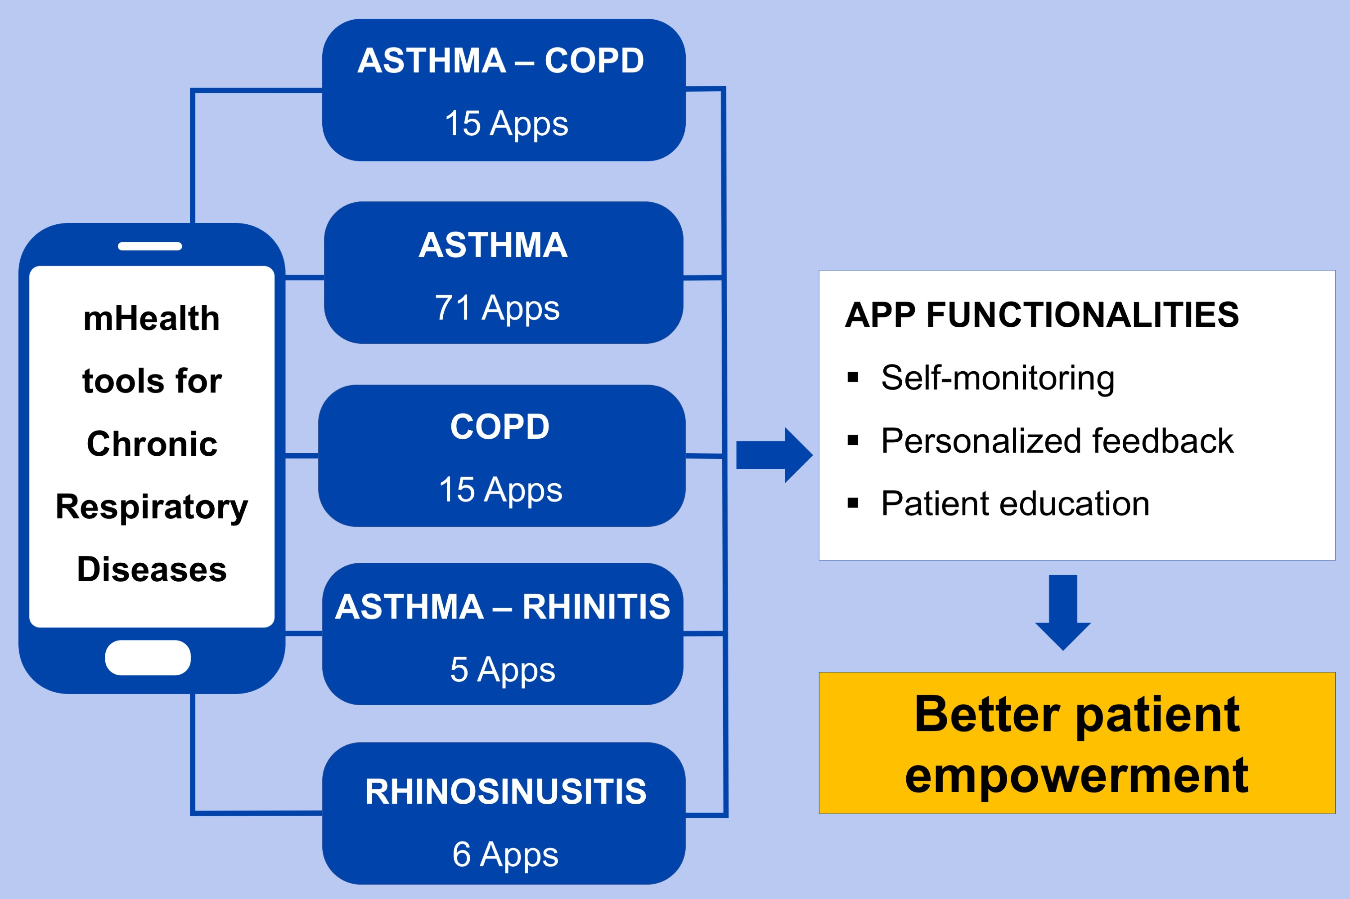
Mobile health tools for the management of chronic respiratory diseases
Kristien Sleurs, Sven F. Seys, Jean Bousquet, Wytske J. Fokkens, Senne Gorris, et al.
Allergy. 2019; 1292-1306 https://doi.org/10.1111/all.13720
© 2019 EAACI and John Wiley and Sons A/S. Published by John Wiley and Sons Ltd.
Notes:
HIGHLIGHTS
•
•
•
ABBREVIATIONS

