Slide 1
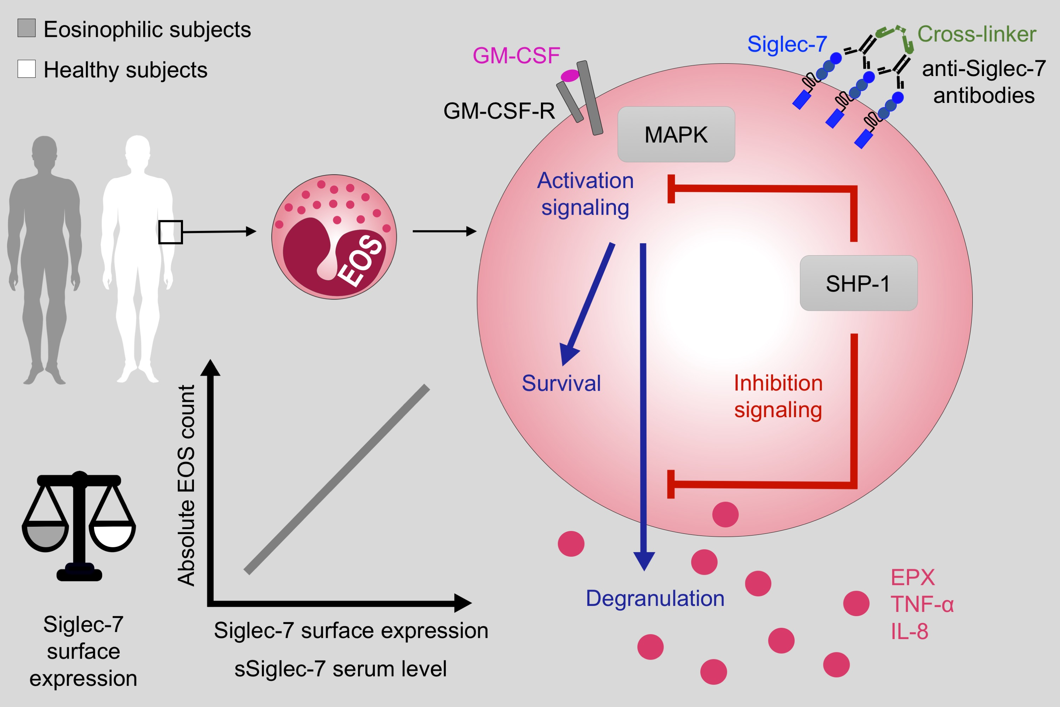
Siglec‐7 on peripheral blood eosinophils: Surface expression and function
Fanny Legrand, Nadine Landolina, Ilan Zaffran, Robert O. Emeh, Elizabeth Chen, et al.
Allergy. 2019; 1257-1265 https://doi.org/10.1111/all.13730
© 2019 EAACI and John Wiley and Sons A/S. Published by John Wiley and Sons Ltd.
Notes:
HIGHLIGHTS
•
•
•
ABBREVIATIONS

