Slide 1
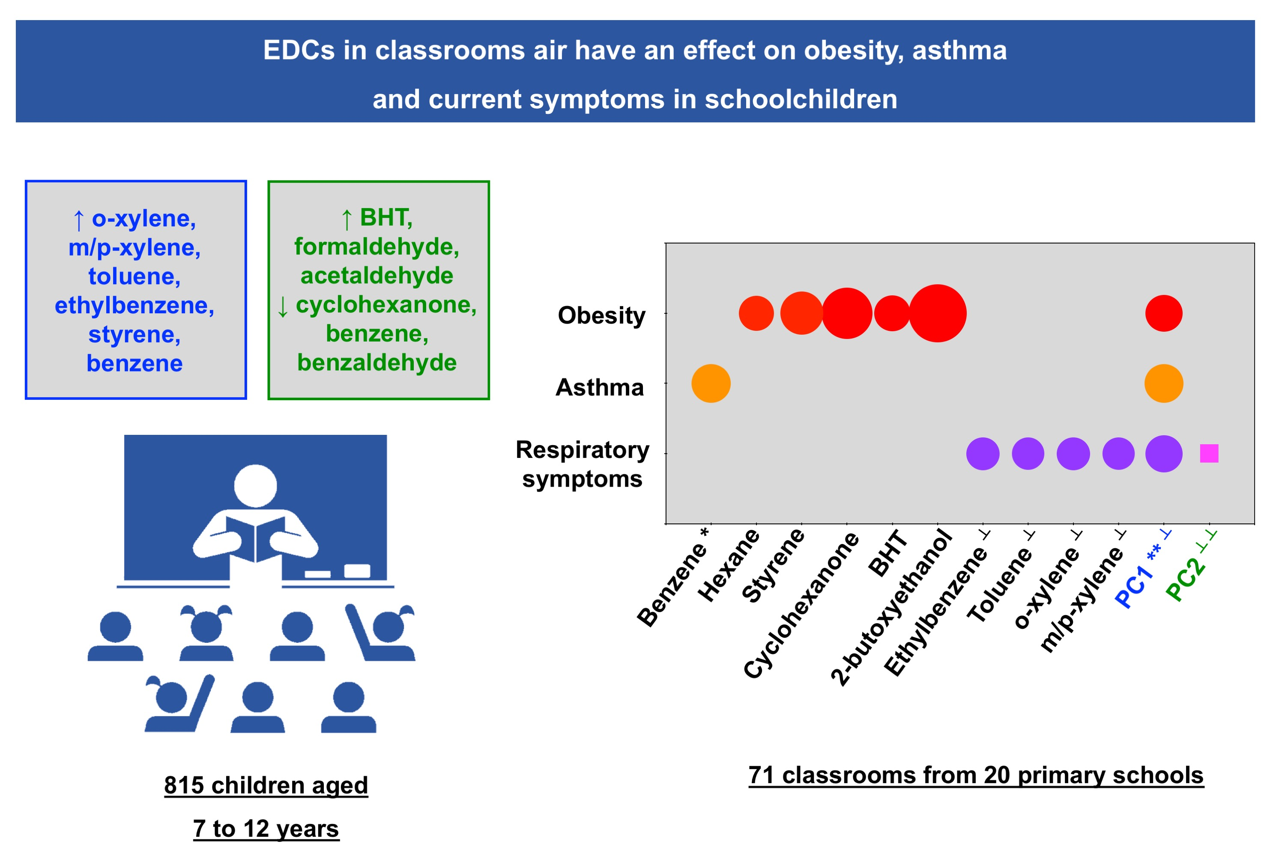
Exposure to indoor endocrine‐disrupting chemicals and childhood asthma and obesity
Inês Paciência, João Cavaleiro Rufo, Diana Silva, Carla Martins, Francisca Mendes, et al.
Allergy. 2019; 1277-1291 https://doi.org/10.1111/all.13740
© 2019 EAACI and John Wiley and Sons A/S. Published by John Wiley and Sons Ltd.
Notes:
HIGHLIGHTS
•
•
•
ABBREVIATIONS

