Slide 1
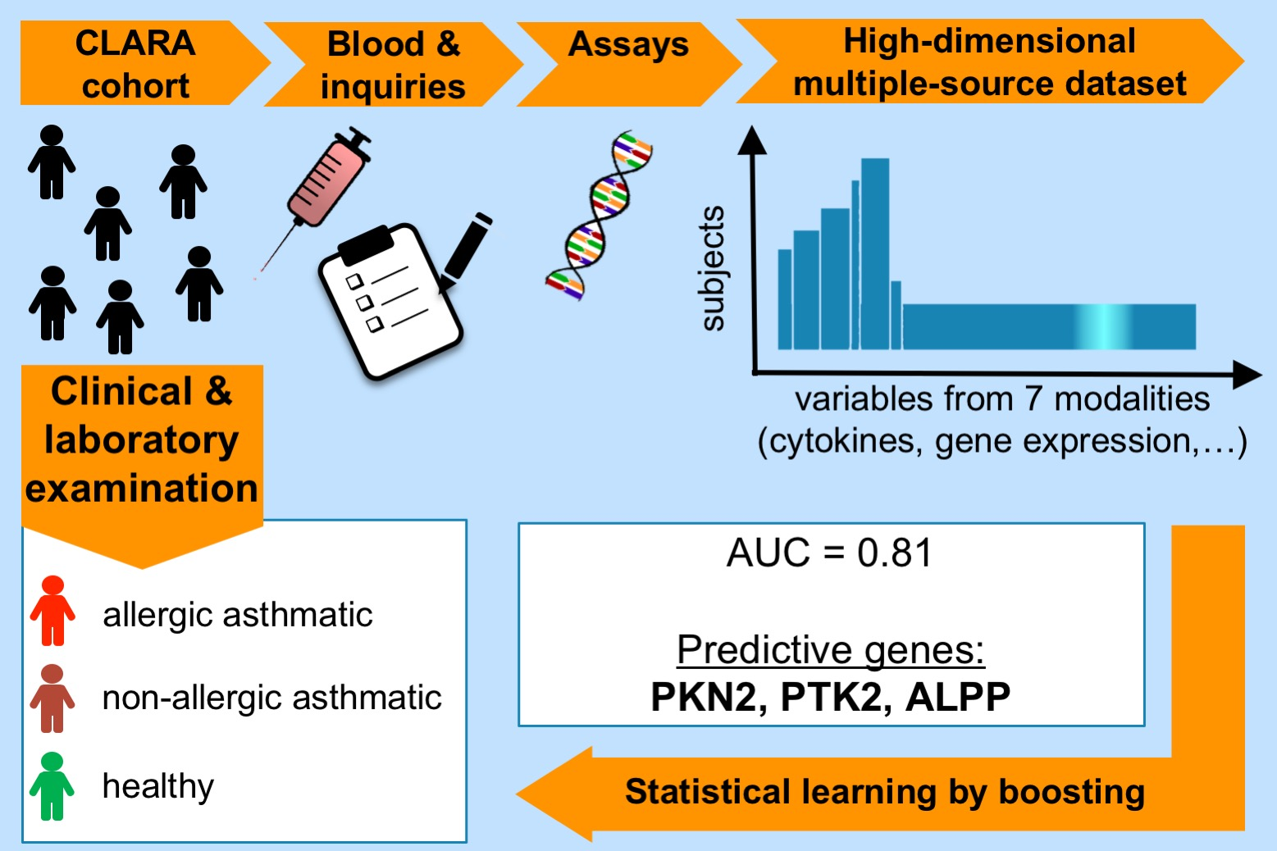
A strategy for high‐dimensional multivariable analysis classifies childhood asthma phenotypes from genetic, immunological, and environmental factors
Norbert Krautenbacher, Nicolai Flach, Andreas Böck, Kristina Laubhahn, Michael Laimighofer, et al.
Allergy. 2019; 1364-1373 https://doi.org/10.1111/all.13745
© 2019 EAACI and John Wiley and Sons A/S. Published by John Wiley and Sons Ltd.
Notes:
HIGHLIGHTS
•
•
•
ABBREVIATIONS

