Slide 1
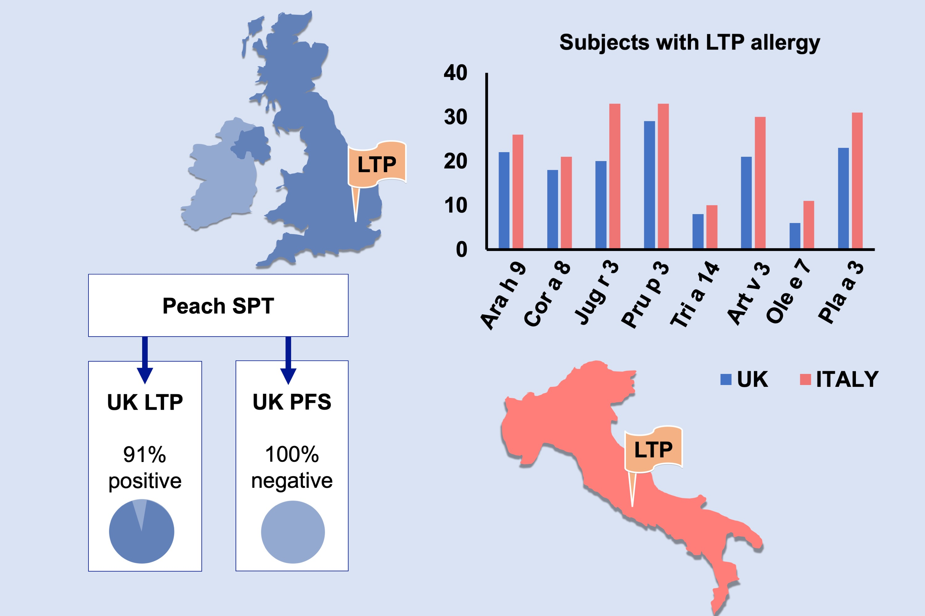
Lipid Transfer Protein allergy in the United Kingdom: Characterization and comparison with a matched Italian cohort
Isabel J. Skypala, Lorenzo Cecchi, Mohamed H. Shamji, Enrico Scala, Stephen Till, et al.
Allergy. 2019; 1340-1351 https://doi.org/10.1111/all.13747
© 2019 EAACI and John Wiley and Sons A/S. Published by John Wiley and Sons Ltd.
Notes:
HIGHLIGHTS
•
•
•
ABBREVIATIONS

