Slide 1
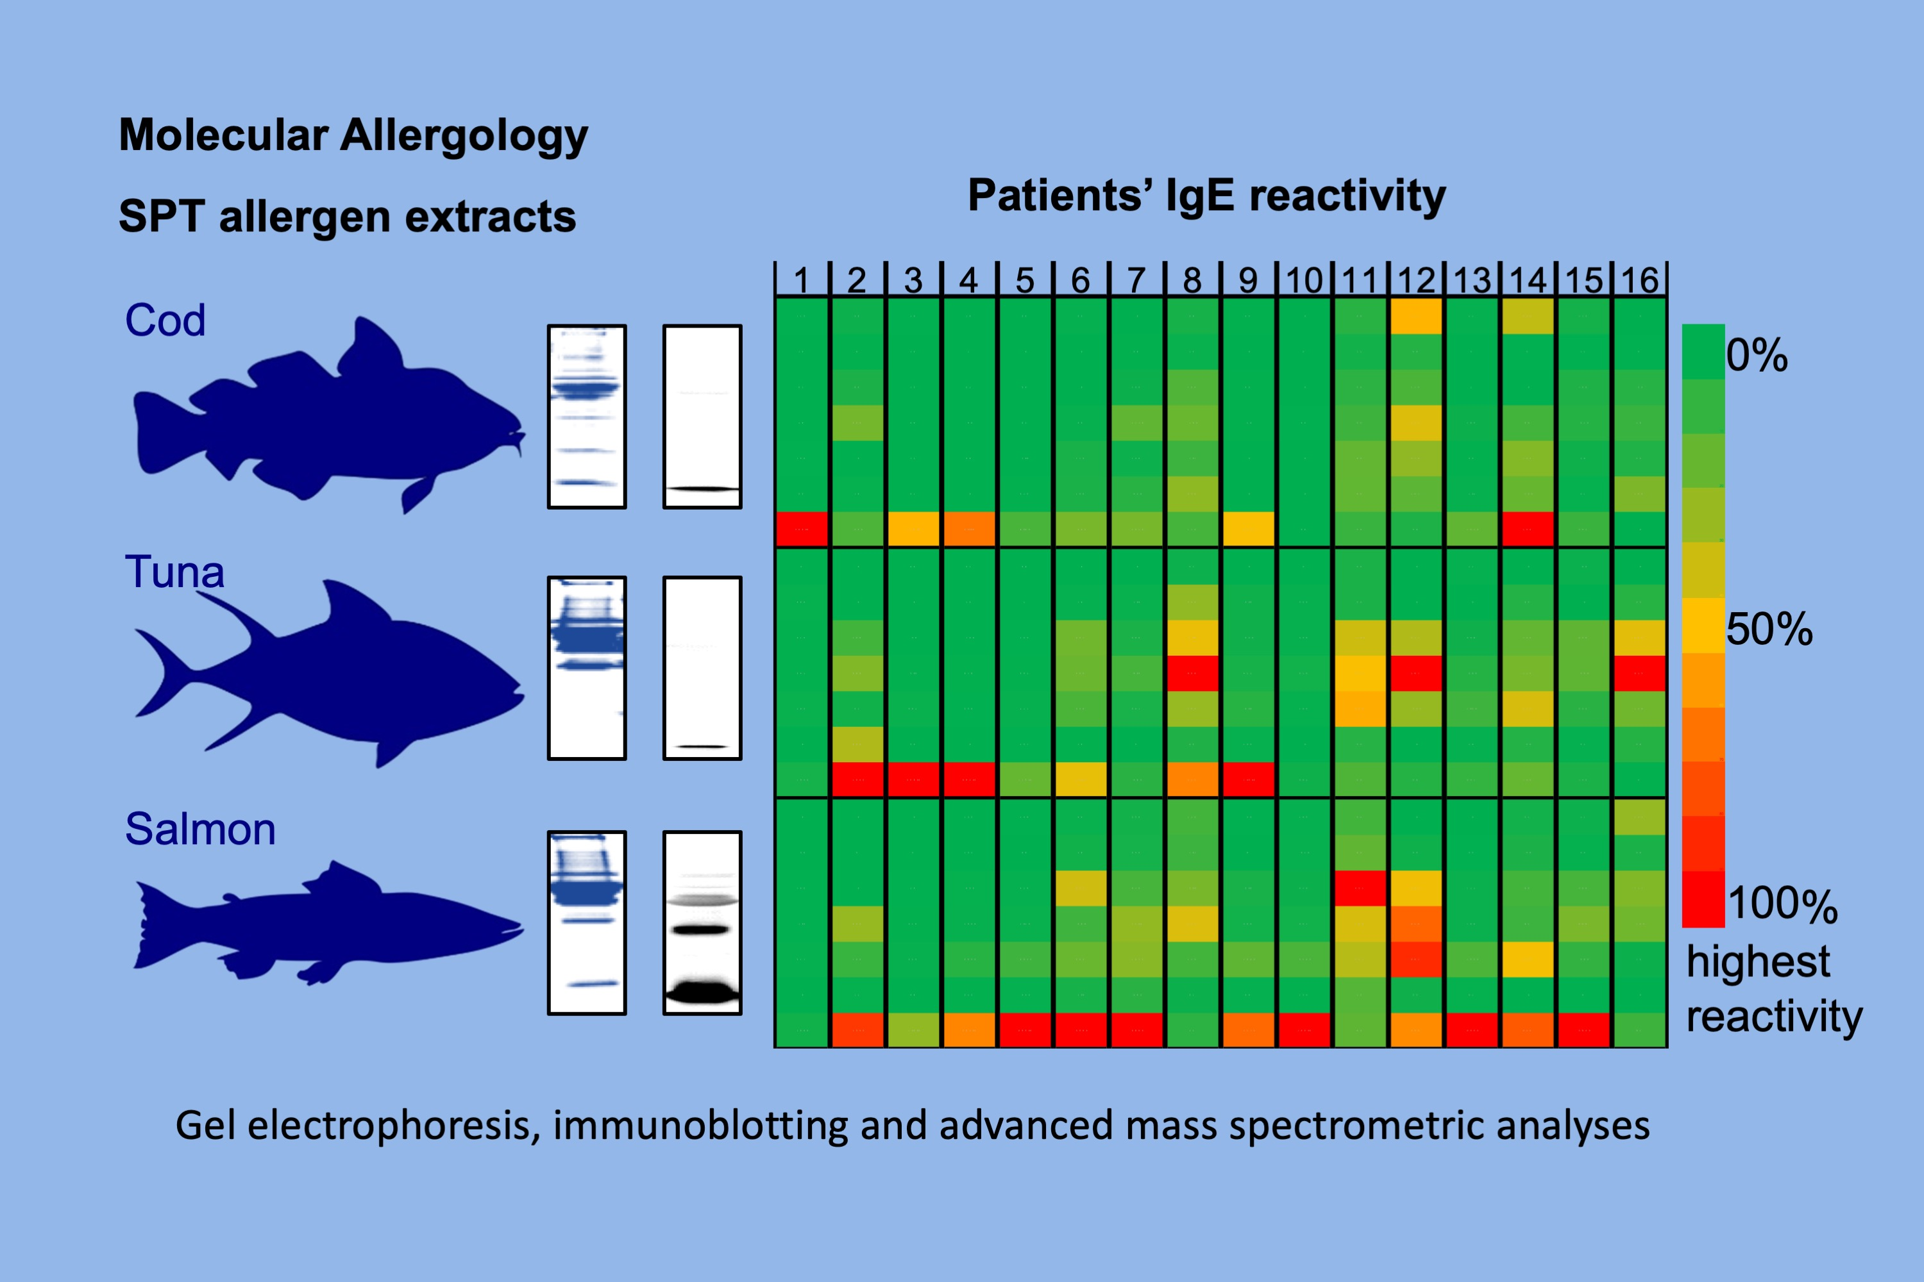
Variability of allergens in commercial fish extracts for skin prick testing
Thimo Ruethers, Aya C. Taki, Roni Nugraha, Trúc T. Cao, Martina Koeberl, et al.
Allergy. 2019; 1352-1363 https://doi.org/10.1111/all.13748
© 2019 EAACI and John Wiley and Sons A/S. Published by John Wiley and Sons Ltd.
Notes:
HIGHLIGHTS
•
•
•
ABBREVIATIONS

