Slide 1
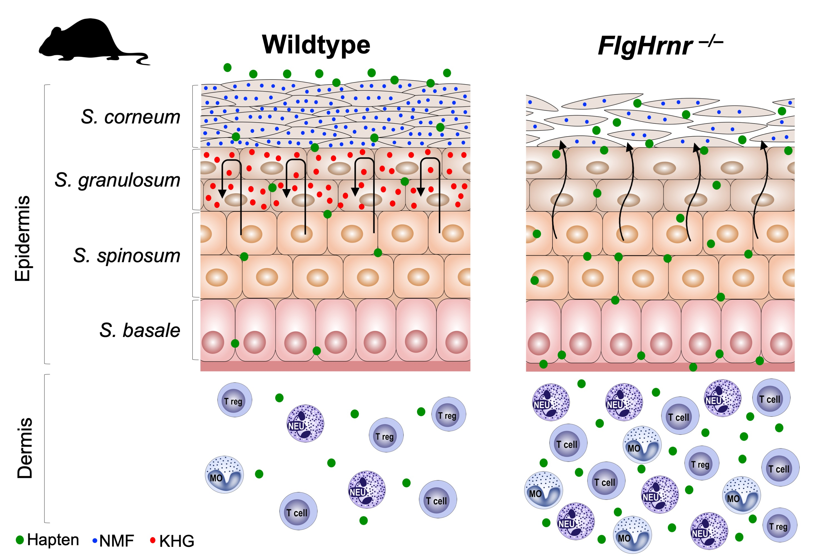
Transient epidermal barrier deficiency and lowered allergic threshold in filaggrin‐hornerin (FlgHrnr−/−) double‐deficient mice
Sebastian Rahrig, Judith M. Dettmann, Birka Brauns, Verena N. Lorenz, Timo Buhl, et al.
Allergy. 2019; 1327-1339 https://doi.org/10.1111/all.13756
© 2019 EAACI and John Wiley and Sons A/S. Published by John Wiley and Sons Ltd.
Notes:
HIGHLIGHTS
•
•
•
ABBREVIATIONS

