Slide 1
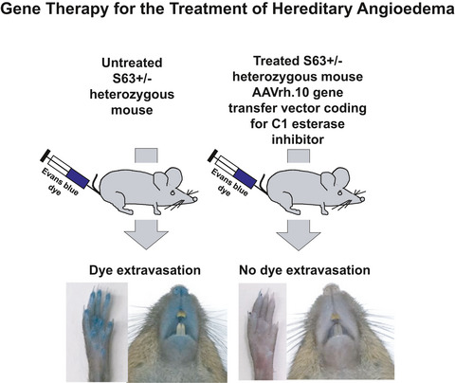
Gene therapy for C1 esterase inhibitor deficiency in a Murine Model of Hereditary angioedema
Ting Qiu, Maria J. Chiuchiolo, Adele S. Whaley, Anthony R. Russo, Dolan Sondhi, et al.
Allergy. 2019; 1081-1089 https://doi.org/10.1111/all.13582
© 2019 EAACI and John Wiley and Sons A/S. Published by John Wiley and Sons Ltd.
Notes:
HIGHLIGHTS
• A novel murine model of hereditary angioedema (HAE) was created using CRSIPR/Cas9 technology, which reproduces the human HAE phenotype at both molecular and phenotypic levels.
• A single administration of a nonhuman primate serotype rh.10 adeno-associated virus coding for C1 esterase inhibitor (AAVrh.10hC1EI) results in sustained human C1EI levels above the predicted therapeutic levels and correction of the vascular leak in the skin, paws, and internal organs of HAE mice.
• If this strategy can be translated to humans, it would represent a paradigm shift for the treatment of patients with clinically significant hereditary angioedema.

