Slide 1
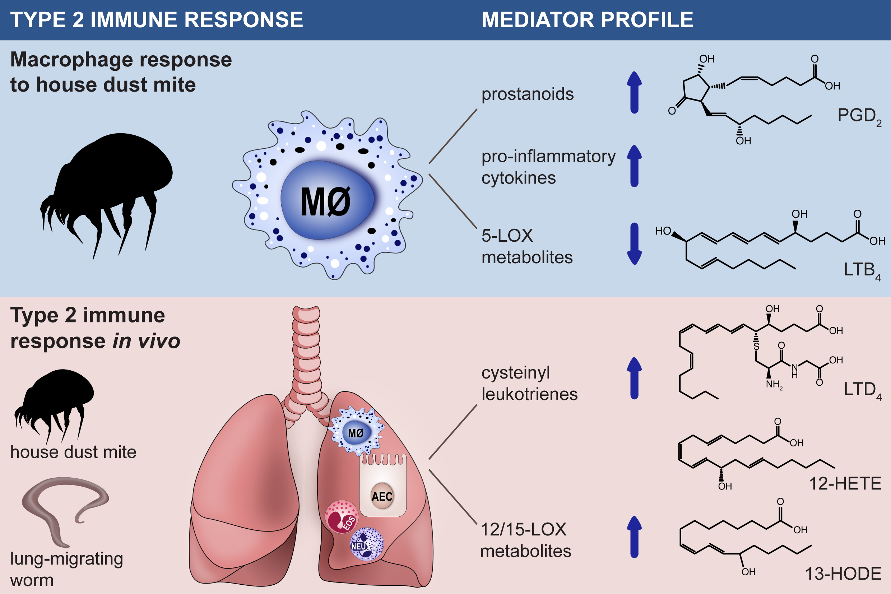
House dust mite drives proinflammatory eicosanoid reprogramming and macrophage effector functions
Fiona D. R. Henkel, Antonie Friedl, Mark Haid, Dominique Thomas, Tiffany Bouchery, et al.
Allergy. 2019; 1090-1101 https://doi.org/10.1111/all.13700
© 2019 EAACI and John Wiley and Sons A/S. Published by John Wiley and Sons Ltd.
Notes:
HIGHLIGHTS
• House dust mite triggers the production of cyclooxygenase metabolites (prostaglandin D2, prostaglandin E2 and thromboxane) as well as of pro-inflammatory cytokines in human macrophages.
• House dust mite-exposed macrophages produce low levels of 5-lipoxygenase metabolites (e.g. leukotriene B4) and suppress neutrophil recruitment.
• High levels of cysteinyl leukotrienes and 12-/15-lipoxygenase metabolites are produced during the type 2 immune response to house dust mite or nematode parasites in the airways.
ABBREVIATIONS
AEC: Airway epithelial cell; COX: Cyclooxygenase; cysLT: Cysteinyl leukotriene; HDM: House dust mite; HETE: Hydroxyeicosatetraenoic acid; HODE: Hydroxyoctadecadienoic acid; LOX: Lipoxygenase

