Slide 1
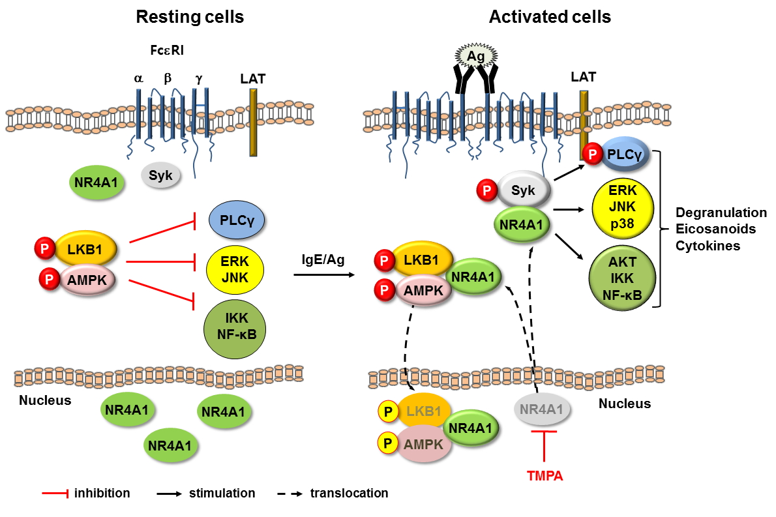
The orphan nuclear receptor NR4A1 promotes FcεRI‐stimulated mast cell activation and anaphylaxis by counteracting the inhibitory LKB1/AMPK axis
Fansi Jin, Xian Li, Yifeng Deng, Maheshwor Timilshina, Bin Huang, et al.
Allergy. 2019; 1145-1156 https://doi.org/10.1111/all.13702
© 2019 EAACI and John Wiley and Sons A/S. Published by John Wiley and Sons Ltd.
Notes:
HIGHLIGHTS
• Nuclear receptor subfamily 4 group A member 1 augments mast cell activation by negatively regulating liver kinase B1/adenosine monophosphate-activated protein kinase and positively regulating spleen tyrosine kinase.
• Ethyl 2-[2,3,4-trimethoxy-6-(1-octanoyl)phenyl]acetate, a high affinity nuclear receptor subfamily 4 group A member 1 antagonist, inhibits mast cell activation.
• Nuclear receptor subfamily 4 group A member 1 is a novel drug target for mast cell-dependent allergic diseases.
ABBREVIATIONS
AMPK: AMP-activated protein kinase; LKB1: liver kinase B1; NR4A1: Nuclear receptor subfamily 4 group A member 1; Syk: spleen tyrosine kinase; TMPA: Ethyl 2-[2,3,4-trimethoxy-6-(1-octanoyl) phenyl]acetate

