Slide 1
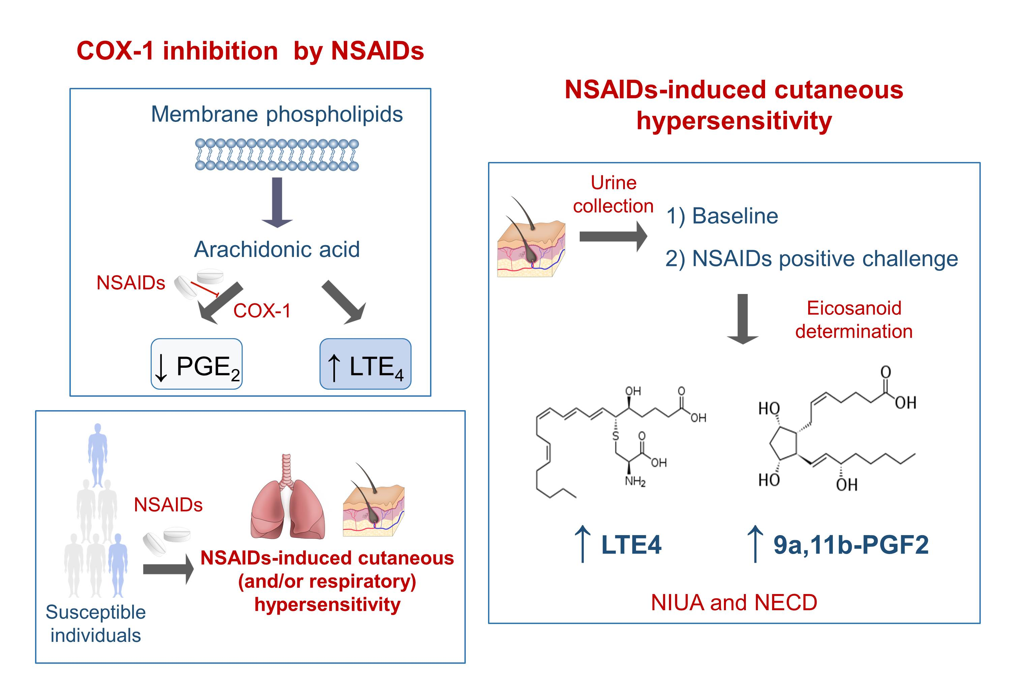
Eicosanoid mediator profiles in different phenotypes of nonsteroidal anti‐inflammatory drug‐induced urticaria
Inmaculada Doña, Raquel Jurado‐Escobar, James R. Perkins, Pedro Ayuso, María Carmen Plaza‐Serón, et al.
Allergy. 2019; 1135-1144 https://doi.org/10.1111/all.13725
© 2019 EAACI and John Wiley and Sons A/S. Published by John Wiley and Sons Ltd.
Notes:
HIGHLIGHTS
• The inhibition of COX-1 by NSAIDs shunts the metabolism of arachidonic acid from PGE2 toward LTE4 synthesis.
• After NSAIDs intake, some individuals develop cutaneous and/or respiratory hypersensitivity reactions.
• Although NIUA and NECD showed distinct urinary eicosanoid excretion profile curves, ASA challenge results in an increase in LTE4 and 9a,11b-PGF2 in both.
ABBREVIATIONS
COX-1: Cyclooxygenase 1; LTE4: Leukotriene E4; NECD: NSAIDs-exacerbated cutaneous disease; NIUA: NSAIDs-induced urticaria/angioedema; NSAIDs: Nonsteroidal anti-inflammatory drugs; PGE2: Prostaglandin E2; 9a,11b-PGF2: 9α,11β-prostaglandin F2

