Slide 1
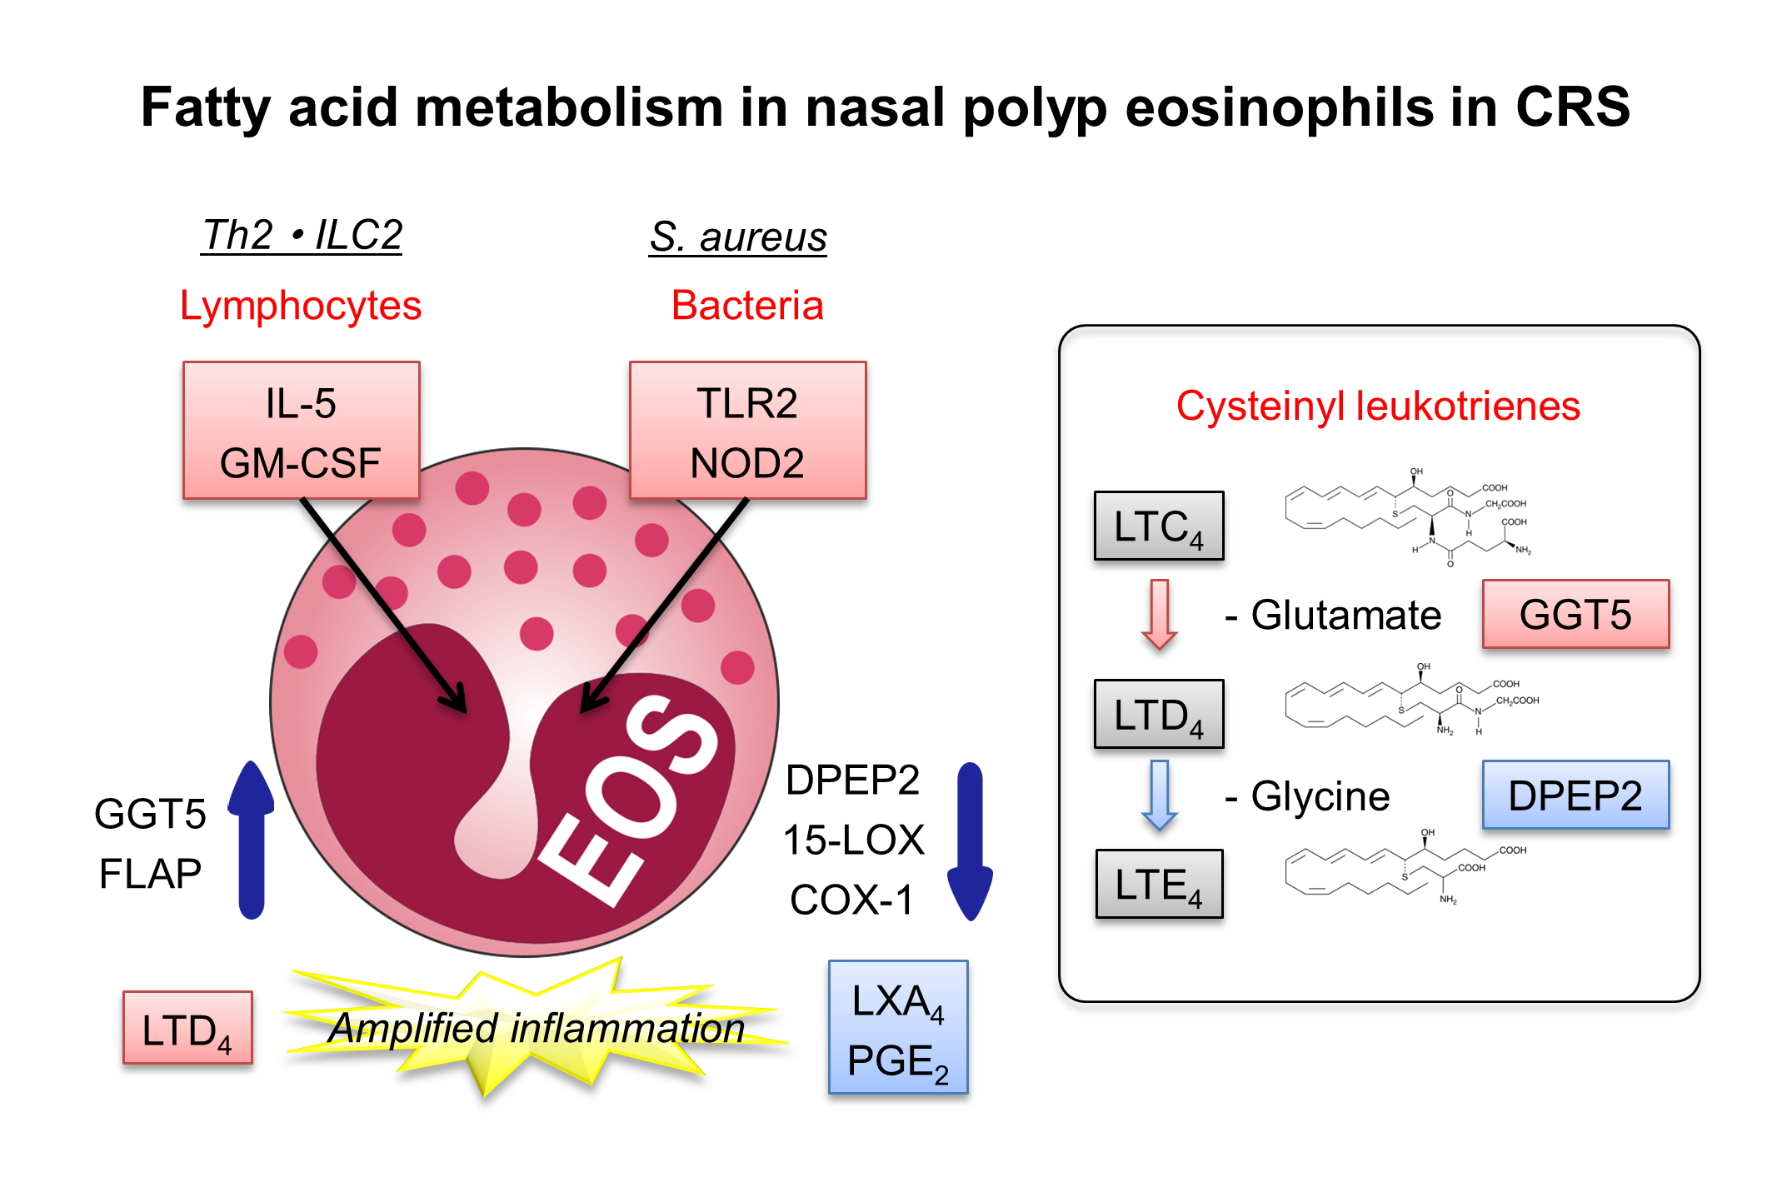
Dysregulated fatty acid metabolism in nasal polyp‐derived eosinophils from patients with chronic rhinosinusitis
Jun Miyata, Koichi Fukunaga, Yusuke Kawashima, Takashi Watanabe, Akina Saitoh, et al.
Allergy. 2019; 1113-1124 https://doi.org/10.1111/all.13726
© 2019 EAACI and John Wiley and Sons A/S. Published by John Wiley and Sons Ltd.
Notes:
HIGHLIGHTS
• Eosinophils isolated from nasal polyps of patients with eosinophilic rhinosinusitis possess dysregulated fatty acid metabolism.
• Of the CysLT (cysteinyl leukotriene) biosynthetic pathway metabolites, LTD 4 production is selectively enhanced with increased expression of GGT5 (gamma-glutamyltransferase-5) and decreased expression of DPEP2 (dipeptidase-2).
• Type 2 cytokines (IL-5 and GM-CSF) and agonists of TLR2 and NOD2 induce similar changes in fatty acid metabolism.
ABBREVIATIONS
COX: Cyclooxygenase; CRS: Chronic rhinosinusitis; DPEP2: Dipeptidase-2; GGT5: Gamma-glutamyl trasferase-5; GM-CSF: Granulocyte-macrophage colony-stimulating factor; ILC2: Type 2
innate lymphoid cells; LTC4: Leukotriene C4; LTD4: Leukotriene D4; LTE4: Leukotriene E4; LXA4: Lipoxin A4; NOD2: Nucleotide binding oligomerization domain containing 2; PGE2: Prostaglandin E2; Th2: Type 2 helper T cells; TLR2: Toll-like receptor 2

