Slide 1
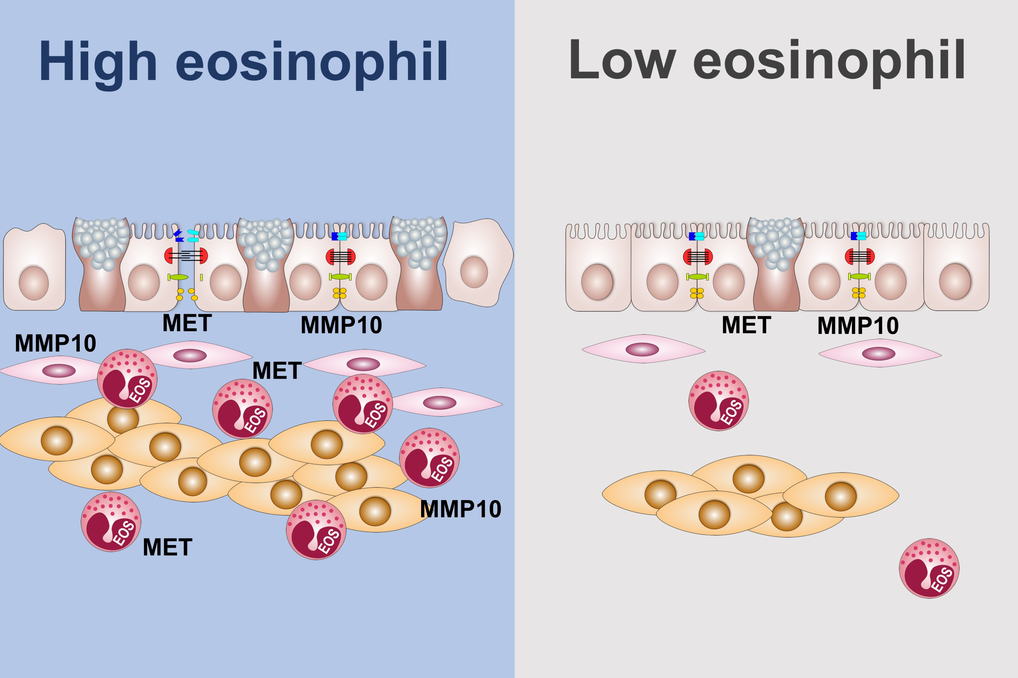
Contribution of airway eosinophils in airway wall remodeling in asthma: Role of MMP‐10 and MET
Chih‐Hsi S. Kuo, Stelios Pavlidis, Jie Zhu, Matthew Loza, Fred Baribaud, et al.
Allergy. 2019; 1102-1112 https://doi.org/10.1111/all.13727
© 2019 EAACI and John Wiley and Sons A/S. Published by John Wiley and Sons Ltd.
Notes:
HIGHLIGHTS
• Analysis of differentially expressed genes in eosinophil-high biopsies of asthma yielded MMP10 and MET as potential drivers of airway wall remodeling.
• Important pathways include extracellular matrix organization, mast cell activation, C-C receptor binding, and regulation of leukocyte activation.
• Bronchial eosinophils are important drivers of airway wall remodeling in asthma.
ABBREVIATIONS
MMP10: Matrix metalloprotease 10 gene; MET: Hepatocyte growth factor receptor gene

