Slide 1
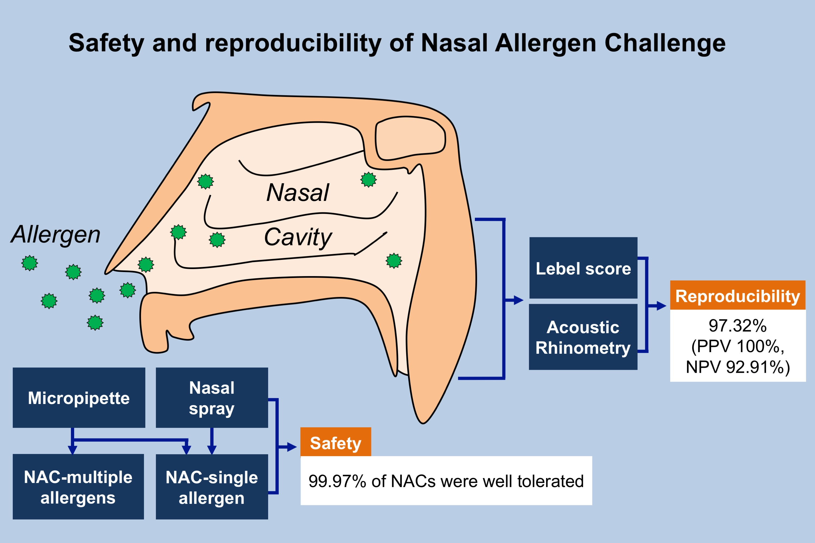
Safety and reproducibility of nasal allergen challenge
Ibon Eguiluz‐Gracia, Almudena Testera‐Montes, Miguel González, Natalia Pérez‐Sánchez, Adriana Ariza, et al.
Allergy. 2019; 1125-1134 https://doi.org/10.1111/all.13728
© 2019 EAACI and John Wiley and Sons A/S. Published by John Wiley and Sons Ltd.
Notes:
HIGHLIGHTS
• This study evaluates 11 499 Nasal Allergen Challenges (NAC) conducted in 6348 adult and pediatric rhinitis patients and in healthy controls.
• The NAC is a very safe technique in children and adults, and it is highly reproducible when monitored by level symptom score and acoustic rhinometry.
• No difference in terms of NAC safety and reproducibility was detected between different allergen application methods or NAC protocols, distinct rhinitis phenotypes, or the presence or absence of asthmatic symptoms.
ABBREVIATIONS
PPV: Positive predictive value; NPV: Negative predictive value

