Slide 1
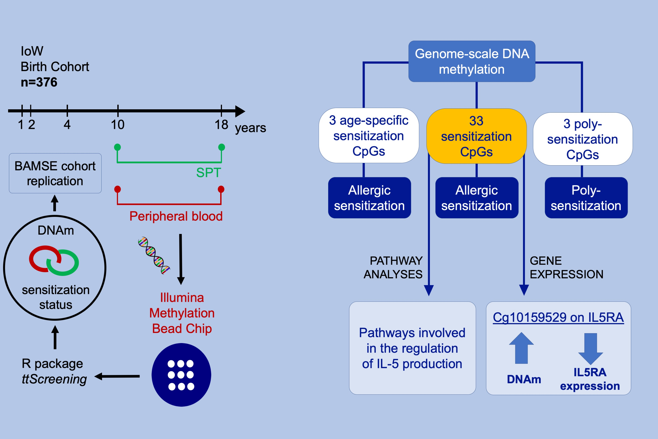
DNA methylation and allergic sensitizations: A genome‐scale longitudinal study during adolescence
Hongmei Zhang, Akhilesh Kaushal, Simon Kebede Merid, Erik Melén, Göran Pershagen, et al.
Allergy. 2019; 1166-1175 https://doi.org/10.1111/all.13746
© 2019 EAACI and John Wiley and Sons A/S. Published by John Wiley and Sons Ltd.
Notes:
HIGHLIGHTS
• DNA methylation (DNAm) at 3 CpGs were associated with poly-sensitization status regardless of gender and age.
• The associations of DNAm at 3 CpGs with overall sensitization status were age specific.
• At 33 CpGs, DNAm was associated with overall sensitization status invariant to gender and age. High DNAm at cg10159529 ( IL5RA ) was associated with low expression of IL5RA.

