Slide 1
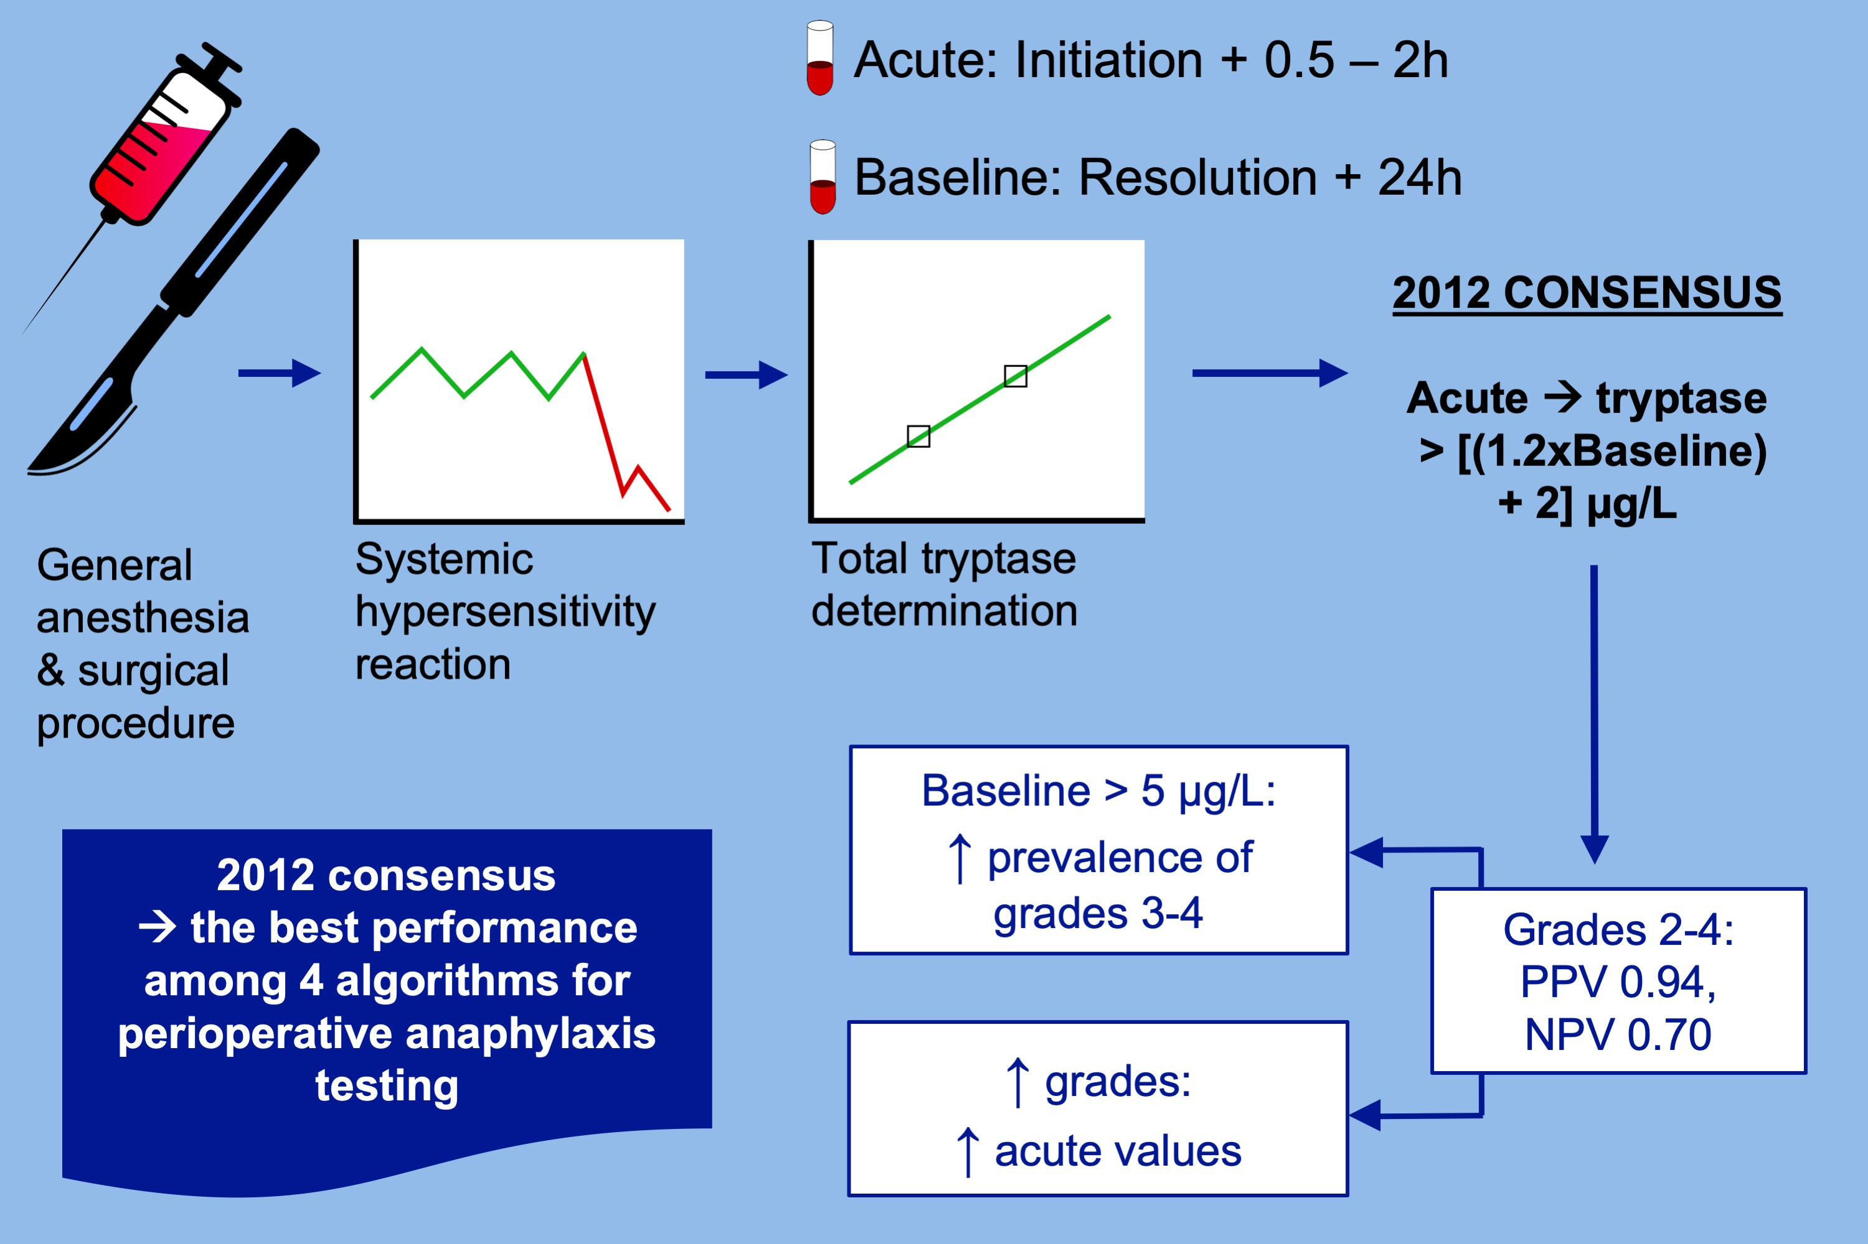
Paired acute‐baseline serum tryptase levels in perioperative anaphylaxis: An observational study
Joana Vitte, Laurent Amadei, Marion Gouitaa, Soraya Mezouar, Laurent Zieleskiewicz, et al.
Allergy. 2019; 1157-1165 https://doi.org/10.1111/all.13752
© 2019 EAACI and John Wiley and Sons A/S. Published by John Wiley and Sons Ltd.
Notes:
HIGHLIGHTS
• The 2012 consensus that acute tryptase should be greater than [(1.2 Å~ baseline tryptase) + 2] μg/L performs best among four algorithms for tryptase interpretation during perioperative anaphylaxis.
• The 2012 consensus that acute tryptase should be greater than [(1.2 Å~ baseline tryptase) + 2] μg/L performs best for reaction grades 2, 3, and 4.
• Higher anaphylaxis grades are associated with higher levels of acute tryptase and more prevalent if baseline tryptase levels are above 5 μg/L.
ABBREVIATIONS
PPV: Positive predictive value; NPV: Negative predictive value

