Slide 1
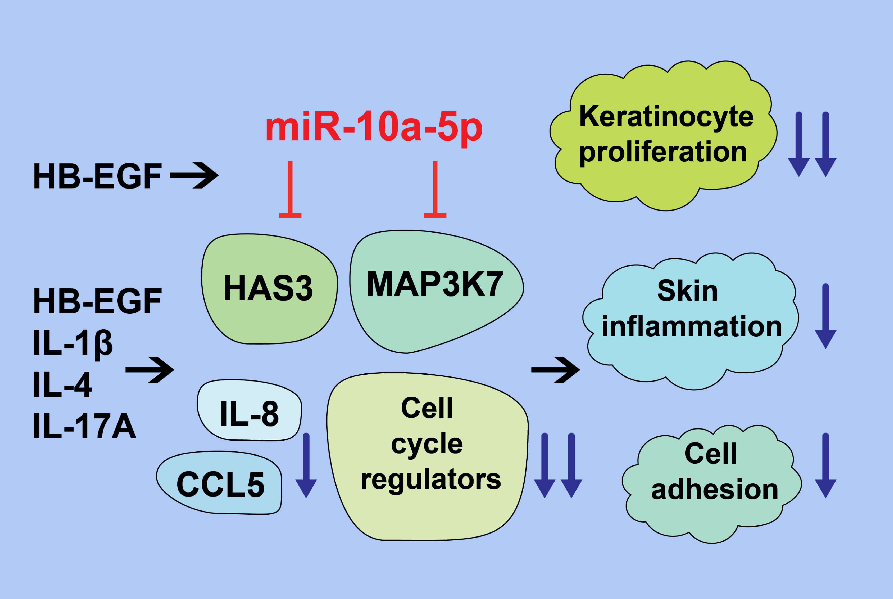
miR‐10a‐5p is increased in atopic dermatitis and has capacity to inhibit keratinocyte proliferation
Helen Vaher, Toomas Runnel, Egon Urgard, Alar Aab, Gemma Carreras Badosa, et al.
Allergy. 2019; 2146-2156 https://doi.org/10.1111/all.13849
© 2019 EAACI and John Wiley and Sons A/S. Published by John Wiley and Sons Ltd.
Notes:
HIGHLIGHTS
• The expression of miR‐10a‐5p is increased in the skin of patients with atopic dermatitis, in proliferating keratinocytes, and in response to growth factor heparin‐binding EGF‐like growth factor.
• miR‐10a‐5p has capacity to inhibit keratinocytes proliferation, the expression of mitogen‐activated kinase 3 kinase 7 and hyaluronan synthase 3, pro‐inflammatory chemokines IL‐8 and CCL5, and numerous genes affecting cell cycle progression.
• miR‐10a‐5p inhibits proliferation and to lesser extent the inflammation and cell adhesion of keratinocytes and thereby may affect the development and severity of atopic dermatitis.

