Slide 1
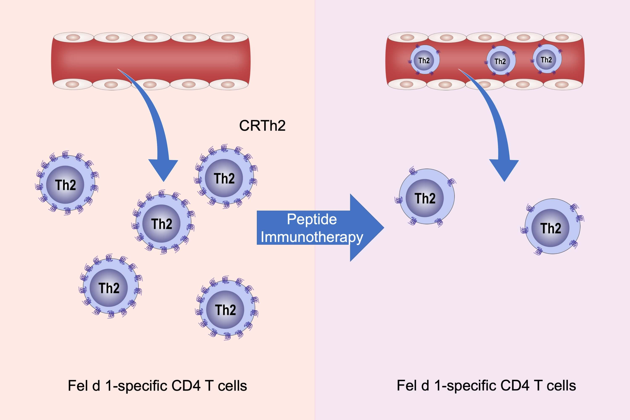
Modulation of CRTh2 expression on allergen‐specific T cells following peptide immunotherapy
Christopher D. Rudulier, Elena Tonti, Eddie James, William W. Kwok, Mark Larché, et al.
Allergy. 2019; 2157-2166 https://doi.org/10.1111/all.13867
© 2019 EAACI and John Wiley and Sons A/S. Published by John Wiley and Sons Ltd.
Notes:
HIGHLIGHTS
• Peptide immunotherapy with Cat‐PAD reduces the surface expression of chemoattractant receptor‐homologous molecule expressed on Th2 cells (CRTh2) on Fel d 1‐specific T cells.
• Neither the frequency, nor memory phenotype of Fel d 1‐specific T cells in the blood was affected by peptide immunotherapy for cat allergy.
• Reduced expression of CRTh2 may modulate recruitment to sites of allergen exposure.

