Slide 1
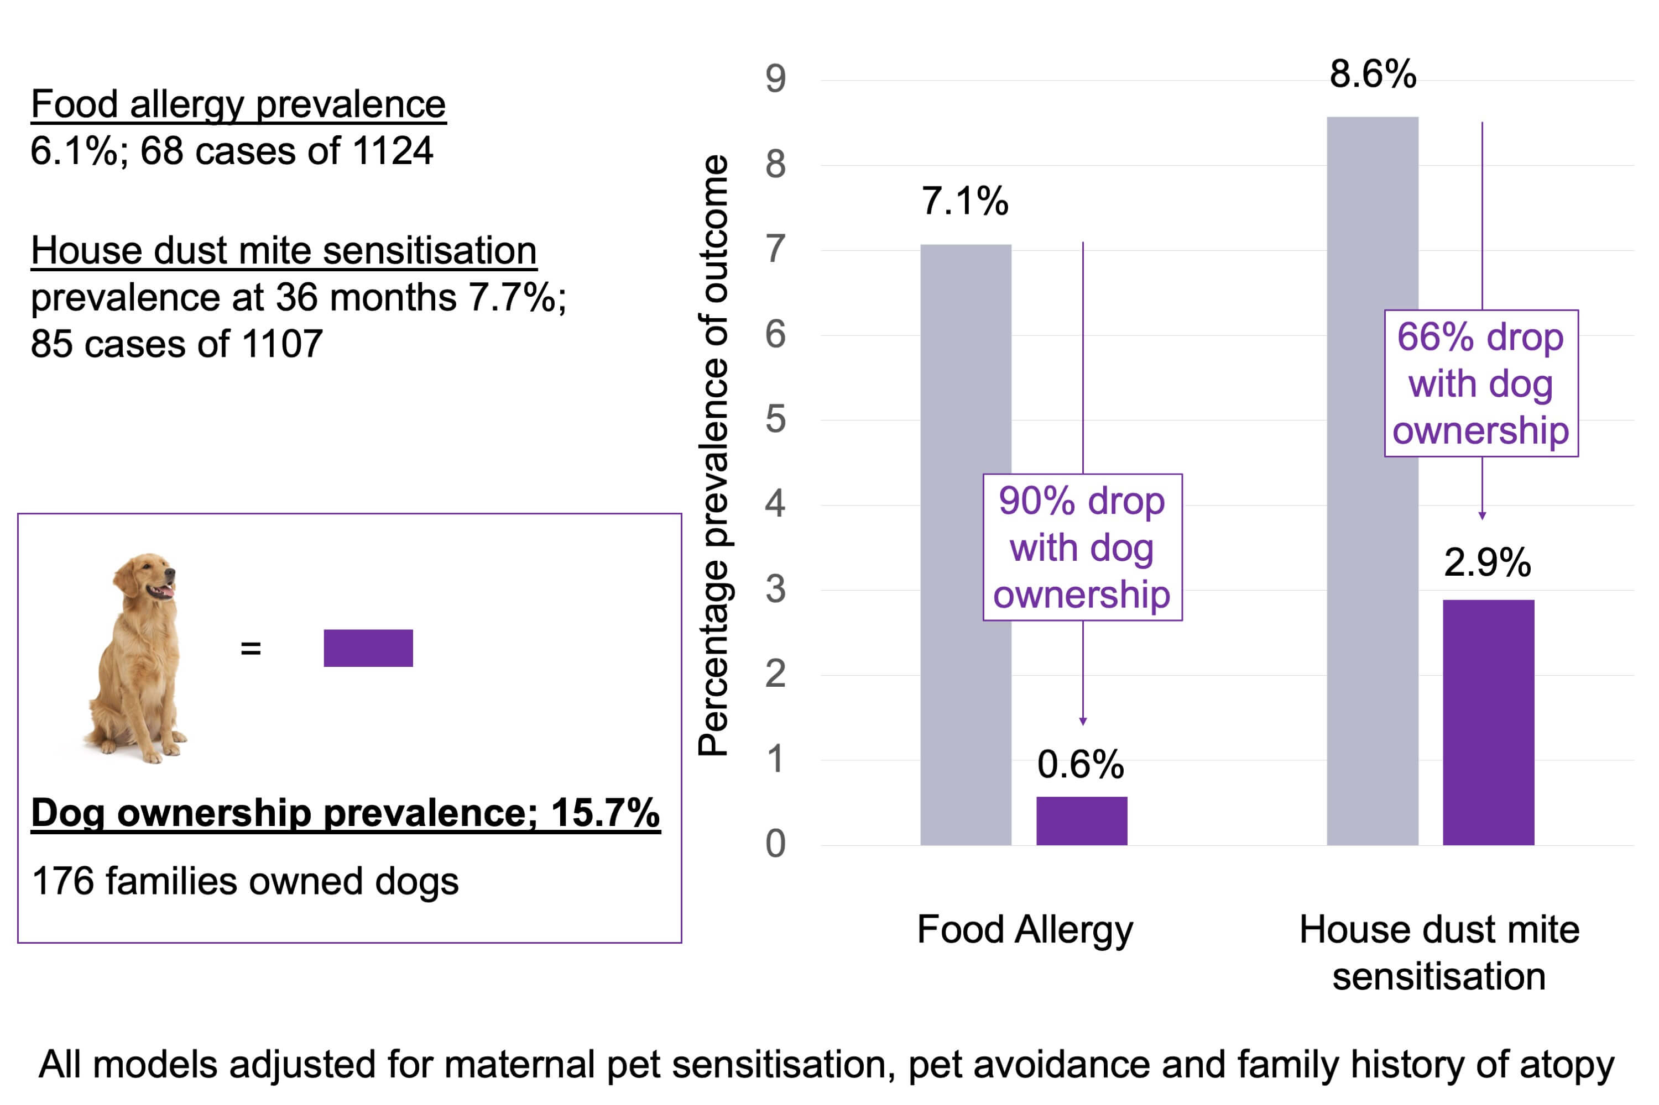
Dog ownership at three months of age is associated with protection against food allergy
Tom Marrs, Kirsty Logan, Joanna Craven, Suzana Radulovic, W.H.A. Irwin McLean, et al.
Allergy. 2019; 2212-2219 https://doi.org/10.1111/all.13868
© 2019 EAACI and John Wiley and Sons A/S. Published by John Wiley and Sons Ltd.
Notes:
HIGHLIGHTS
• Dog ownership was associated with a significant reduction in the development of food allergy amongst a prospective birth cohort.
• Physiological plausibility was enhanced by finding dose‐response effects and inverse associations with food and house dust mite sensitization.
• The inverse relationship with food sensitization was appearing by three months, suggesting that immune modulation may commence from birth or prenatally

