Slide 1
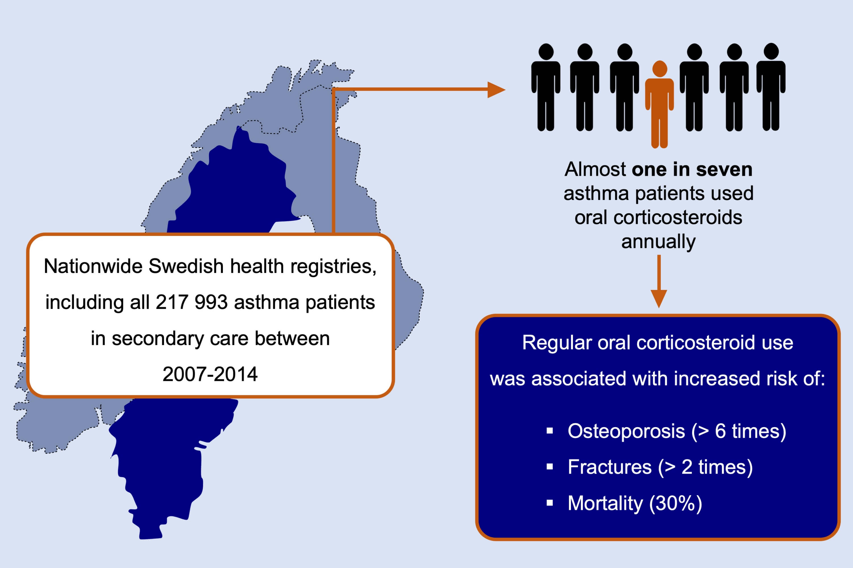
Oral corticosteroid use, morbidity and mortality in asthma: A nationwide prospective cohort study in Sweden
Magnus Ekström, Bright I. Nwaru, Pål Hasvold, Fredrik Wiklund, Gunilla Telg, et al.
Allergy. 2019; 2181-2190 https://doi.org/10.1111/all.13874
© 2019 EAACI and John Wiley and Sons A/S. Published by John Wiley and Sons Ltd.
Notes:
HIGHLIGHTS
• Annually, almost one in seven asthma patients used oral corticosteroids, which was stable over the 10‐year study period.
• Oral corticosteroids are still a substantial part of current asthma management for many patients and are associated with severe side effects and mortality risk.
• There is a need for other treatments for severe asthma patients who are using regular oral corticosteroids.

