Slide 1
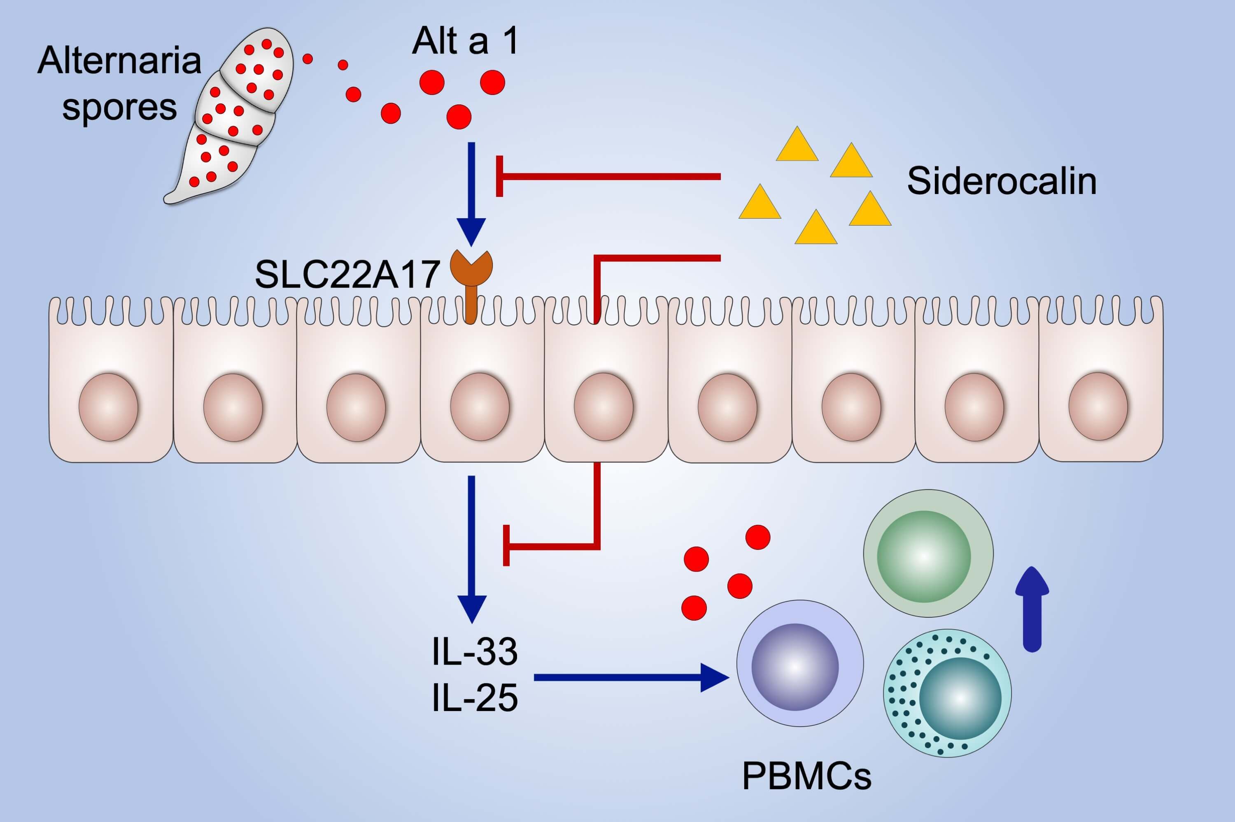
Interaction of Alt a 1 with SLC22A17 in the airway mucosa
María Garrido‐Arandia, Jaime Tome‐Amat, Diego Pazos‐Castro, Vanesa Esteban, Maria M. Escribese, et al.
Allergy. 2019; 2167-2180 https://doi.org/10.1111/all.13877
© 2019 EAACI and John Wiley and Sons A/S. Published by John Wiley and Sons Ltd.
Notes:
HIGHLIGHTS
• Alt a 1 is released from Alternaria alternata spores in complex with its native ligand, being recognized by the Solute carrier family 22 member 17 receptor.
• Production of cytokines IL25 and IL33 occurs only in the presence of the ligand, being abolished with specific antibodies against Solute carrier family 22 member 17.
• Alt a 1 shows structural relationship with human siderocalin mimicking its airway entry route.

