Slide 1
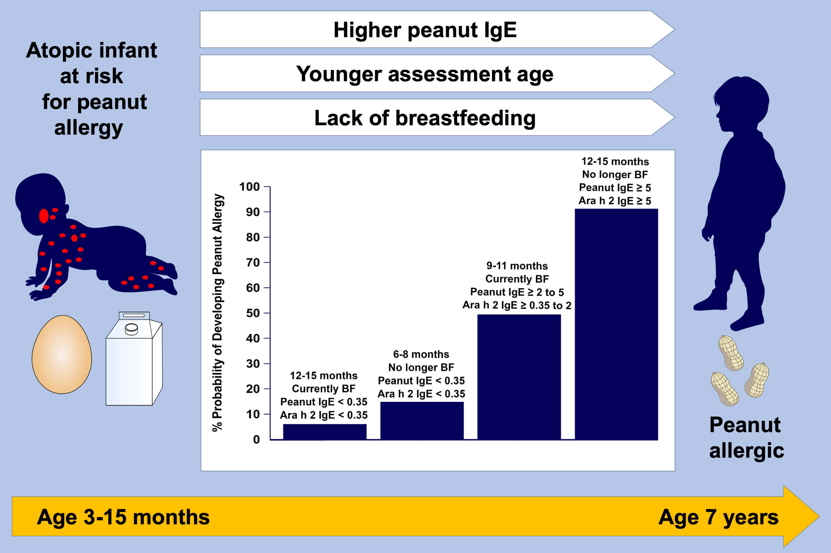
Clinical factors associated with peanut allergy in a high‐risk infant cohort
Scott H. Sicherer, Robert A. Wood, Tamara T. Perry, Stacie M. Jones, Donald Y. M. Leung, et al.
Allergy. 2019; 2199-2211 https://doi.org/10.1111/all.13920
© 2019 EAACI and John Wiley and Sons A/S. Published by John Wiley and Sons Ltd.
Notes:
HIGHLIGHTS
• In high‐risk infants (eg moderate‐to‐severe eczema and egg/milk sensitization or likely egg/milk allergy), parameters associated with the development of peanut allergy were identified.
• Multivariate models identified younger age at initial assessment, higher peanut IgE and Ara h2 IgE levels and lack of breastfeeding (BF) as significant associated factors.
• Models were constructed to predict risk of peanut allergy based on these variables.

