Slide 1
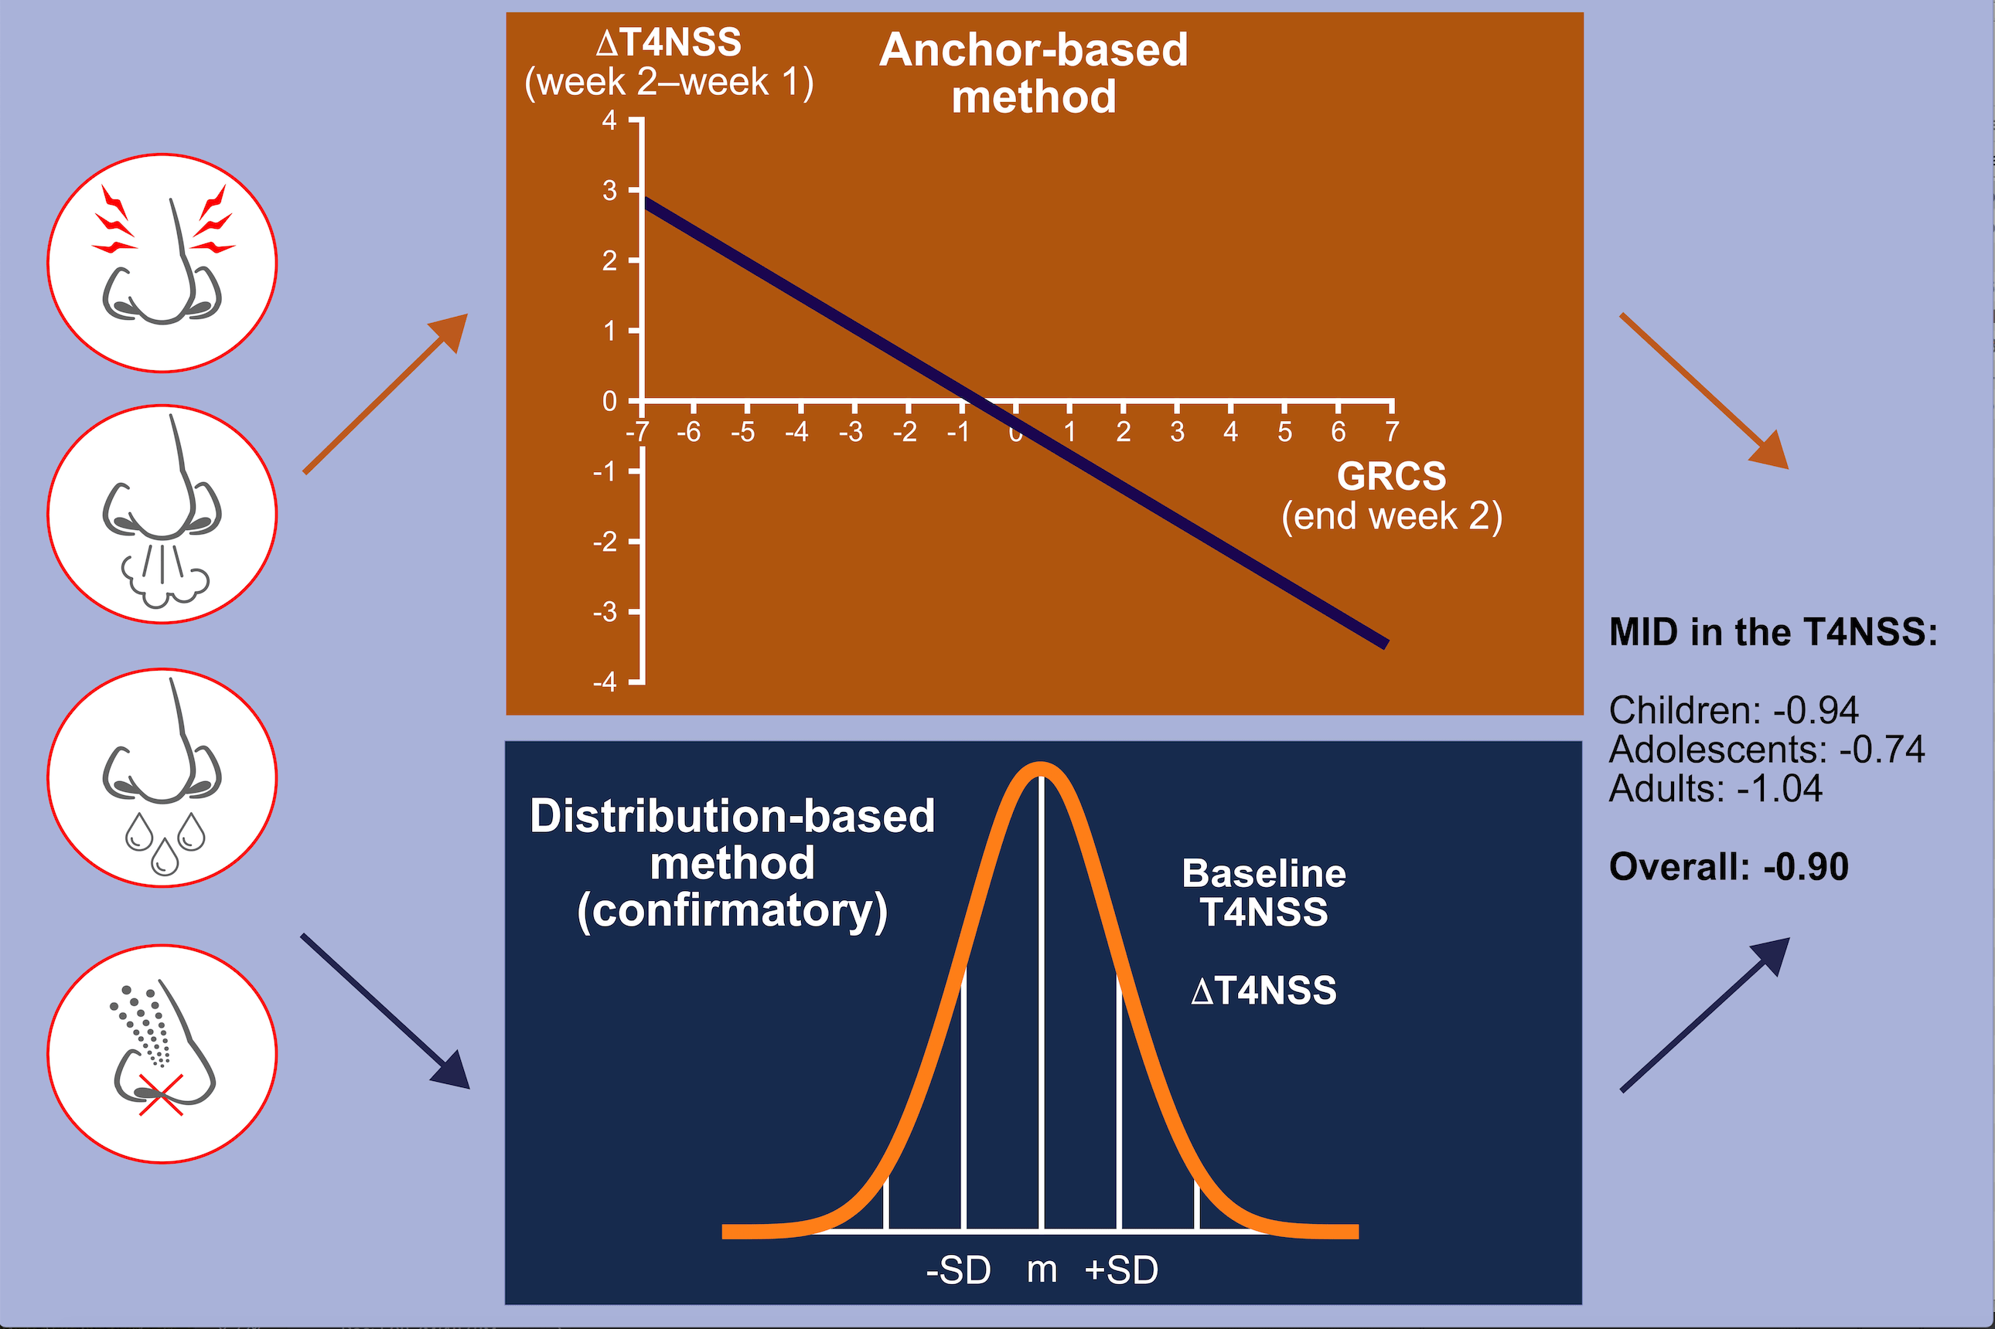
Determination of the minimally important difference in a nasal symptom score in house dust mite allergy
Philippe Devillier, Harald Brüning, Karl‐Christian Bergmann
Allergy. 2019; 2191-2198 https://doi.org/10.1111/all.13925
© 2019 EAACI and John Wiley and Sons A/S. Published by John Wiley and Sons Ltd.
Notes:
HIGHLIGHTS
• In patients with house dust mite allergic rhinoconjunctivitis, the minimal important difference for improvement in a four-item nasal symptom score was at least 0.9 units.
• This value was estimated in children (n=187), adolescents (n=125), and adults (n=197) by both regression analyses using anchors and distribution-based analyses using the standard deviation (SD).
• The anchors in the regression analyses were either a 15-point global rating of change scale or the age-specific Rhinoconjunctivitis Quality of Life Questionnaires.
ABBREVIATIONS
GRCS: global rating of change scale; MID: minimal important difference; T4NSS: four-component nasal symptom score

