Slide 1
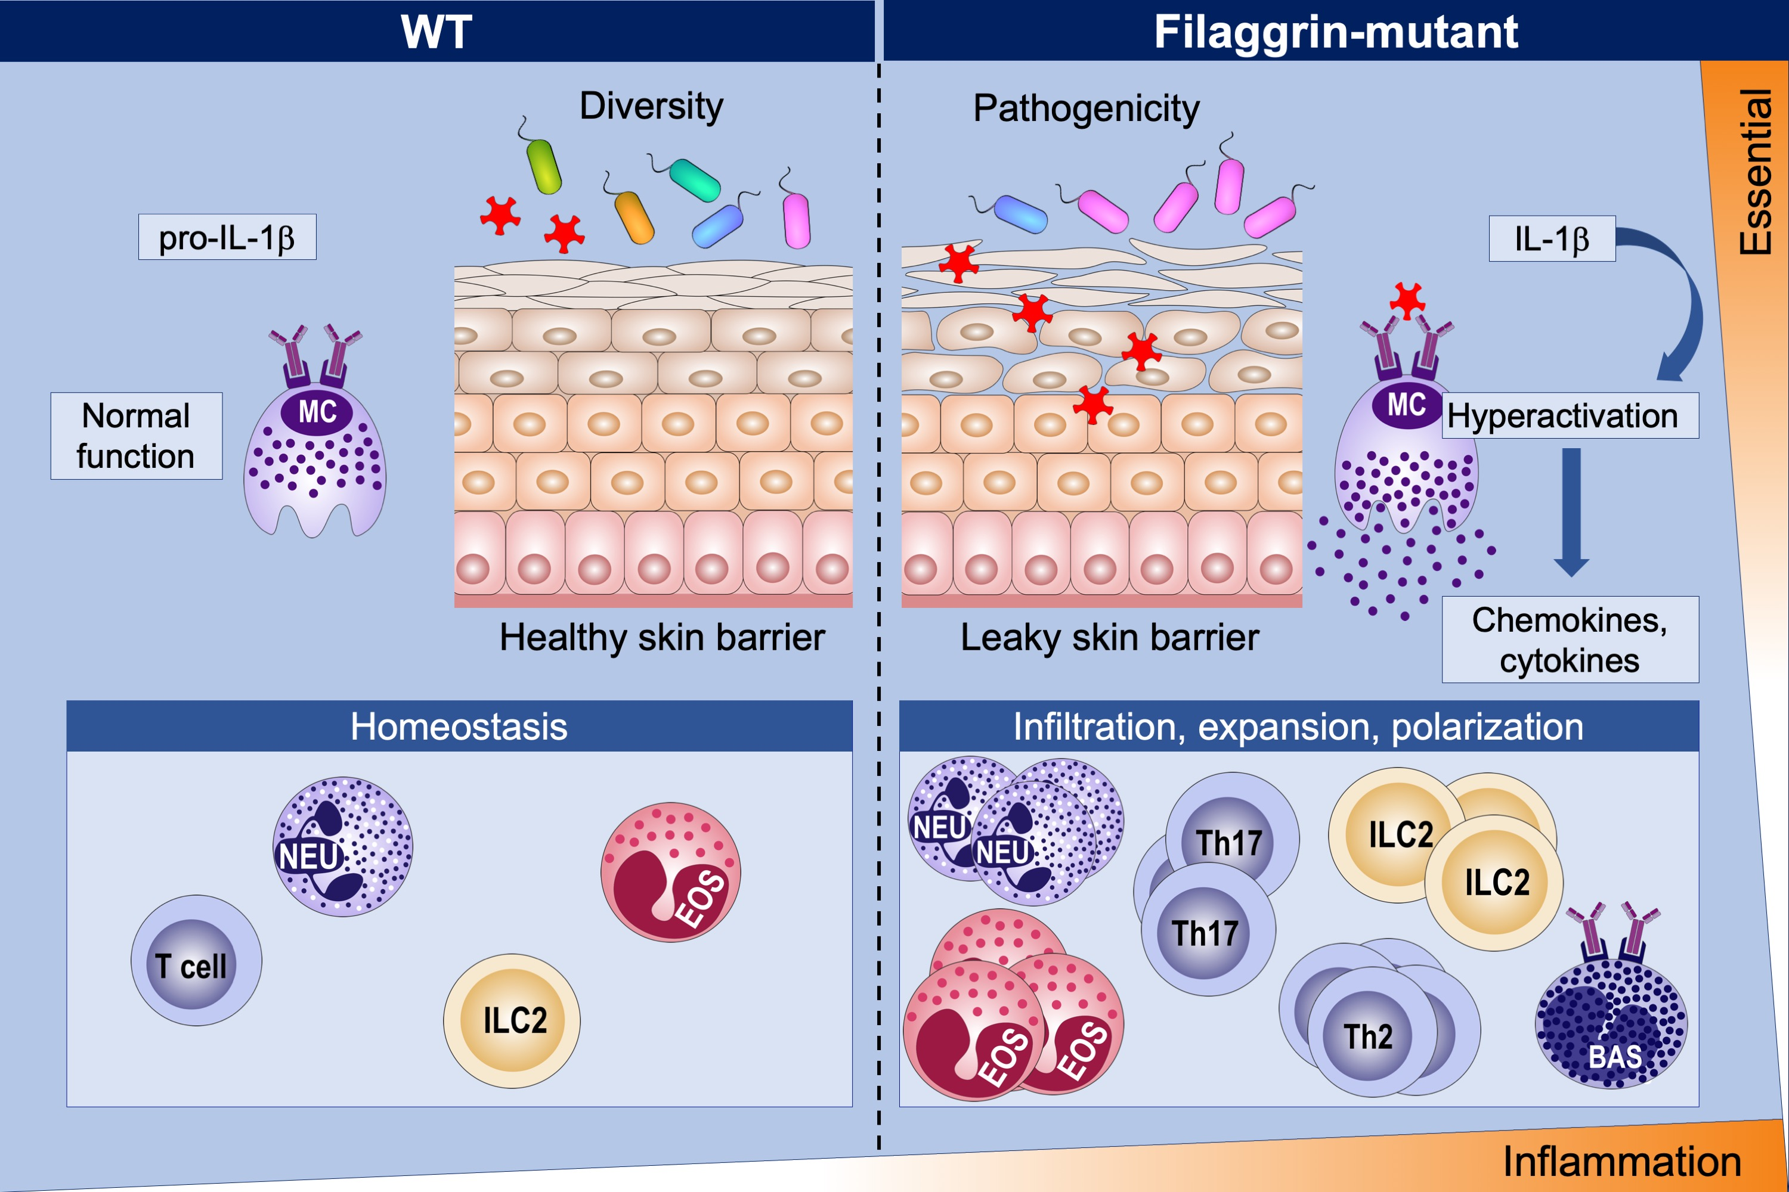
Spontaneous atopic dermatitis in mice with a defective skin barrier is independent of ILC2 and mediated by IL‐1β
Christian Schwartz, Tara Moran, Sean P. Saunders, Agnieszka Kaszlikowska, Achilleas Floudas, et al.
Allergy. 2019; 00-00 https://doi.org/10.1111/all.13801
© 2019 EAACI and John Wiley and Sons A/S. Published by John Wiley and Sons Ltd.
Notes:
HIGHLIGHTS
• Filaggrin deficiency leads to skin dysbiosis early after birth altering adult immune responses, while mice raised under germ-free conditions remain disease-free.
• NLR Family Pyrin Domain Containing 3-independent processing of IL-1 in the skin promotes atopic dermatitis (AD)-like ILC2-independent inflammation.
• IL-1 deficiency or targeting IL-1 by monoclonal antibodies ameliorates dermatitis.
• IL-1R1-expressing dermal mast cells are key responders to IL-1, acquire a hyperactive phenotype, and promote AD-like inflammation.

