Slide 1
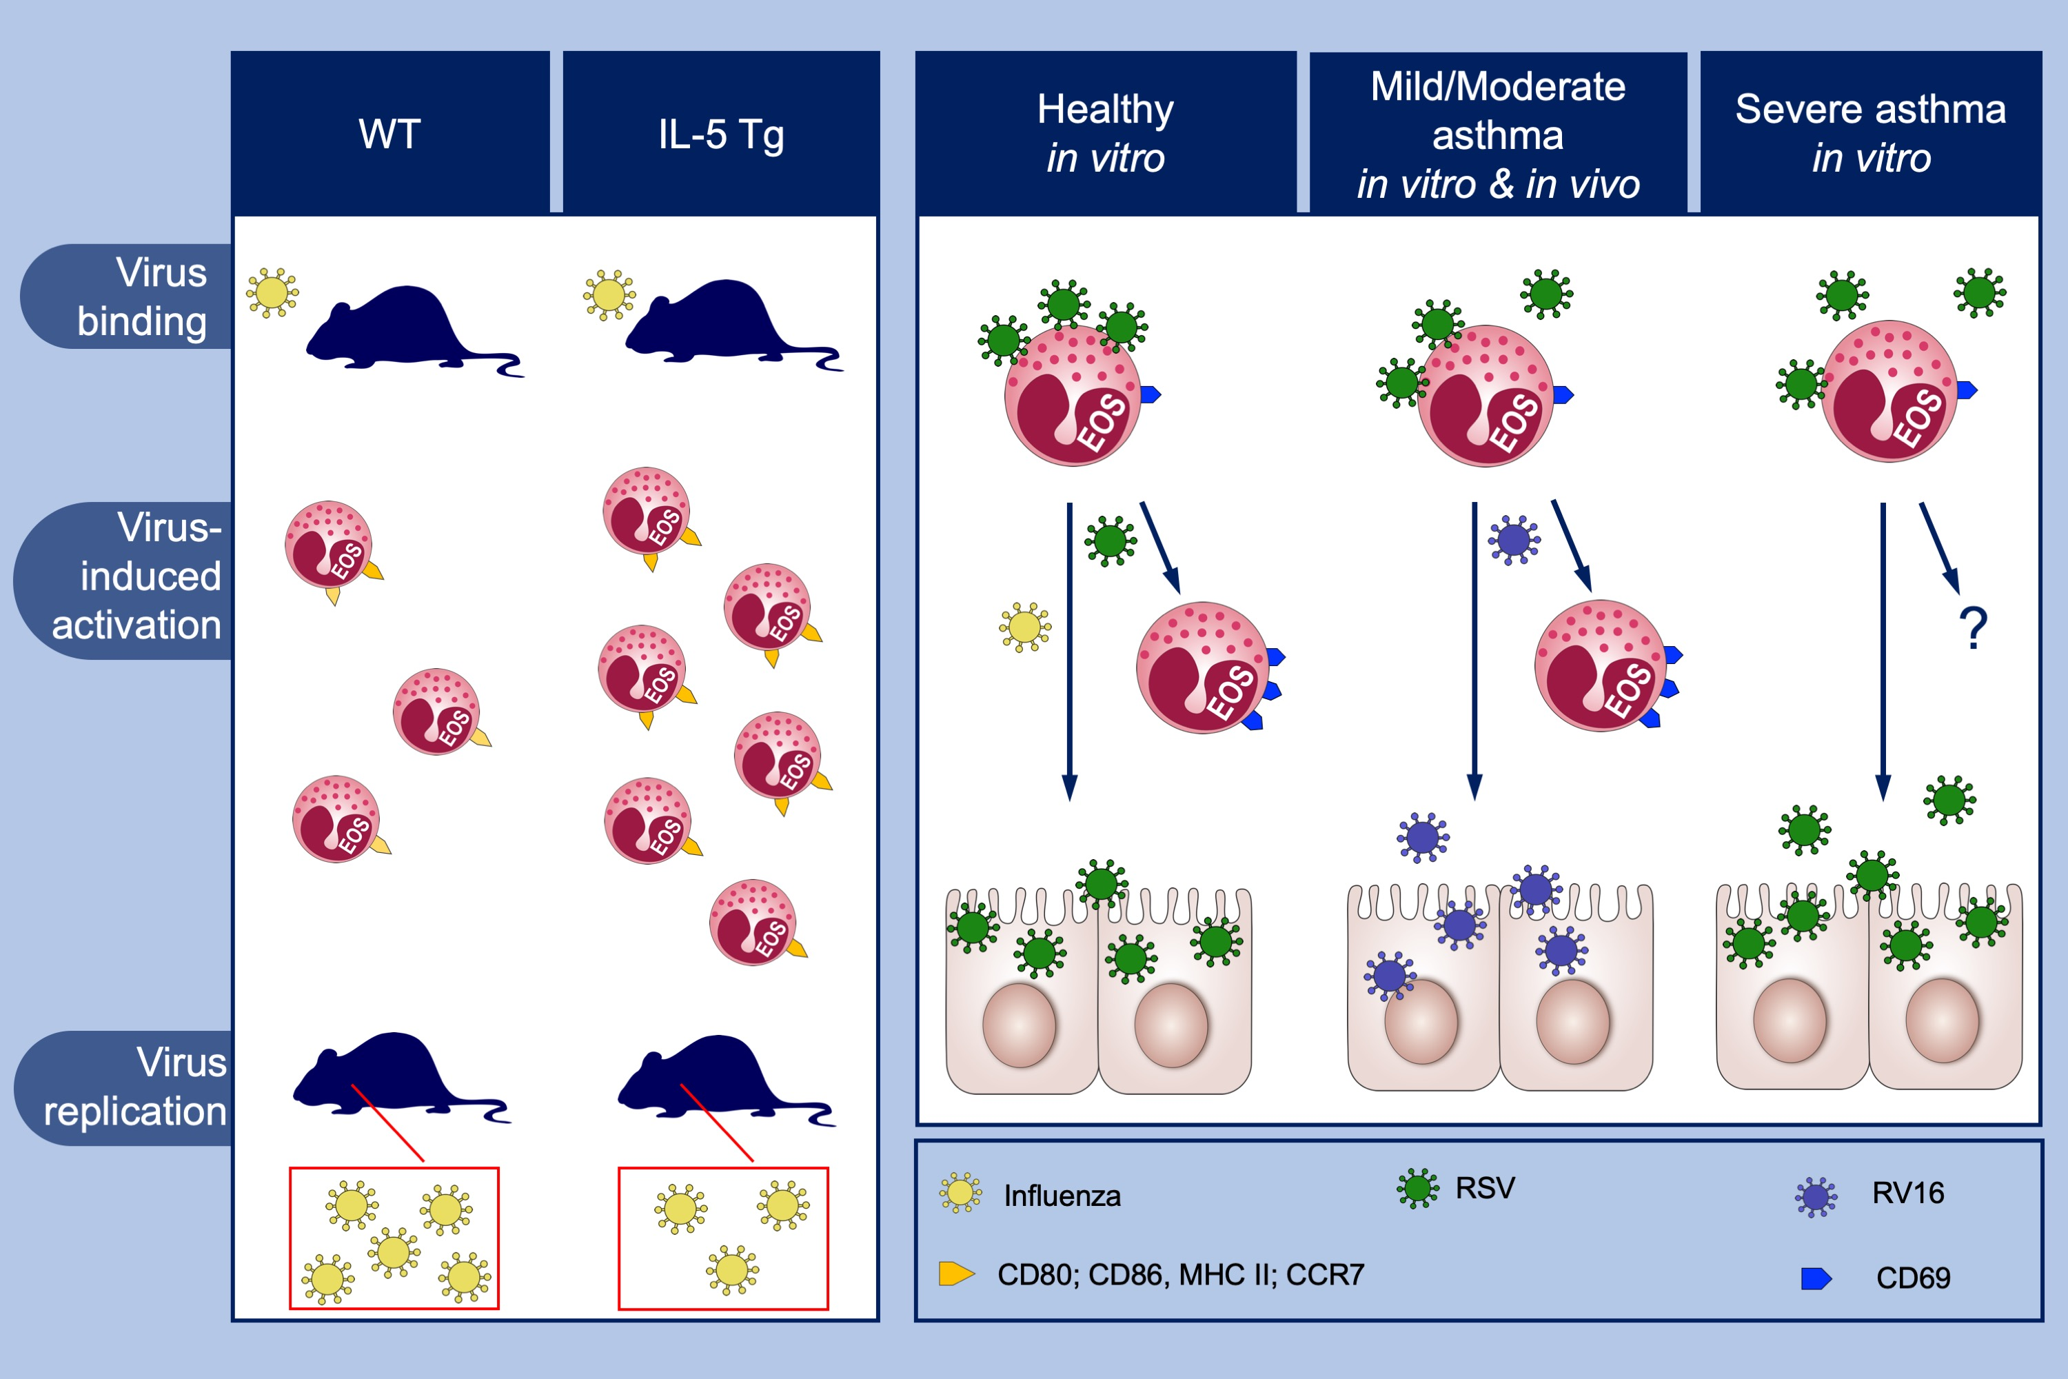
Eosinophils capture viruses, a capacity that is defective in asthma
Yanaika S. Sabogal Piñeros, Suzanne M. Bal, Annemiek Dijkhuis, Christof J. Majoor, Barbara S. Dierdorp, et al.
Allergy. 2019; 00-00 https://doi.org/10.1111/all.13802
© 2019 EAACI and John Wiley and Sons A/S. Published by John Wiley and Sons Ltd.
Notes:
HIGHLIGHTS
• 1,19 – dioctadecyl - 3, 3, 39, 39 – tetramethylindocarbocyanine (DiD)-respiratory syncytial virus and DiD-influenza adhered to human eosinophils.
• Both viruses were internalized and inactivated by eosinophils.
• The capacity of eosinophils to capture virus was reduced with increasing severity of asthma.

