Slide 1
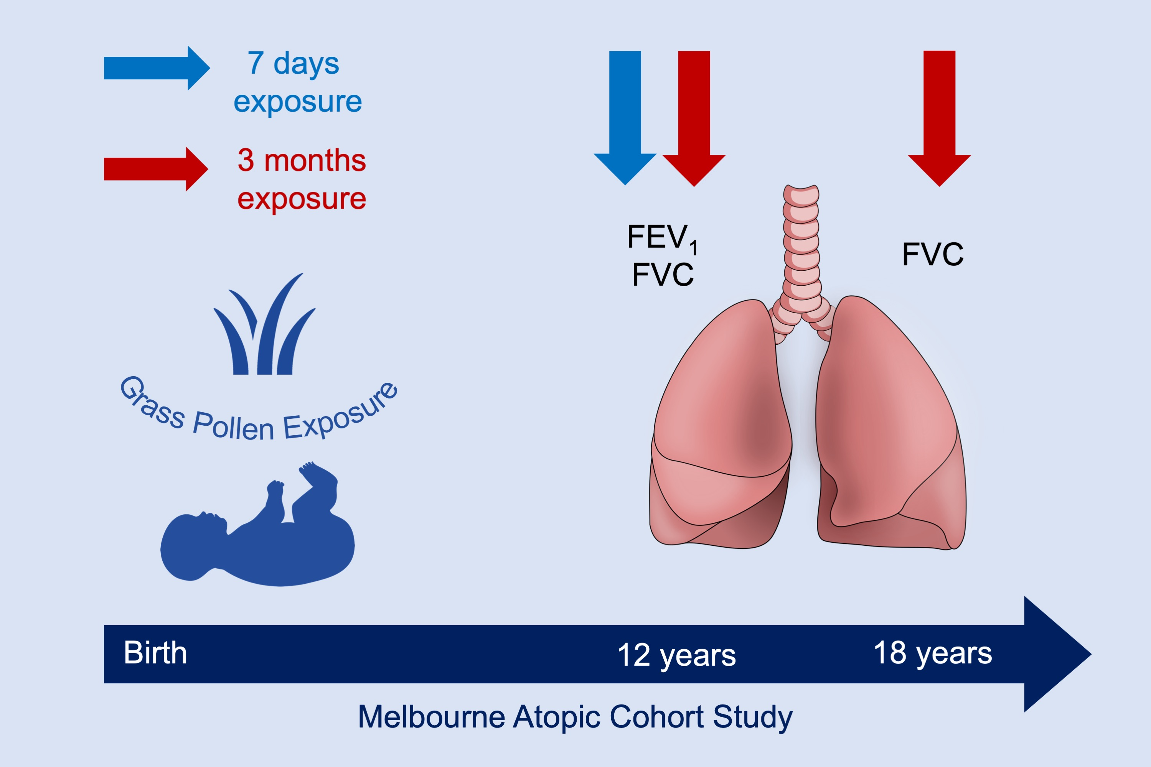
Pollen exposure at birth and adolescent lung function, and modification by residential greenness
Katrina A. Lambert, Caroline Lodge, Adrian J. Lowe, Luke A. Prendergast, Paul S. Thomas, et al.
Allergy. 2019; 00-00 https://doi.org/10.1111/all.13803
© 2019 EAACI and John Wiley and Sons A/S. Published by John Wiley and Sons Ltd.
Notes:
HIGHLIGHTS
• Early life exposure to pollen was associated with reduced lung function at 12 years in a high-risk birth cohort.
• Associations with a nonlinear reduction in forced vital capacity (FVC) were also apparent at 18 years.
• Exposure to high residential greenness modified the association at 18 years.
ABBREVIATION
FEV1: Forced expiratory volume during the first second

