Slide 1
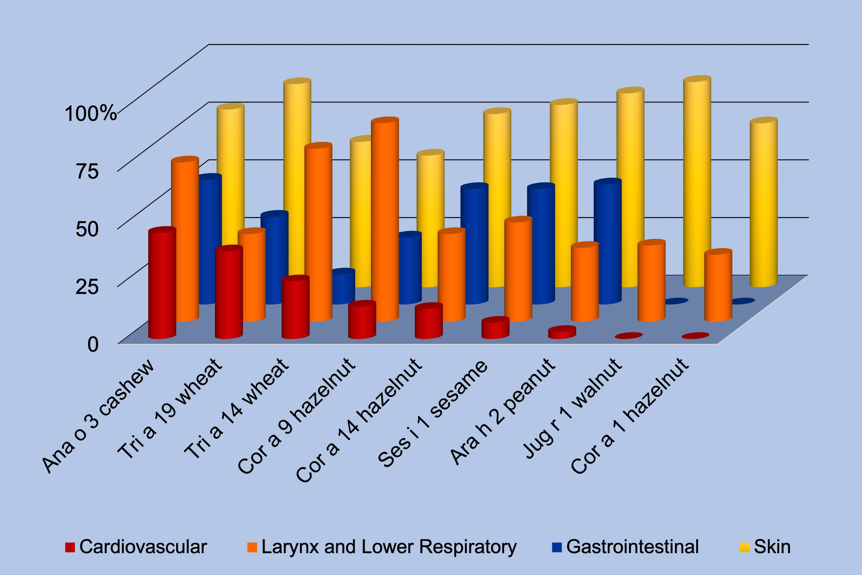
Food allergy endotype with high risk of severe anaphylaxis in children—Monosensitization to cashew 2S albumin Ana o 3
Lukasz Blazowski, Pawel Majak, Ryszard Kurzawa, Piotr Kuna, Joanna Jerzynska, et al.
Allergy. 2019; 00-00 https://doi.org/10.1111/all.13810
© 2019 EAACI and John Wiley and Sons A/S. Published by John Wiley and Sons Ltd.
Notes:
HIGHLIGHTS
• Seed storage protein allergen components are the most common food anaphylaxis triggers in children.
• The incidence of clinical symptoms during seed anaphylaxis depends on trigger defined at the component level.
• Monosensitization to Ana o 3, 2S albumin from cashew is associated with the highest risk of severe anaphylaxis including cardiovascular and severe respiratory symptoms (grade IV-V of Cox scale).

