Slide 1
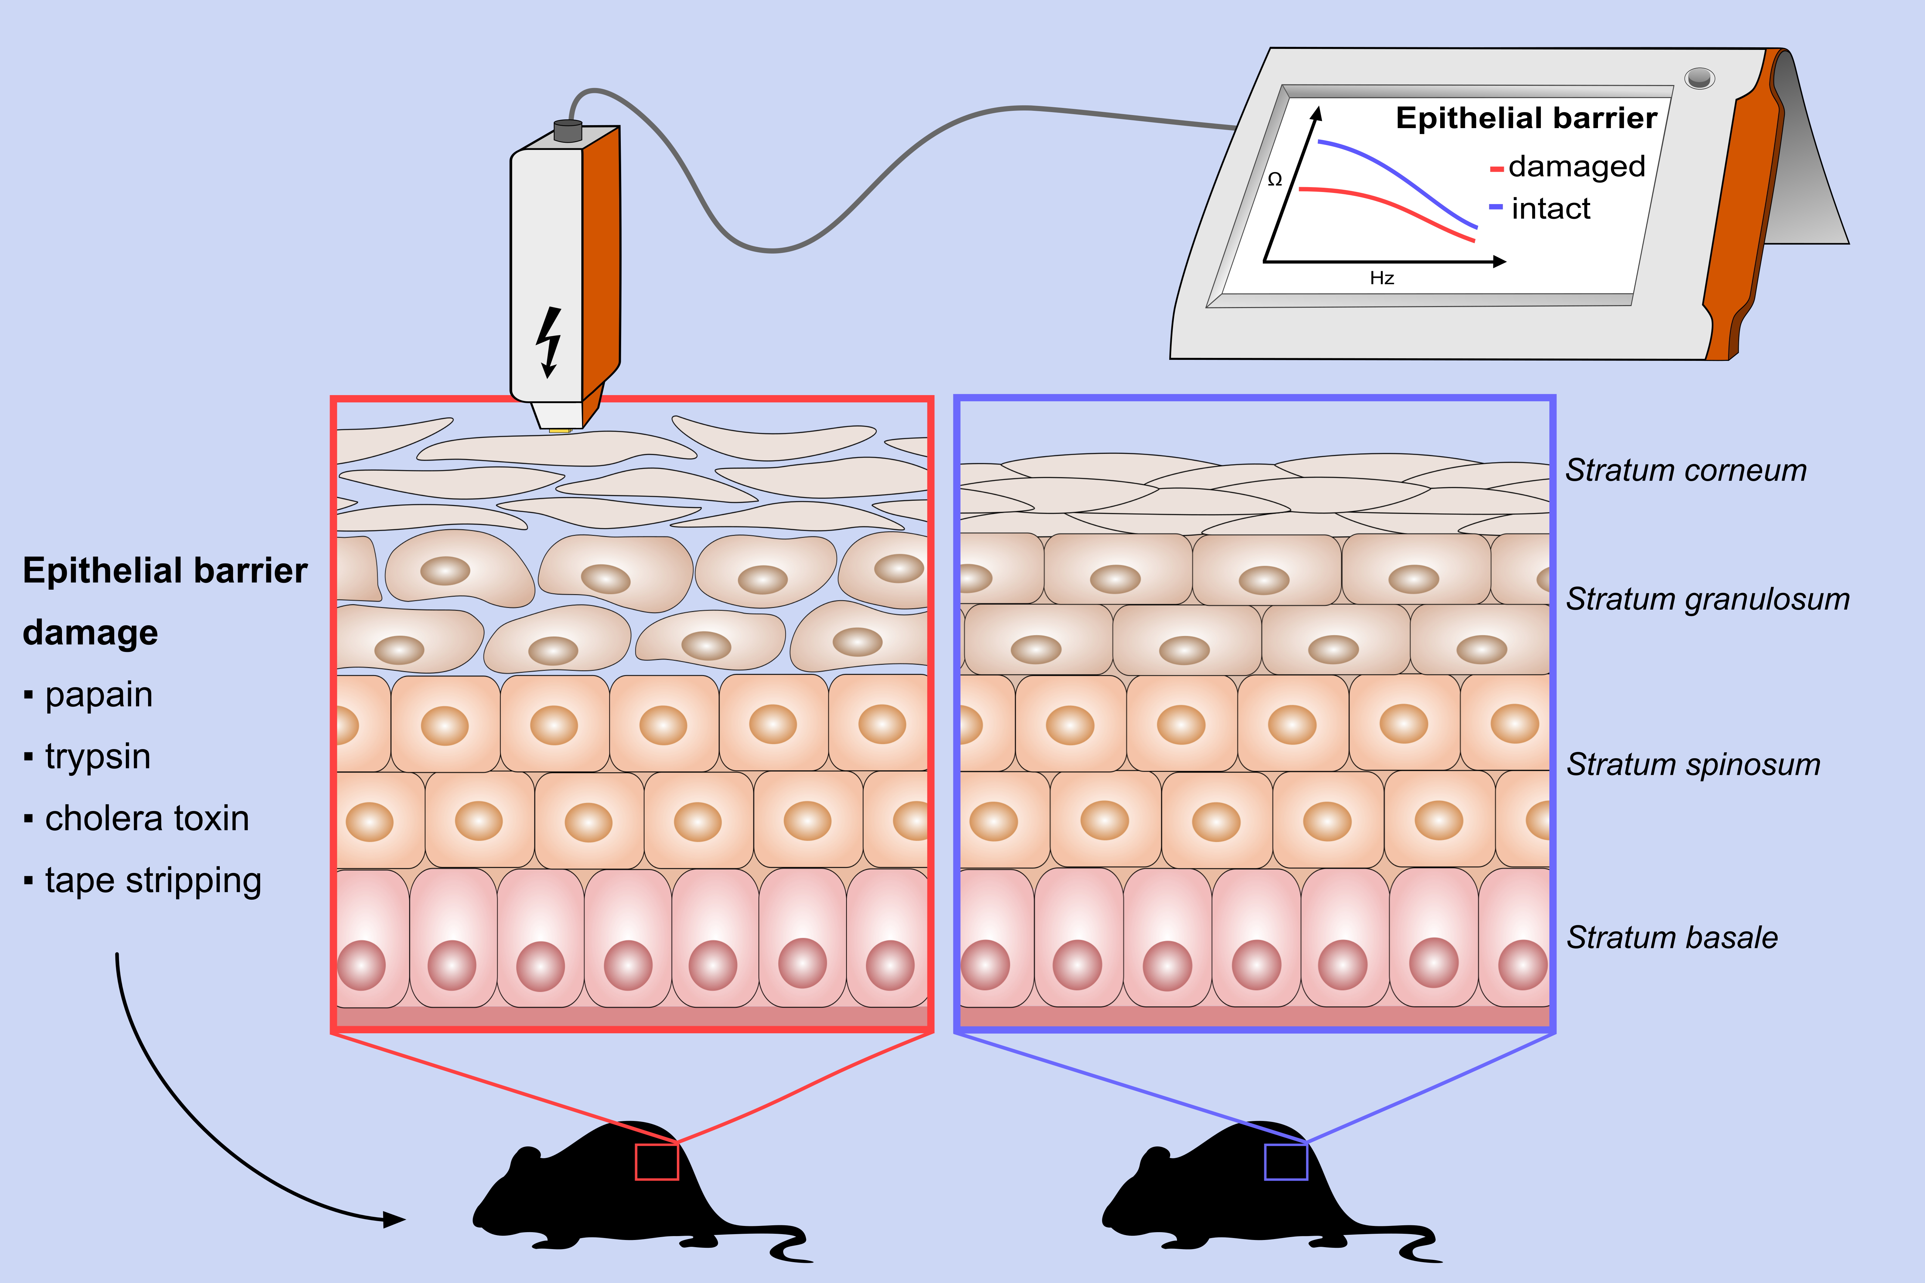
Direct assessment of skin epithelial barrier by electrical impedance spectroscopy
Arturo O. Rinaldi, Hideaki Morita, Paulina Wawrzyniak, Anita Dreher, Simon Grant, et al.
Allergy. 2019; 00-00 https://doi.org/10.1111/all.13824
© 2019 EAACI and John Wiley and Sons A/S. Published by John Wiley and Sons Ltd.
Notes:
HIGHLIGHTS
• Mice epidermal barrier was damaged by epicutaneous application of papain, trypsin, cholera toxin, and by tape stripping.
• Electrical impedance (EI) spectroscopy is a rapid and reliable diagnostic tool to detect skin barrier defects and shows a negative correlation with transepidermal water loss (TEWL).
• Changes in EI reflect skin barrier damage, as well as tissue healing.

