Slide 1
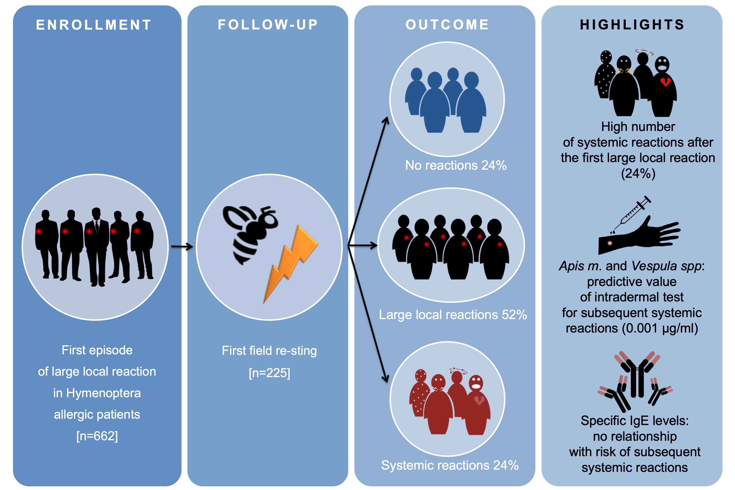
Large local reactions to Hymenoptera stings: Outcome of re‐stings in real life
Maria Beatrice Bilò, Matteo Martini, Valerio Pravettoni, Donatella Bignardi, Patrizia Bonadonna, et al.
Allergy. 2019; 00-00 https://doi.org/10.1111/all.13863
© 2019 EAACI and John Wiley and Sons A/S. Published by John Wiley and Sons Ltd.
Notes:
HIGHLIGHTS
• The frequency of systemic reactions, after one first large local reaction, is considerably high (24%).
• Skin reactivity to Apis mellifera or Vespula species seems a good risk predictor, particularly at low concentration (0.001 μg/ml).
• An accurate diagnostic workup should be considered for large local reactions, particularly skin testing, to assess the risk of subsequent systemic reactions and the consequent management.

