Slide 1
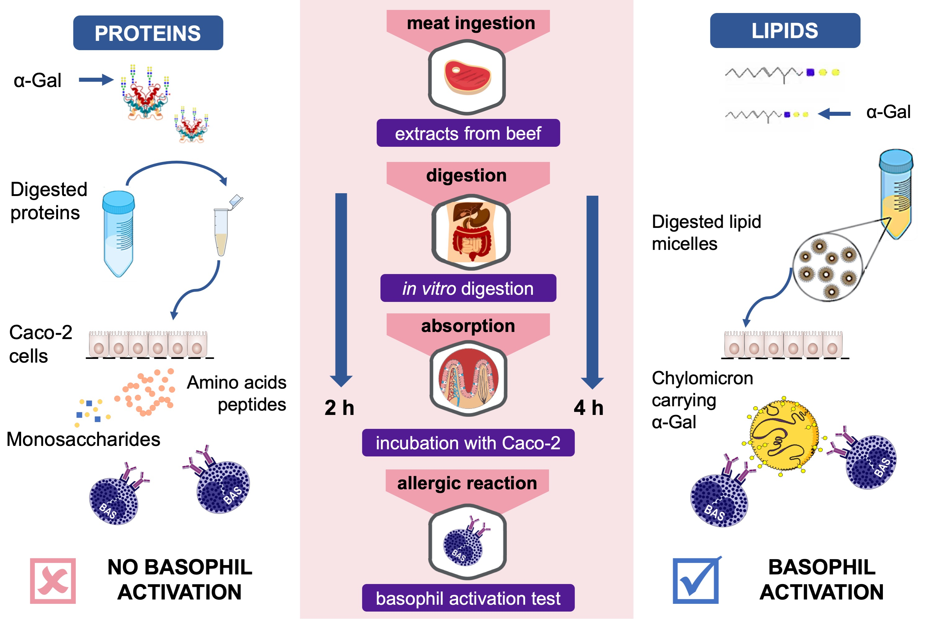
Only α‐Gal bound to lipids, but not to proteins, is transported across enterocytes as an IgE‐reactive molecule that can induce effector cell activation
Patricia Román‐Carrasco, Barbara Lieder, Veronika Somoza, Marta Ponce, Zsolt Szépfalusi, et al.
Allergy. 2019; 00-00 https://doi.org/10.1111/all.13873
© 2019 EAACI and John Wiley and Sons A/S. Published by John Wiley and Sons Ltd.
Notes:
HIGHLIGHTS
• α-Gal is present in both lipids and proteins from beef, but only when it is bound to beef lipids, the oligosaccharide can cross the Caco-2 cell monolayer.
• α-Gal carried by lipids is packaged by the enterocytes into chylomicrons, which are then able to activate the basophils of an –Gal allergic patient.
• The slower in vivo digestion and absorption of lipids explain the delayed allergic reactions to α-Gal.
ABBREVIATION
α-Gal: galactose- α-1,3-galactose

