Slide 1
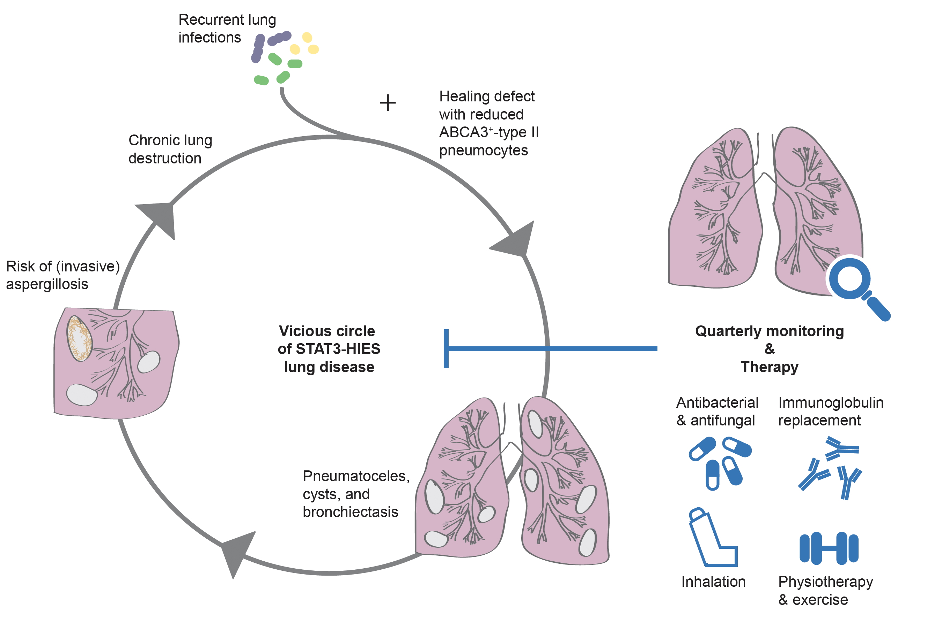
Lung disease in STAT3 hyper‐IgE syndrome requires intense therapy
Carolin Kröner, Jens Neumann, Julia Ley‐Zaporozhan, Beate Hagl, Iris Meixner, et al.
Allergy. 2019; 1691-1702 https://doi.org/10.1111/all.13753
© 2019 EAACI and John Wiley and Sons A/S. Published by John Wiley and Sons Ltd.
Notes:
HIGHLIGHTS
• Pulmonary complications in STAT3-HIES patients account for significant morbidity and mortality; patients are endangered by severe postinfectiouspulmonary tissue damage including extensive pneumatocele or cyst formation. Preliminary data hint
towards a healing defect associated with reduced ABCA3 expression in type 2 pneumocytes due to STAT3 malfunctioning.
• Strict monitoring and intensive acute and long-term therapy is required including antimicrobial treatment, immunoglobulin replacement therapy (IGRT), inhalation therapy, and chest physiotherapy. Regular IGRT stabilized lung function.
• Preliminary data hint towards a healing defect associated with reduced ABCA3 expression in type 2 pneumocytes due to STAT3 malfunctioning.

