Slide 1
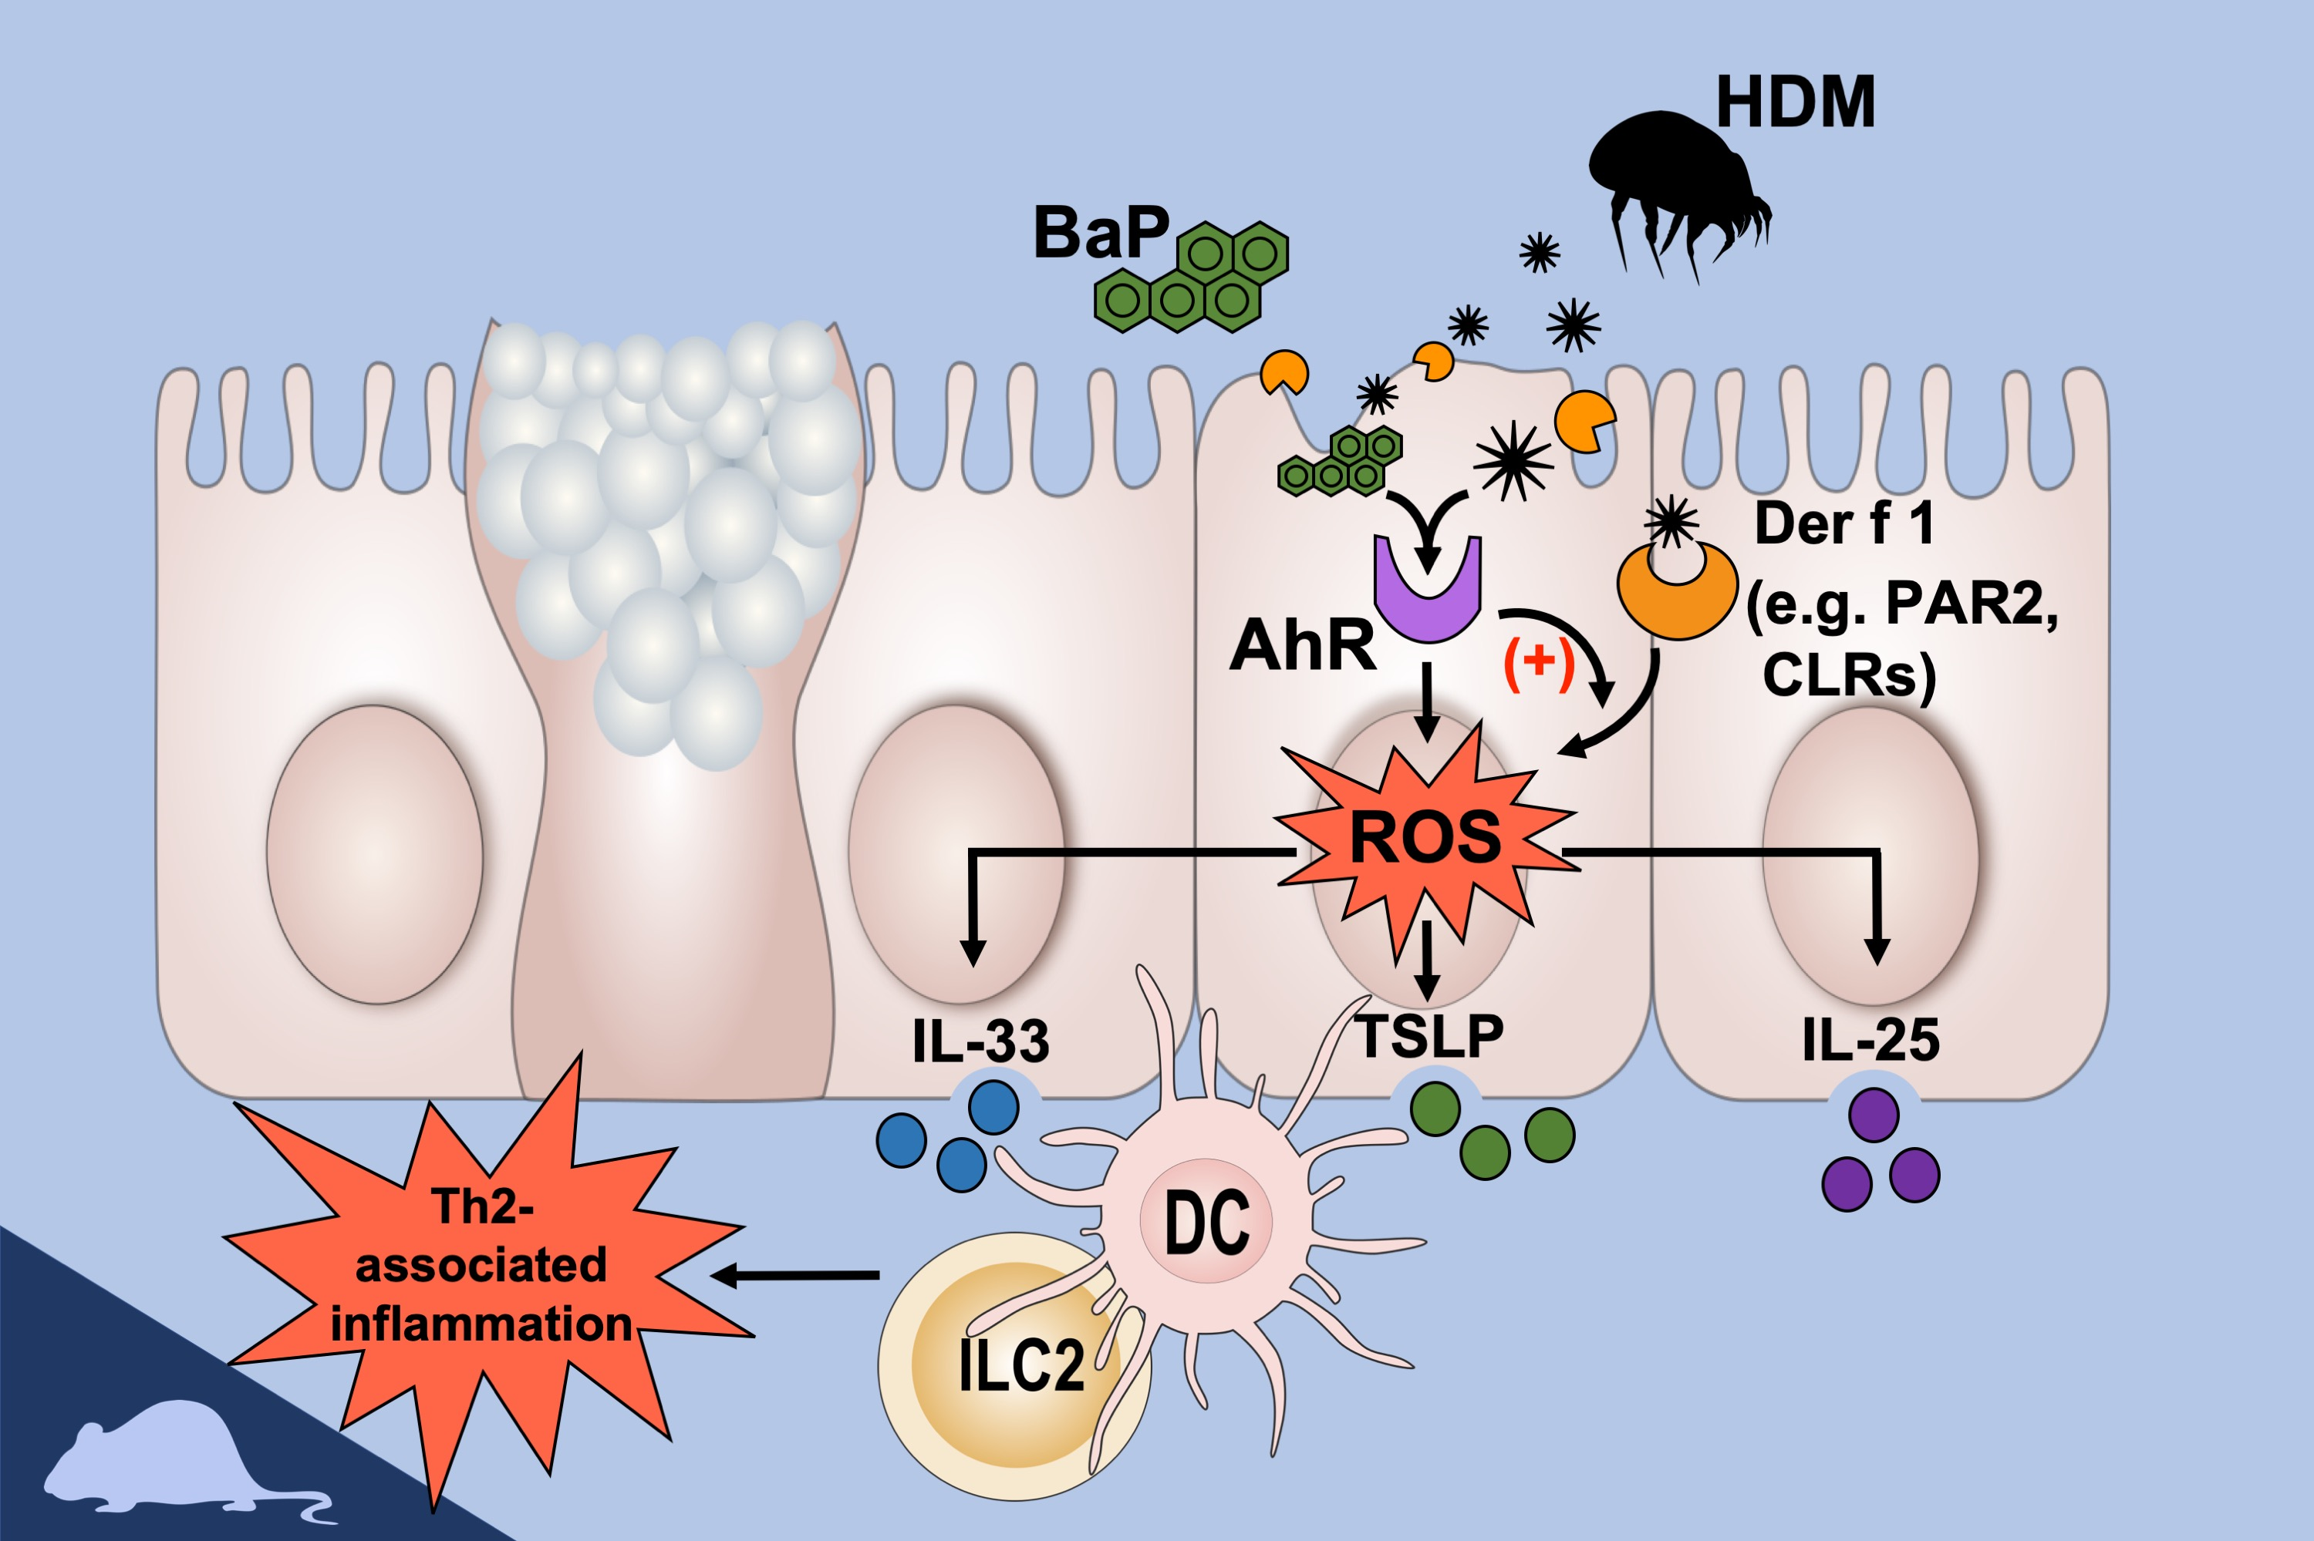
Benzo(a)pyrene facilitates dermatophagoides group 1 (Der f 1)‐induced epithelial cytokine release through aryl hydrocarbon receptor in asthma
Eryi Wang, Xiaoyu Liu, Wei Tu, Danh C. Do, Haiqiong Yu, et al.
Allergy. 2019; 1675-1690 https://doi.org/10.1111/all.13784
© 2019 EAACI and John Wiley and Sons A/S. Published by John Wiley and Sons Ltd.
Notes:
HIGHLIGHTS
• Compared with Der f 1 alone, BaP and Der f 1 co-exposure leads to airway hyperresponsiveness and increases Th2-associated lung inflammation in mouse model of asthma.
• AhR signaling plays a critical role in BaP and Der f 1 co-exposure-induced oxidative stress and cytokine expression in airway epithelial cells.
• The AhR-ROS axis regulates BaP and Der f 1 co-exposure-induced epithelial cytokine expression and allergic inflammation.
ABBREVIATIONS
AhR: Aryl hydrocarbon receptor; BaP: benzo(a)pyrene; CLRs: C-type lectin receptors; HDM: house dust mite; PAR2: protease-activated receptor 2; ROS: reactive oxygen species.

