Slide 1
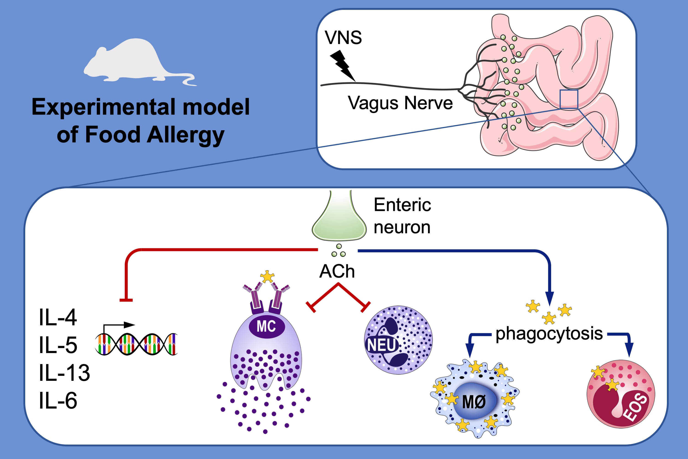
Vagus nerve stimulation dampens intestinal inflammation in a murine model of experimental food allergy
Goele Bosmans, Iris Appeltans, Nathalie Stakenborg, Pedro J. Gomez‐Pinilla, Morgane V. Florens, et al.
Allergy. 2019; 1748-1759 https://doi.org/10.1111/all.13790
© 2019 EAACI and John Wiley and Sons A/S. Published by John Wiley and Sons Ltd.
Notes:
HIGHLIGHTS
• Vagus nerve stimulation (VNS) has anti-inflammatory effects in a Th2 inflammatory model of experimental food allergy.
• VNS dampens the intestinal inflammatory response as evidenced by reduced expression of inflammatory genes IL-4, IL-5, IL-13 and IL-6, reduced neutrophil infiltration and reduced number and activation of mast cells.
• Phagocytosis of allergen by macrophages is increased in response to VNS. The contrary is observed for eosinophils.
ABBREVIATIONS
ACh: acetylcholine

