Slide 1
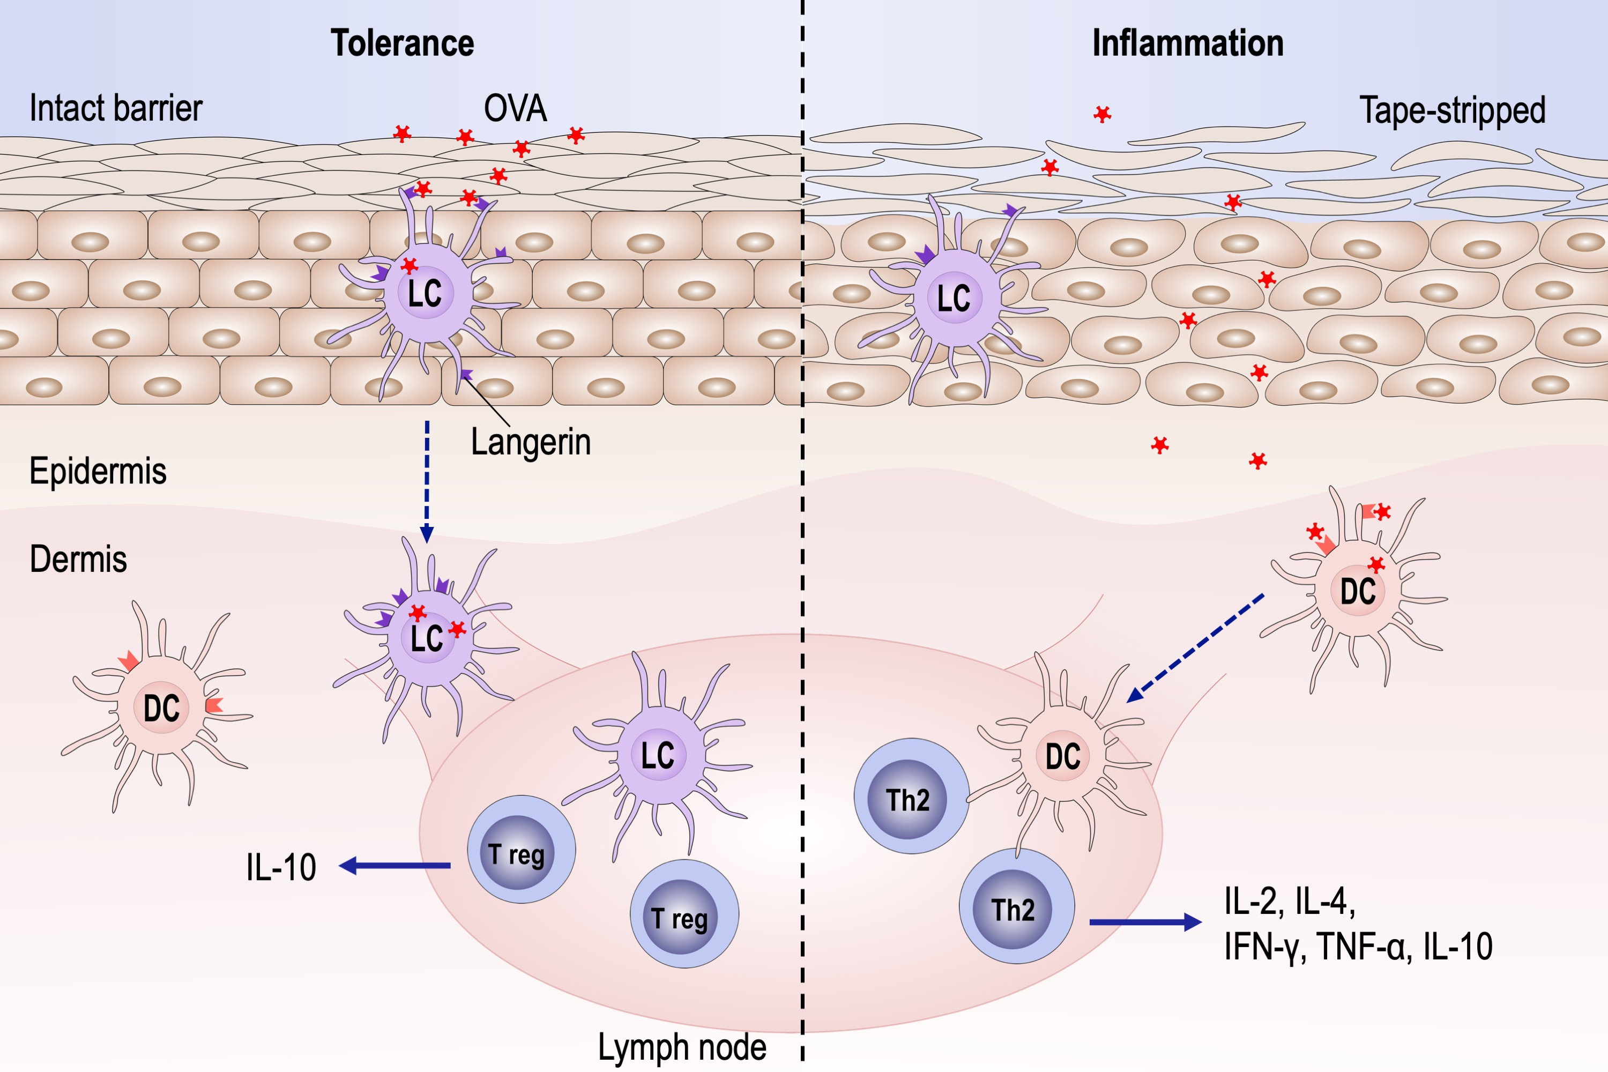
Langerhans cells mediate the skin‐induced tolerance to ovalbumin via Langerin in a murine model
Yang Luo, Su Wang, Xiaochun Liu, He Wen, Wei Li, et al.
Allergy. 2019; 1738-1747 https://doi.org/10.1111/all.13813
© 2019 EAACI and John Wiley and Sons A/S. Published by John Wiley and Sons Ltd.
Notes:
HIGHLIGHTS
• Langerhans cells (LCs) are required in the intact skin-induced tolerance to ovalbumin (OVA).
• Application of OVA on intact skin induces the production of IL-10 by LCs.
• Langerin mediates the tolerogenic effects of LCs through binding of OVA.

