Slide 1
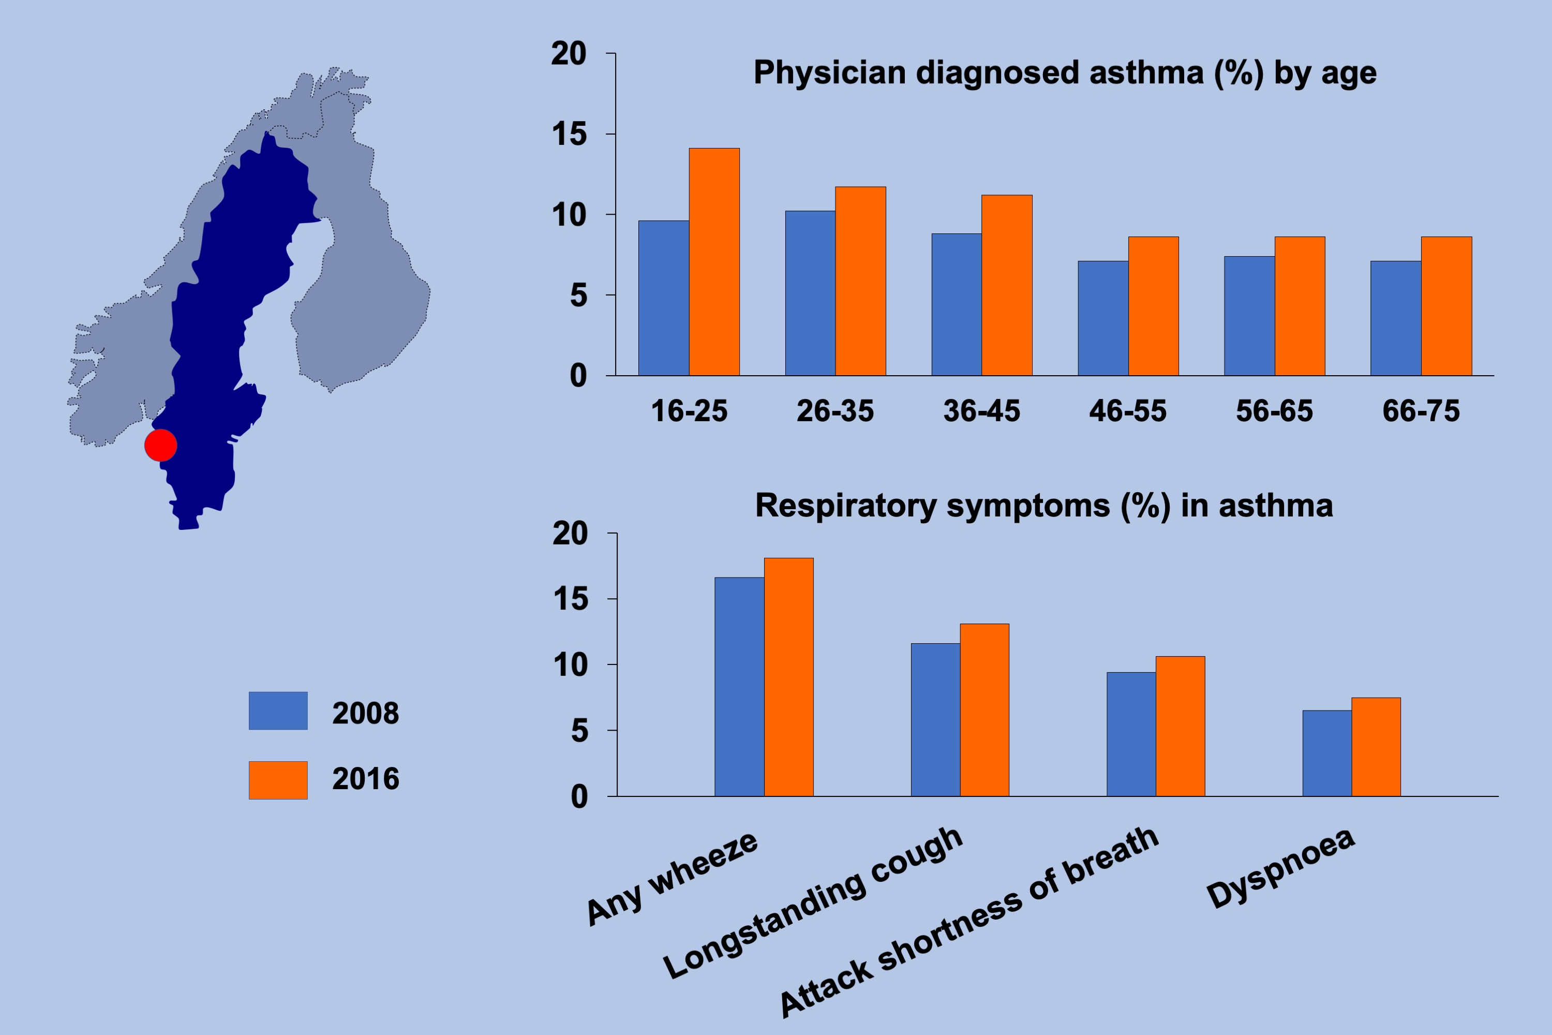
Changes in the prevalence of asthma and respiratory symptoms in western Sweden between 2008 and 2016
Eivind Borna, Bright I. Nwaru, Anders Bjerg, Roxana Mincheva, Madeleine Rådinger, et al.
Allergy. 2019; 1703-1715 https://doi.org/10.1111/all.13840
© 2019 EAACI and John Wiley and Sons A/S. Published by John Wiley and Sons Ltd.
Notes:
HIGHLIGHTS
• We investigated the prevalence of asthma and respiratory symptoms in two large randomly selected cohorts in western Sweden between 2008 and 2016.
• Asthma prevalence showed a moderate increase between 2008 and 2016. The increase in asthma prevalence was seen irrespective of age but was most pronounced in younger age groups.
• An increase in most respiratory symptoms was seen from 2008 to 2016. Allergic rhinitis was the most common symptom and showed the highest increase.

