Slide 1
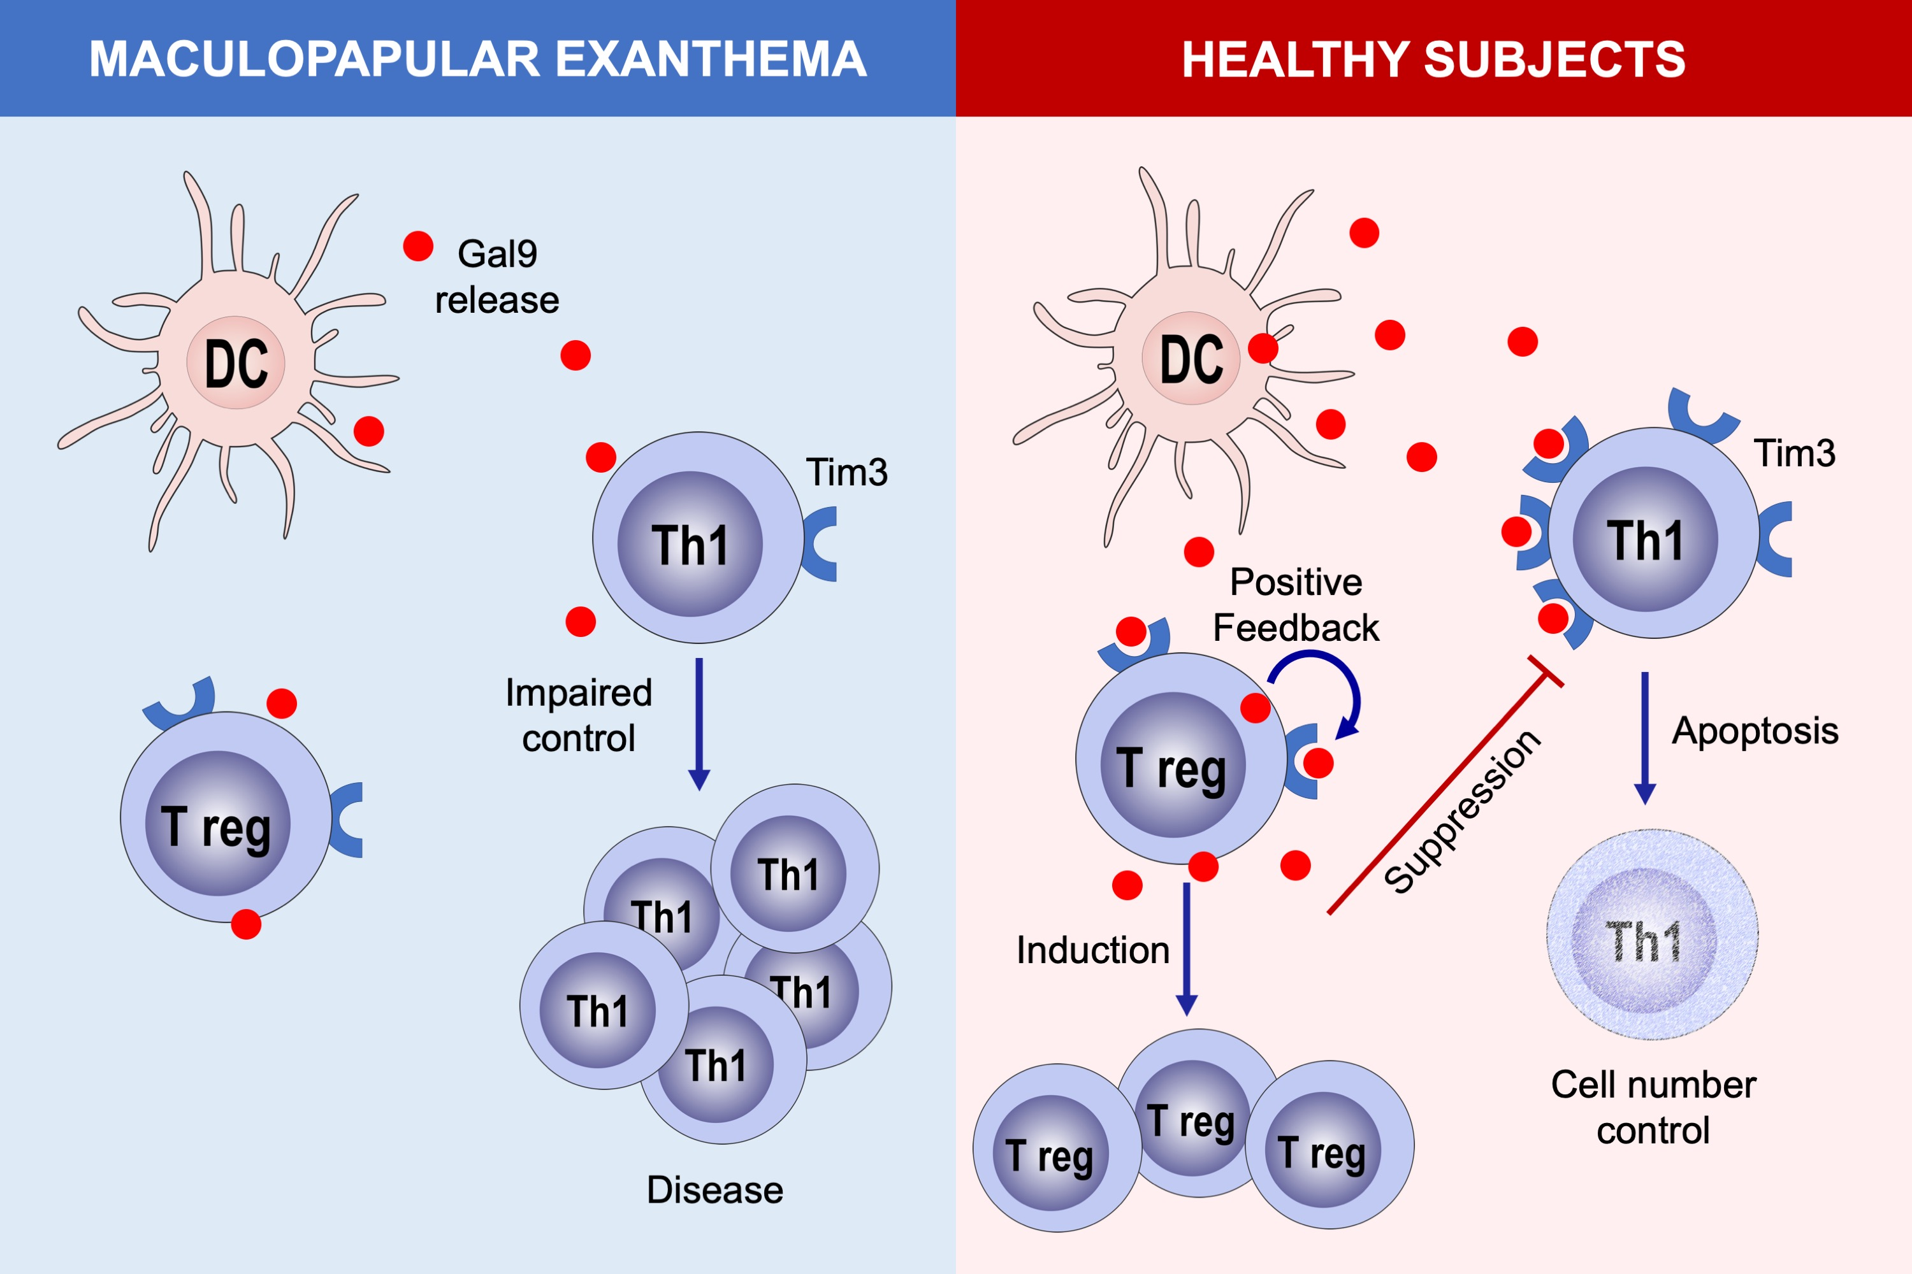
Expression of the Tim3‐galectin‐9 axis is altered in drug‐induced maculopapular exanthema
Ruben Fernandez‐Santamaría, Francisca Palomares, Maria Salas, Inmaculada Doña, Gador Bogas, et al.
Allergy. 2019; 1769-1779 https://doi.org/10.1111/all.13847
© 2019 EAACI and John Wiley and Sons A/S. Published by John Wiley and Sons Ltd.
Notes:
HIGHLIGHTS
• The reduced level of the checkpoint molecule Tim3 in Th1 cells together with the impaired expression of Gal9 in PBMCs and dendritic cells hampers the control of Th1 cell numbers in patients with drug-induced maculopapular exanthema (MPE).
• The reduced expression of Gal9 in patients with drug-induced MPE could be responsible for the low frequencies of Treg cells in these patients.
• Exogenous administration of Gal9 could be a potential therapeutic tool able to suppress Th1 and enhance Treg differentiation in patients with drug-induced MPE.

