Slide 1
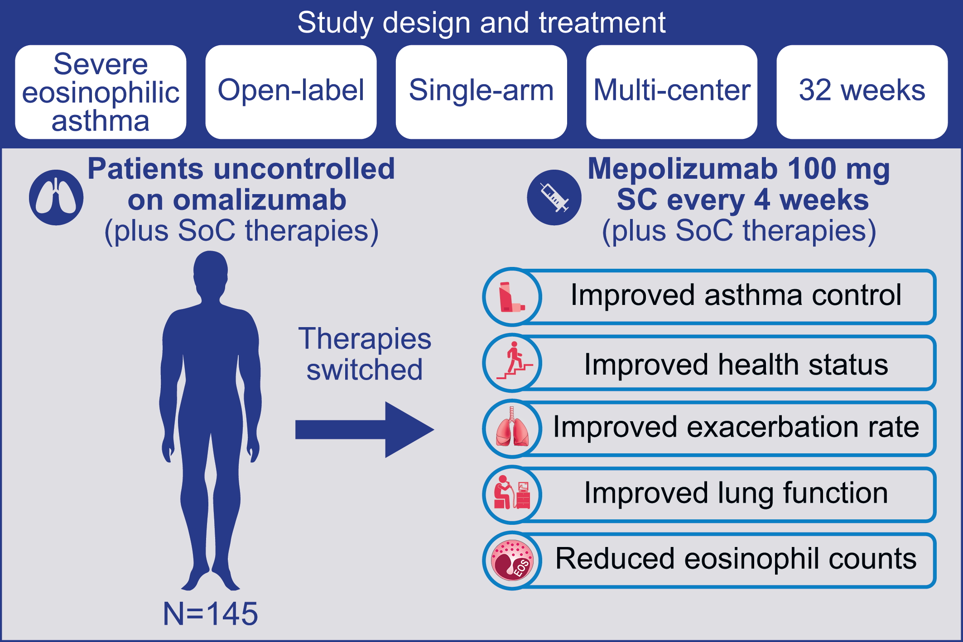
The clinical benefit of mepolizumab replacing omalizumab in uncontrolled severe eosinophilic asthma
Kenneth R. Chapman, Frank C. Albers, Bradley Chipps, Xavier Muñoz, Gilles Devouassoux, et al.
Allergy. 2019; 1716-1726 https://doi.org/10.1111/all.13850
© 2019 EAACI and John Wiley and Sons A/S. Published by John Wiley and Sons Ltd.
Notes:
HIGHLIGHTS
• Minimal clinically important difference for improvement in asthma control questionnaire-5 and St. George's Respiratory Questionnaire total scores was achieved by 77% and 79% of patients, respectively.
• Annualized rate of clinically significant exacerbations was reduced from 3.26 to 1.18 events/year.
• Safety and immunogenicity profiles of mepolizumab were consistent with previous placebo-controlled trials in severe eosinophilic asthma.

