Slide 1
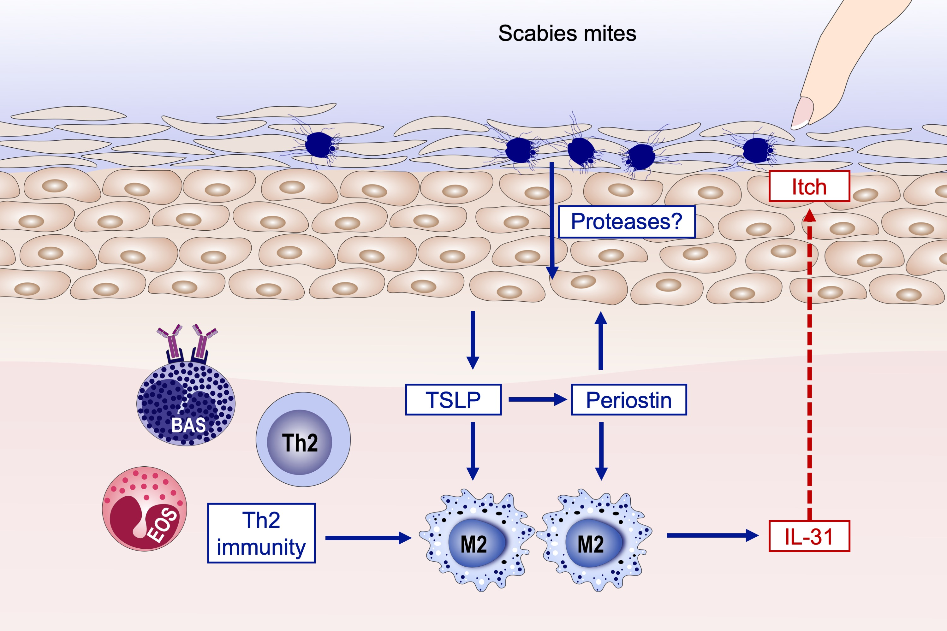
Pruritus in ordinary scabies: IL‐31 from macrophages induced by overexpression of thymic stromal lymphopoietin and periostin
Takashi Hashimoto, Takahiro Satoh, Hiroo Yokozeki, Takashi Hashimoto, Takahiro Satoh, et al.
Allergy. 2019; 1727-1737 https://doi.org/10.1111/all.13870
© 2019 EAACI and John Wiley and Sons A/S. Published by John Wiley and Sons Ltd.
Notes:
HIGHLIGHTS
• A large number of CCR4+ cells, basophils, and eosinophils were observed in human ordinary scabies lesions, suggesting that a Th2 immune response is predominant in ordinary scabies.
• Increased IL-31, a pruritogenic cytokine, thymic stromal lymphopoietin (TSLP), and periostin were detected in the lesions.
• The majority of IL-31+ cells were CD68+, Arg1+, and CD163+ M2 macrophages and IL-31 could be induced by overexpression of TSLP and periostin.
ABBREVIATIONS
Arg1: arginase 1; CCR4: C-C chemokine receptor type 4; TSLP: thymic stromal lymphopoietin

