Slide 1
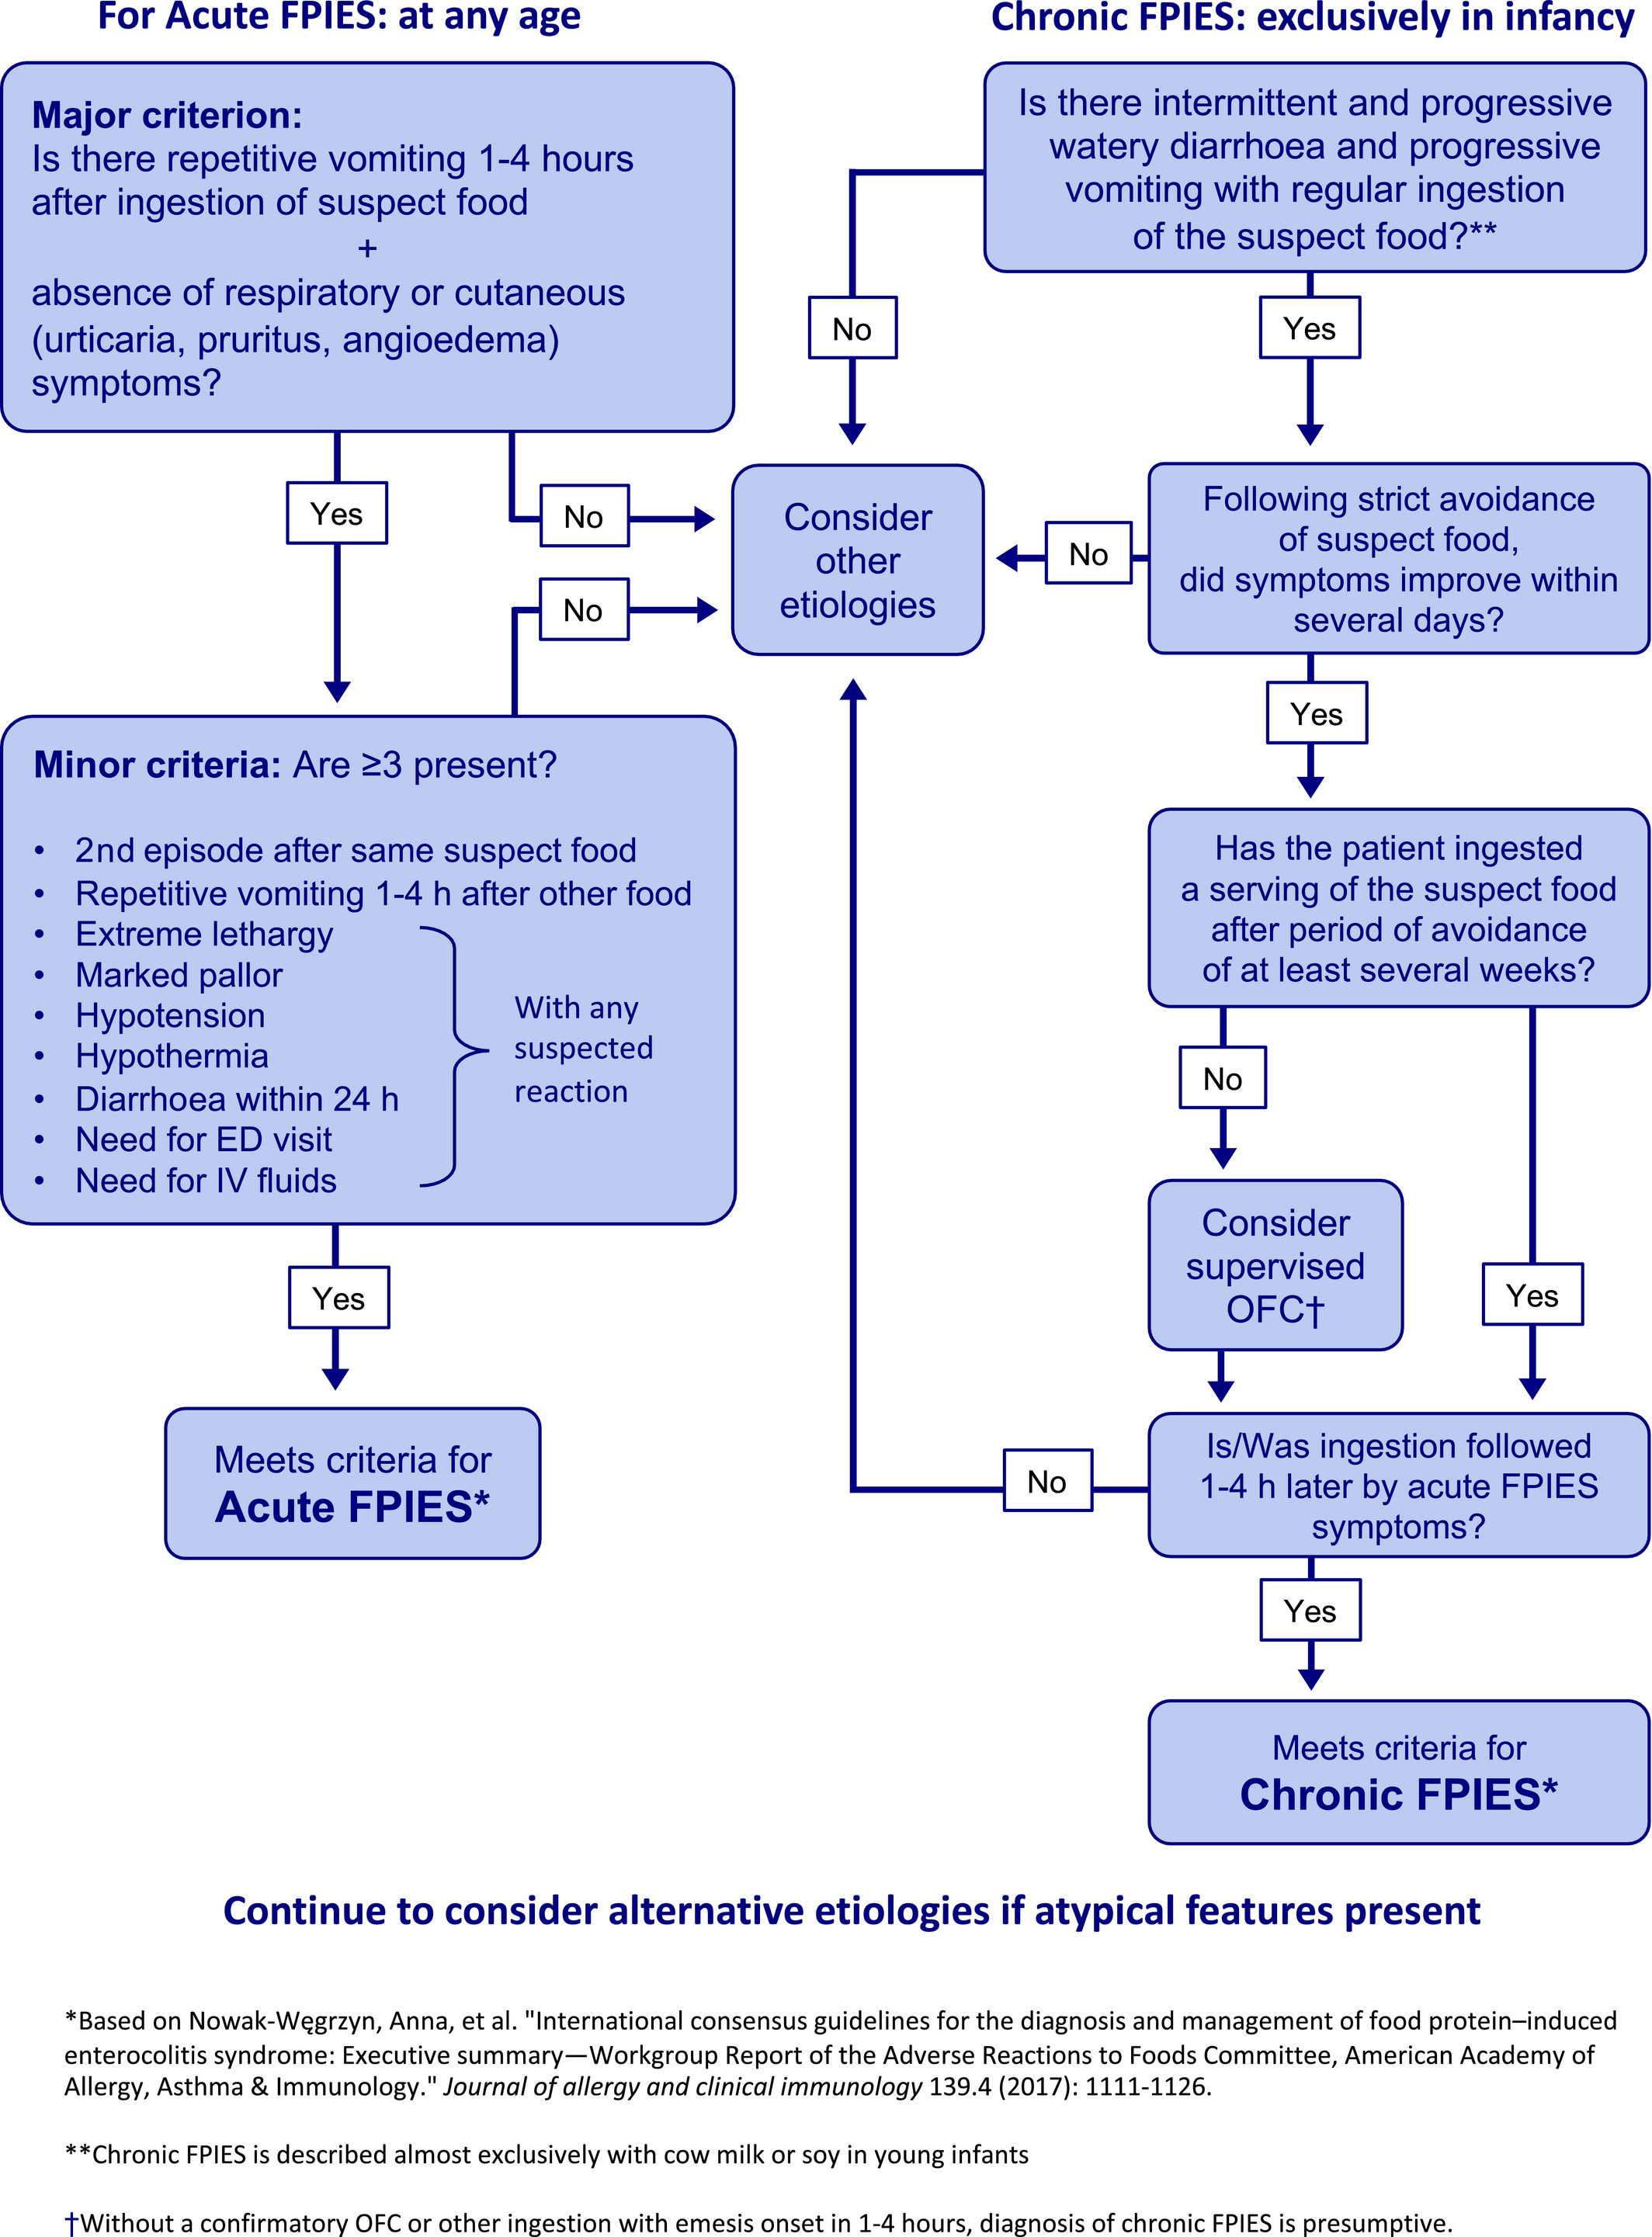
Medical Algorithms: Recognizing and treating food protein‐induced enterocolitis syndrome
Elizabeth Feuille, Anna Nowak-Wegrzyn
Allergy, Volume: 74, Issue: 10, Pages: 2019-2022, First published: 09 May 2019, DOI: (10.1111/all.13857)
Notes:
Diagnostic algorithm for food protein‐induced enterocolitis syndrome
IF THIS IMAGE HAS BEEN PROVIDED BY OR IS OWNED BY A THIRD PARTY, AS INDICATED IN THE CAPTION LINE, THEN FURTHER PERMISSION MAY BE NEEDED BEFORE ANY FURTHER USE. PLEASE CONTACT WILEY'S PERMISSIONS DEPARTMENT ON PERMISSIONS@WILEY.COM OR USE THE RIGHTSLINK SERVICE BY CLICKING ON THE 'REQUEST PERMISSIONS' LINK ACCOMPANYING THIS ARTICLE. WILEY OR AUTHOR OWNED IMAGES MAY BE USED FOR NON-COMMERCIAL PURPOSES, SUBJECT TO PROPER CITATION OF THE ARTICLE, AUTHOR, AND PUBLISHER.

