Slide 1
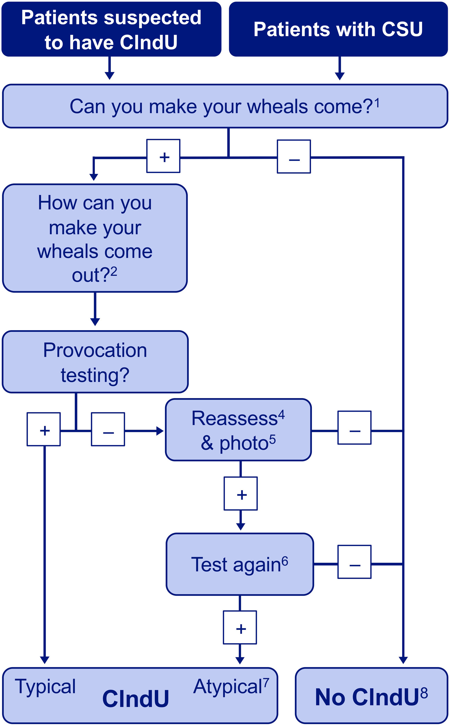
Diagnosis and treatment of chronic inducible urticaria
Marcus Maurer, Tomasz Hawro, Karoline Krause,Markus Magerl, Martin Metz, et al.
Allergy, Volume: 74, Issue: 12, Pages: 2550-2553, First published: 18 May 2019, DOI: (10.1111/all.13878)
Notes:
How to diagnose chronic inducible urticarias. The diagnosis of CIndU is built on the patient history and provocation testing. Abbreviations: CIndU, chronic inducible urticaria; CSU, chronic spontaneous urticaria. 1Patients should be asked whether there is anything they can do to make wheals appear, such as scratching the skin (symptomatic dermographism) or physical exercise (cholinergic urticaria); 2All triggers that are suspected to induce whealing should be assessed for their relevance by provocation testing; 3Provocation testing is done to confirm that suspected triggers induce whealing. Established protocols and appropriate instruments should be used; 4When provocation tests are negative, patients should be asked to describe, in detail, previous triggering situations that resulted in whealing; 5Patients should be asked to take pictures of wheals induced by triggers in real life; 6If, despite negative provocation testing, the history strongly suggests trigger‐induced whealing, provocation testing should be repeated and modified in accordance with the information obtained from patients, for example, by changing the test site or the trigger strength or duration of exposure or by testing multiple triggers simultaneously; 7Atypical cases of CIndU are characterized by negative results in standard provocation tests and positive results in modified provocation testing. Examples of atypical CIndUs include cold‐induced cholinergic urticaria, where exercise in cold environments leads to generalized urticaria, and localized cold urticaria, in which only certain areas of the body urticate with cold contact; 8Differential diagnoses of CIndUs include CSU, autoinflammatory disorders (vs cold urticaria), exercise‐induced anaphylaxis (vs cholinergic urticaria), diseases characterized by trigger‐induced itching without whealing, for example, aquagenic pruritus (vs aquagenic urticaria), and diseases with trigger‐induced skin inflammatory reactions that are not urticarial, for example, polymorphous light eruption (vs solar urticaria)
IF THIS IMAGE HAS BEEN PROVIDED BY OR IS OWNED BY A THIRD PARTY, AS INDICATED IN THE CAPTION LINE, THEN FURTHER PERMISSION MAY BE NEEDED BEFORE ANY FURTHER USE. PLEASE CONTACT WILEY'S PERMISSIONS DEPARTMENT ON PERMISSIONS@WILEY.COM OR USE THE RIGHTSLINK SERVICE BY CLICKING ON THE 'REQUEST PERMISSIONS' LINK ACCOMPANYING THIS ARTICLE. WILEY OR AUTHOR OWNED IMAGES MAY BE USED FOR NON-COMMERCIAL PURPOSES, SUBJECT TO PROPER CITATION OF THE ARTICLE, AUTHOR, AND PUBLISHER.

