Slide 1
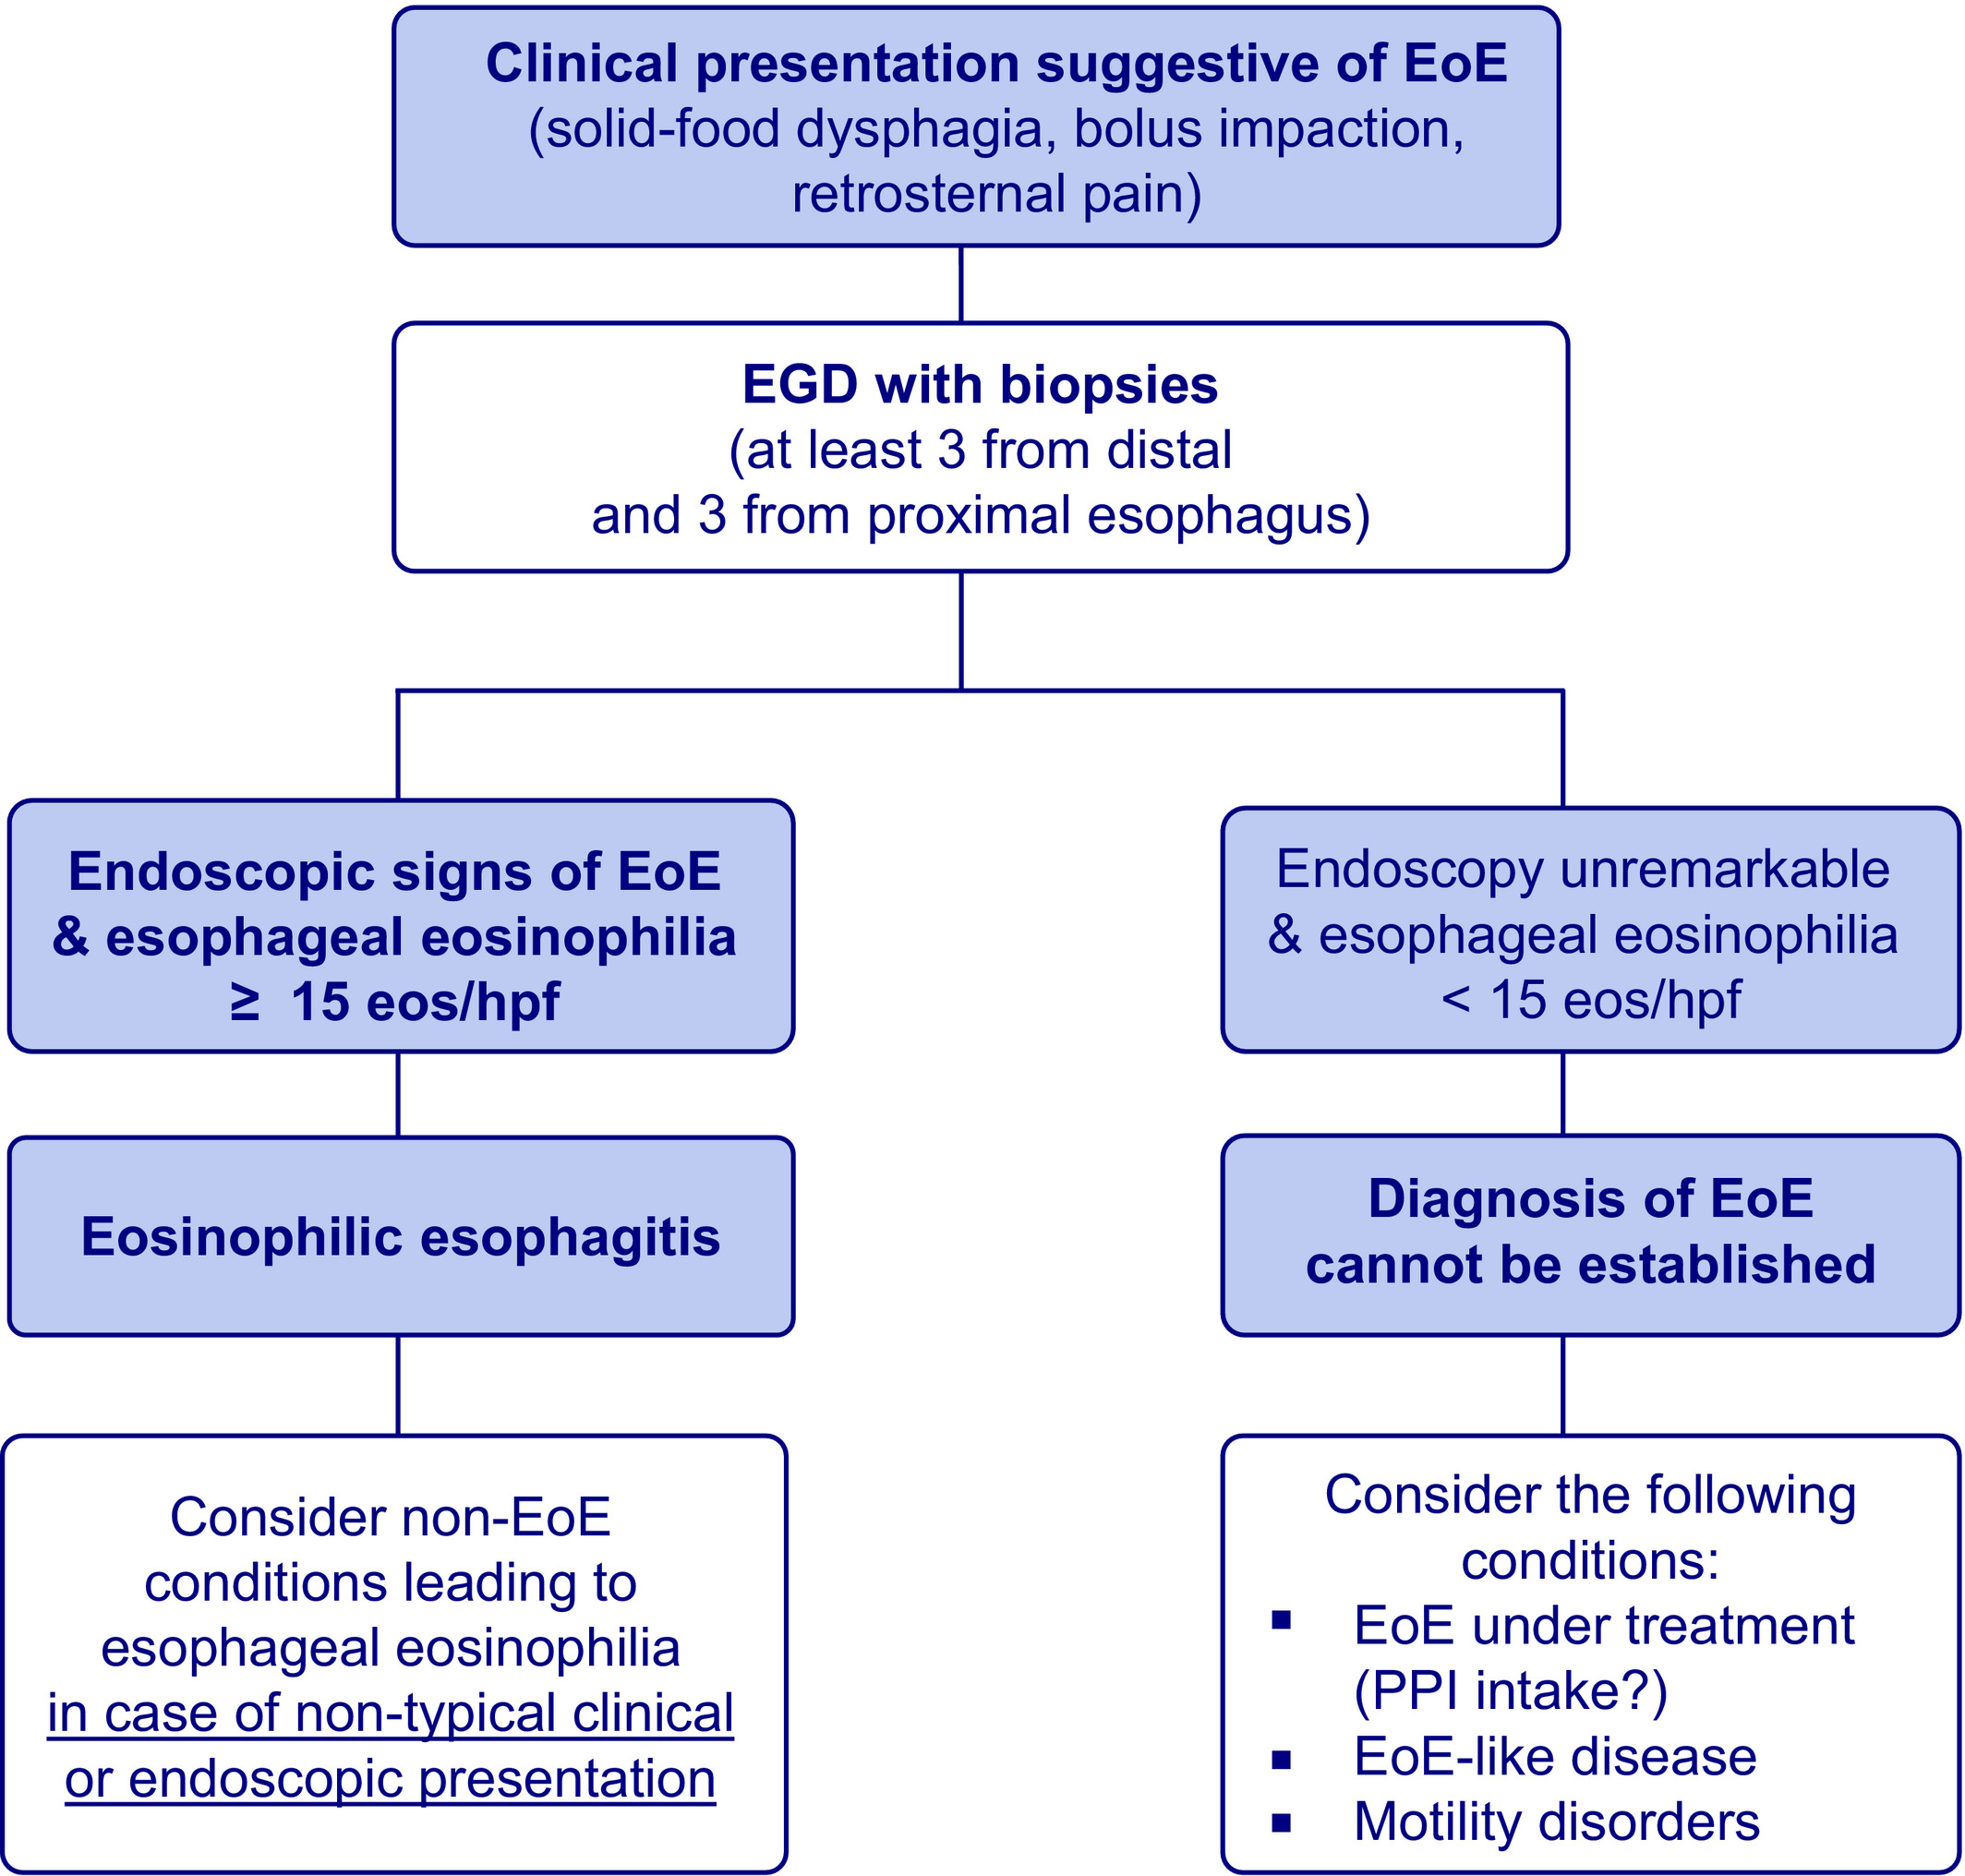
Medical algorithm: Diagnosis and treatment of eosinophilic esophagitis in adults
Thomas Greuter, Alex Straumann
Allergy, Volume: 75, Issue: 3, Pages: 727-730, First published: 12 November 2019, DOI: (10.1111/all.14112)
Notes:
Algorithm for the diagnosis of eosinophilic esophagitis in adults. EGD, esophagogastroduodenoscopy; hpf; high‐power field; peak eos count, peak eosinophil count in the esophageal mucosa
IF THIS IMAGE HAS BEEN PROVIDED BY OR IS OWNED BY A THIRD PARTY, AS INDICATED IN THE CAPTION LINE, THEN FURTHER PERMISSION MAY BE NEEDED BEFORE ANY FURTHER USE. PLEASE CONTACT WILEY'S PERMISSIONS DEPARTMENT ON PERMISSIONS@WILEY.COM OR USE THE RIGHTSLINK SERVICE BY CLICKING ON THE 'REQUEST PERMISSIONS' LINK ACCOMPANYING THIS ARTICLE. WILEY OR AUTHOR OWNED IMAGES MAY BE USED FOR NON-COMMERCIAL PURPOSES, SUBJECT TO PROPER CITATION OF THE ARTICLE, AUTHOR, AND PUBLISHER.

