Slide 1
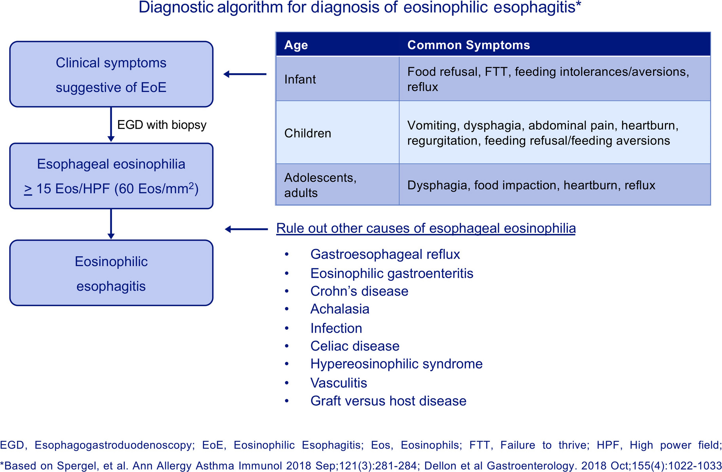
Medical algorithm: Diagnosis and treatment of eosinophilic esophagitis in children
Jonathan M. Spergel, Terri A. Brown-Whitehorn, Amanda Muir, Chris A. Liacouras
Allergy, Volume: 75, Issue: 6, Pages: 1522-1524, First published: 18 January 2020, DOI: (10.1111/all.14188)
Notes:
Diagnostic algorithm for diagnosis of eosinophilic esophagitis*
IF THIS IMAGE HAS BEEN PROVIDED BY OR IS OWNED BY A THIRD PARTY, AS INDICATED IN THE CAPTION LINE, THEN FURTHER PERMISSION MAY BE NEEDED BEFORE ANY FURTHER USE. PLEASE CONTACT WILEY'S PERMISSIONS DEPARTMENT ON PERMISSIONS@WILEY.COM OR USE THE RIGHTSLINK SERVICE BY CLICKING ON THE 'REQUEST PERMISSIONS' LINK ACCOMPANYING THIS ARTICLE. WILEY OR AUTHOR OWNED IMAGES MAY BE USED FOR NON-COMMERCIAL PURPOSES, SUBJECT TO PROPER CITATION OF THE ARTICLE, AUTHOR, AND PUBLISHER.

