Slide 1
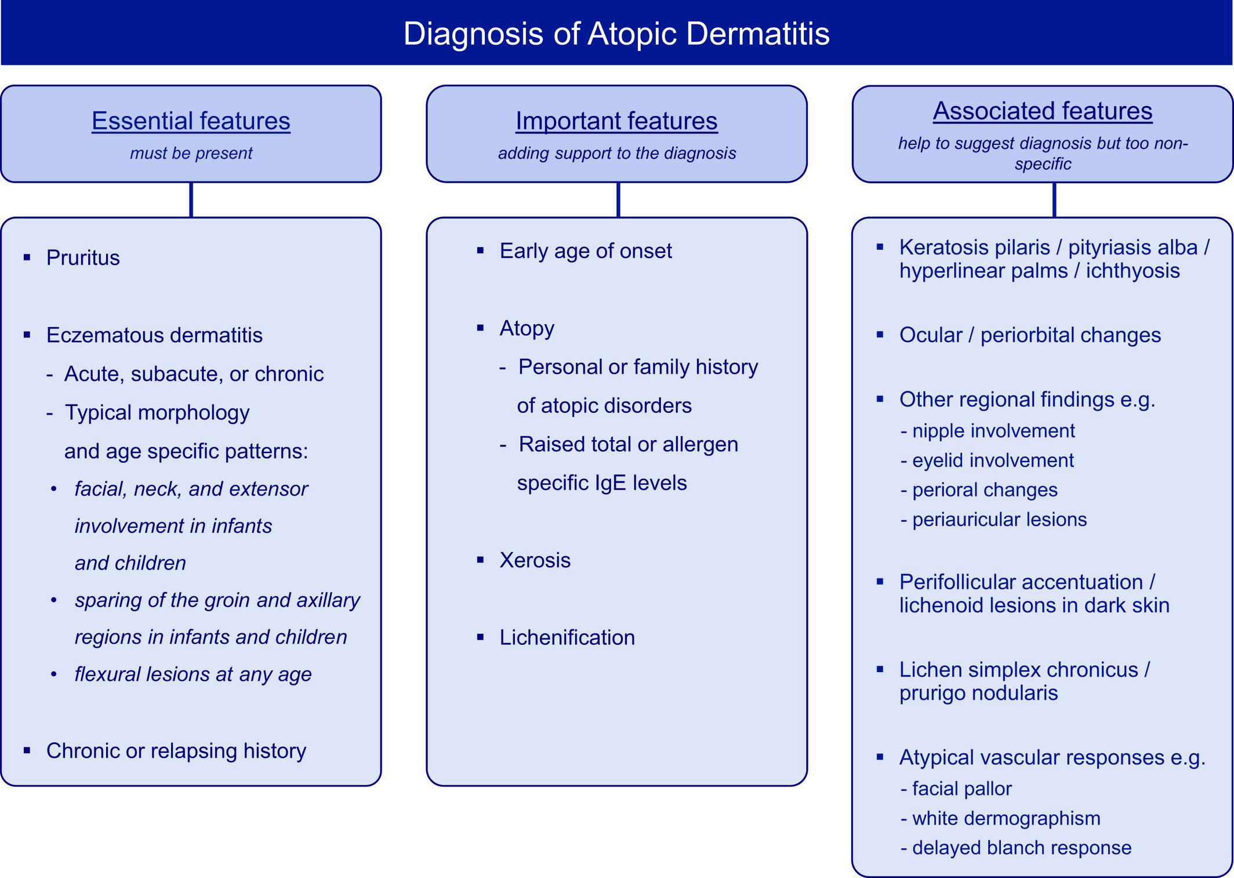
Medical algorithm: Diagnosis of atopic dermatitis in early childhood (part I)
Sherief R. Janmohamed, Martine Grosber, Lawrence F. Eichenfield, Johannes Ring, Jan Gutermuth
Allergy, Volume: 76, Issue: 1, Pages: 403-406, First published: 22 October 2020, DOI: (10.1111/all.14638)
Notes:
Diagnosis of atopic dermatitis (AD). Useful clinical findings for clinicians, outlined by the American Academy of Dermatology (AAD), divided into essential (must be present), important (adding support to the diagnosis), and associated (help to suggest the diagnosis but too nonspecific) features. Adapted from Eichenfield L et al, J Am Acad Dermatol, 20037
IF THIS IMAGE HAS BEEN PROVIDED BY OR IS OWNED BY A THIRD PARTY, AS INDICATED IN THE CAPTION LINE, THEN FURTHER PERMISSION MAY BE NEEDED BEFORE ANY FURTHER USE. PLEASE CONTACT WILEY'S PERMISSIONS DEPARTMENT ON PERMISSIONS@WILEY.COM OR USE THE RIGHTSLINK SERVICE BY CLICKING ON THE 'REQUEST PERMISSIONS' LINK ACCOMPANYING THIS ARTICLE. WILEY OR AUTHOR OWNED IMAGES MAY BE USED FOR NON-COMMERCIAL PURPOSES, SUBJECT TO PROPER CITATION OF THE ARTICLE, AUTHOR, AND PUBLISHER.

